Slide 1
Internationalisation and Planning
Ana Maria Fernandez Maldonado
September 2015

Slide 2
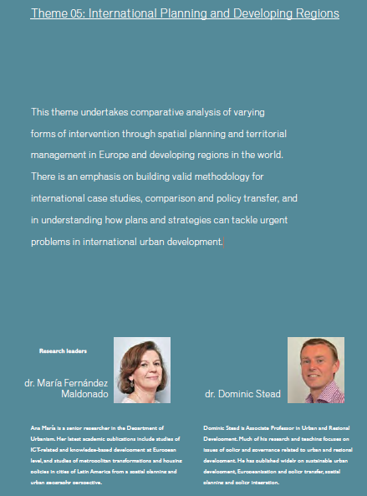
Theme 05:

Slide 3
Background
Increasing:
  global integration
  economic and cultural globalization
  internationalization of academic studies and students
Awareness of:
  stark differences between cities and regions
  pressing problems affecting cities and regions of rapid urbanization

Slide 4
Ideas to discuss:
Challenges of graduation projects carried out at international level
Planning systems and planning cultures

Slide 5
Many methodological and ethical issues arise from working at international level.
Especially problematic when working within rapid urbanisation cities and regions
Careful attention has to be given to the local context, cultural issues and language differences

Slide 6
To take into account:
Comparative methods help to reveal taken-for- granted national/regional conditions.
Deep examination of culture-bound concepts are crucial
Avoiding “developmentalism” or suggestions of an universal theory of urbanism (Robinson, 2006)
Avoiding “subaltern urbanism” or accounts of slumdog cities (Roy, 2011)
Recognising the importance of informal urban processes

Slide 7
“Developmentalism”(Robinson, 2006)
Urban studies: global cities versus megacities.
The West as 'the model' or 'the modern’
Cities considered in competition for scarce resources, with winners and losers.
Hierarchical Dichotomies:
  Modern - Traditional
  Core - Peripheral
  Developed - Underdeveloped
  Global North - Global South
  Global - Non-global

Slide 8
Global cities literature examples
John Friedmann (1986) The World-City Hypothesis
Paul Knox & Peter Taylor (1995) World Cities in a World System
Saskia Sassen (1991) The Global City.
Saskia Sassen (2000) Cities in a World Economy

Slide 9
Global city discourse
Global cities as command nodes of a global system of informational capitalism.
Focus on advanced sectors of the economy
Market relations as the tie binding relationally constructed places.
However, cities are much more than marketplaces

Slide 10
Intra-developmentalism
Applied to urban patterns and processes within cities:
  Formal – informal
  Conventional - marginal
  Central – peripheral
Who decides what is formal and what is marginal?

Slide 11
“Subaltern urbanism” (Roy, 2011)
Dominant narratives of the megacity and its patterns and processes theorizes them as apocalyptic and dystopian
The rise of the ‘slum’ as a prominent concept
Slumdog Millionaire as “poverty pornography”
Who decides what is formal and what is criminalised?

Slide 12
Diversity instead of hierarchy
Paradox: much current urban growth takes place in the developing world, but many theories of how cities function remain rooted in the developed world (Roy, 2005).
All places important to understand urban patterns and processes, and how globalization trends affect them “on the ground”.
Recognition of the great importance of deep knowledge of the local context
Planners are not the experts → shift from government to governance

Slide 13
Urban informality
Back in the urban agenda: from undesirable to accepted
  Central to analyses of urban development
  Growing attention in the urban literature
Diversity of types of urban informality (depending on extent of complying to official standards)
Usual policy responses to informality: slum upgrading and land titling.
“No single planning model to respond effectively to urban informality” (UN-Habitat, 2009:150)

Slide 14
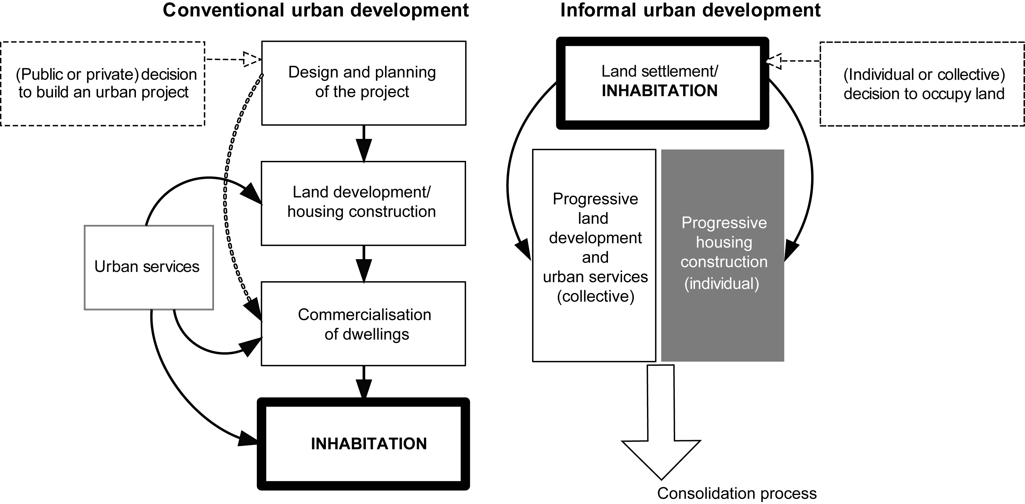
Informal sprawl: a huge threat to sustainability

Slide 15
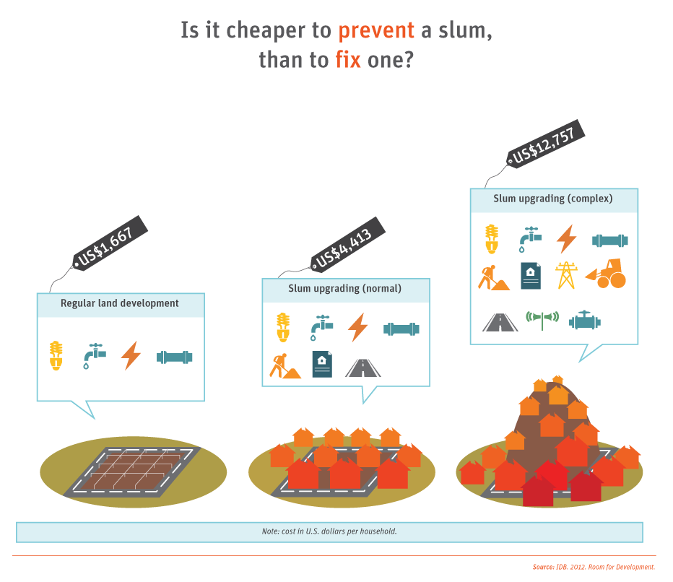

Slide 16
Important:
Urban informality is not restricted to the spaces of the informal settlements
It may also dominate important sectors of urban functioning such as commerce (retail and wholesale trade); public transport; telecommunications; etc.
Urban informality is a mode of production of space deeply intertwined with the formal sector.

Slide 17
Understanding planning systems as institutions
Planning systems are social constructs (Servillo and van den Broeck, 2012).
  Linked to historical and cultural processes (logics and values) of the institutions responsible for planning.
  Result of a series of agreements and alliances between major urban actors, and of power relations between them.

Slide 18
Effective planning approaches
Have to be elaborated locally and depending on:
the nature of local problems;
the institutional context and legal system; and
the local culture: the values and attitudes of the main actors in the process.

Slide 19
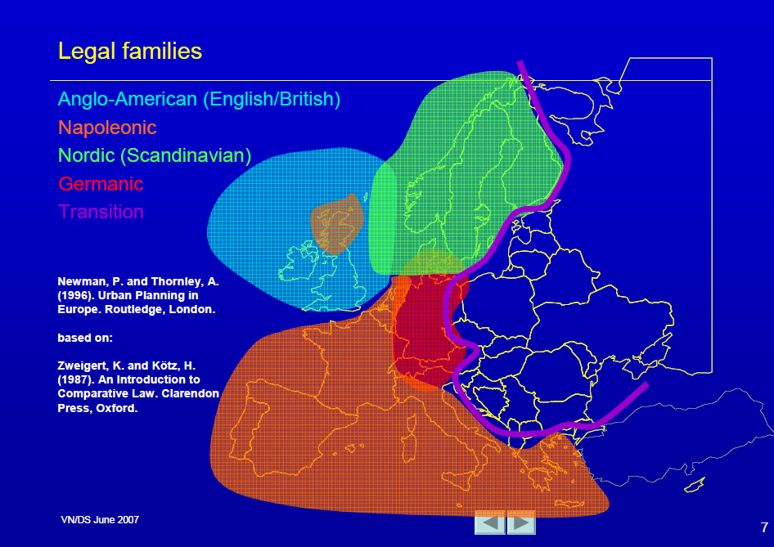

Slide 20
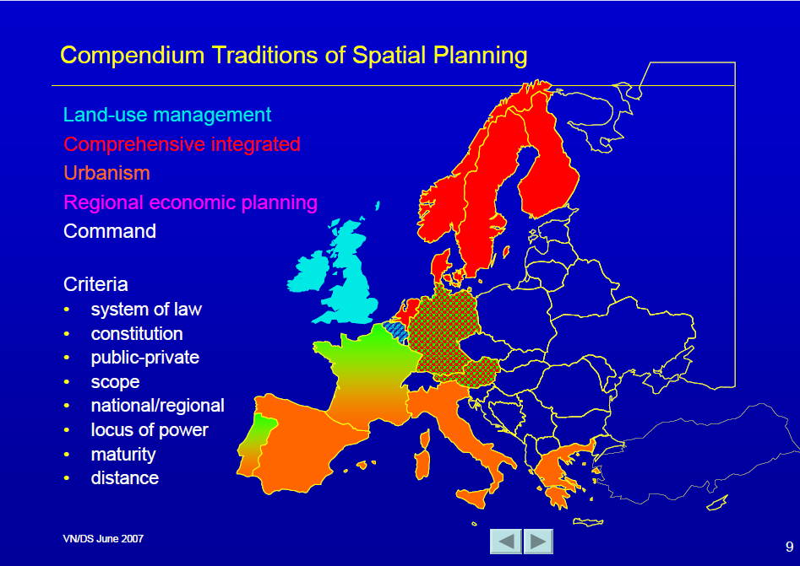
Regional Economic planning
(Nadin & Stead, 2007)

Slide 21
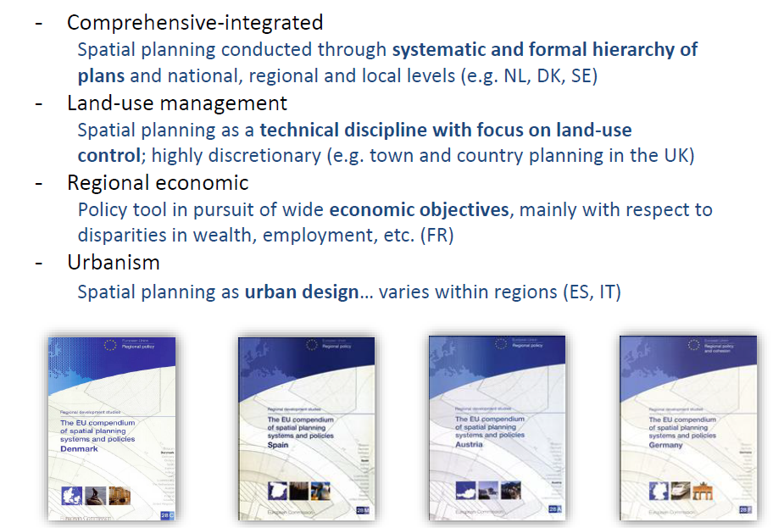
(CEC, 1997)

Slide 22
Some reflexions / issues for debate
An academic approach demands a deep knowledge of the local context and culture, avoiding stereotypes and simple narratives
Planning problems are wicked problems and as such they don’t have “solutions”(Webber, 1973).
Comparative approaches can help us to recognize differences to advance knowledge and elaborate more effective planning and design proposals

Slide 23
References
Bouillon, C.P. (Ed.). (2012). Room for Development. Housing Markets in Latin America and the Caribbean (IADB). Palgrave Macmillan.
Nadin, V. & Stead, D. (1997) Linking Planning Cultures, Planning Systems
and Models of Society.
Roy, A. (2005). Urban informality: toward an epistemology of planning. Journal of the American Planning Association, 71(2).
Roy, A. (2011). Slumdog cities: rethinking subaltern urbanism. International Journal of Urban and Regional Research, 35(2).
Robinson, J. (2006). Ordinary cities: between modernity and development. London: Routledge.
Servillo, L. A., & Van Den Broeck, P. (2012). The Social Construction of Planning Systems: A Strategic-Relational Institutionalist Approach. Planning Practice and Research, 27(1).
UN-Habitat. (2009). Planning sustainable cities: Global Report on Human Settlements. 2009.

