Slide 1

Notes:
INTERNATIONAL NEW TOWN INSTITUTE
国际新城研究中心INTI
INTI is an independent, non-profit scientific knowledge institute based in the center of the New Town Almere, close to Amsterdam in the Netherlands.
INTI provides specialized knowledge about building, developing and restructuring New Towns to professionals in New Towns worldwide.
INTI是一家独立的非营利的知识机构，它的办公地点在荷兰大阿姆斯特丹区域的新城阿尔梅勒。
INTI为国际上新城方面的专业人士提供新城建设、发展以及结构重组方面的专业知识。

Slide 2
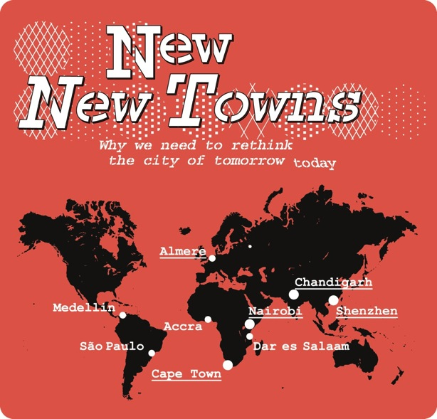
Notes:
New New Towns is an international, multidisciplinary research program initiated by INTI. The program is dedicated to improving the urban and social quality of exceptional and fast changing New Towns. New New Towns serves a unique role in bringing together Dutch and local expertise on urban planning, sociology and economics in an international, multidisciplinary think-tank. The program acts as a catalyst for the exchange of knowledge between students, researchers, design professionals, developers, policymakers and politicians by initiating research, conferences, design workshops and publications. New New Towns started in Shenzhen in 2012.

Slide 3
PARTNERS FROM SHENZHEN
- Shenzhen Center for Design
- Chinese University of Hong Kong
- China Development Institute
- Architecture Office Urbanus
- Architecture Office NODE
- Urban Planning Design Institute Shenzhen
- Shenzhen University
- Peking University Campus Shenzhen
- Hong Kong University
- Da Lang Government
- Guangming New Town Government
PARTNERS FROM THE NETHERLANDS
- City of Almere
- Delft University of Technology
- Institute for Housing and Urban Development Studies
- University of Amsterdam
- CAH Almere University of Applied Sciences
- Ministry of Economic Affairs
- Ministry of Infrastructure and the Environment
- Rotterdamse Academie van Bouwkunst
- Windesheim University of Applied Sciences

Slide 4
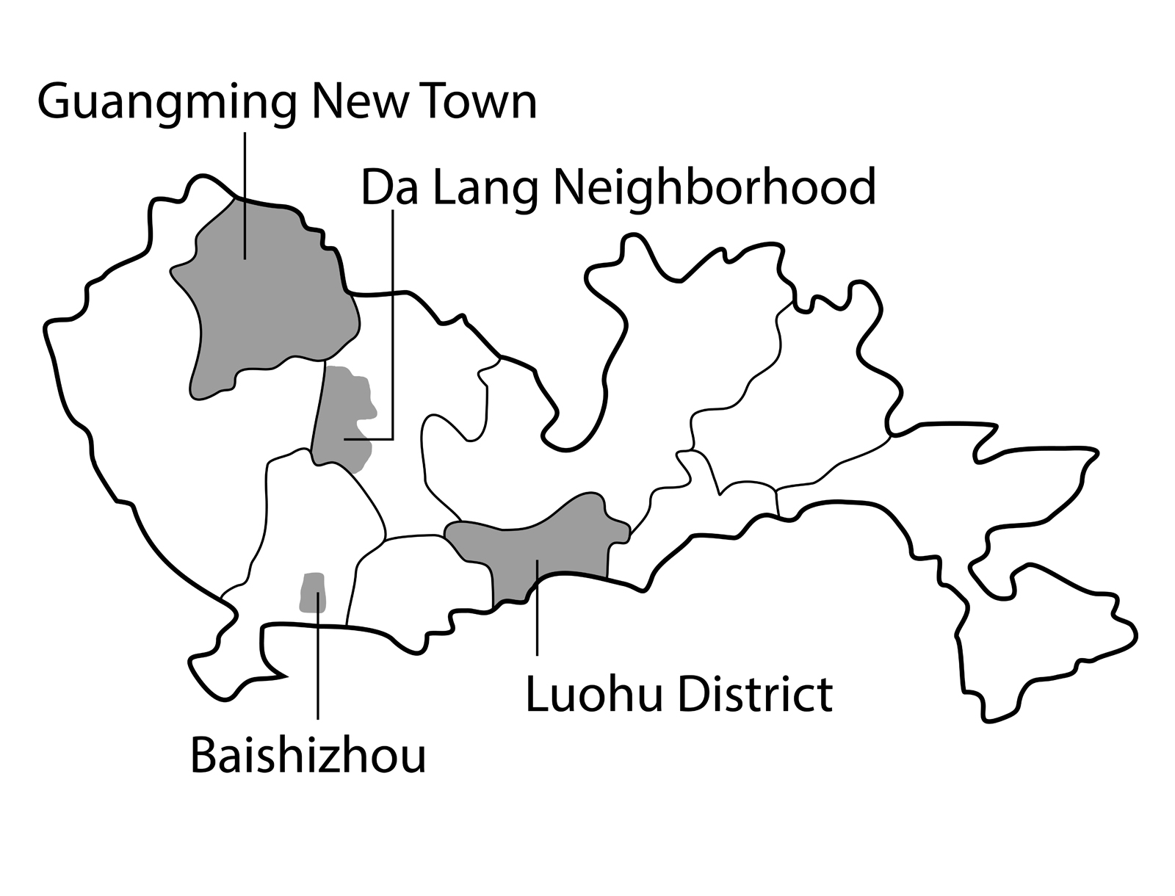

Slide 5
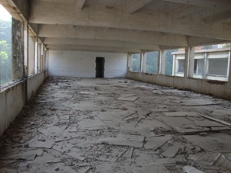
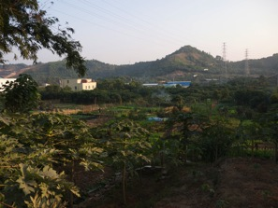
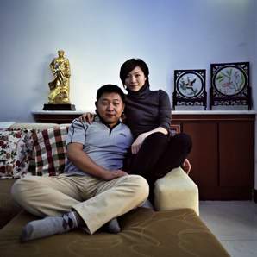
URBAN REGENERATION
ECOLOGICAL SUSTAINABILITY
SOCIAL DYNAMICS

Slide 6
Number of inhabitants: ca. 500,000
People registered: 8,200
Floating population: ca. 491,800
Area: 37 km²

Slide 7
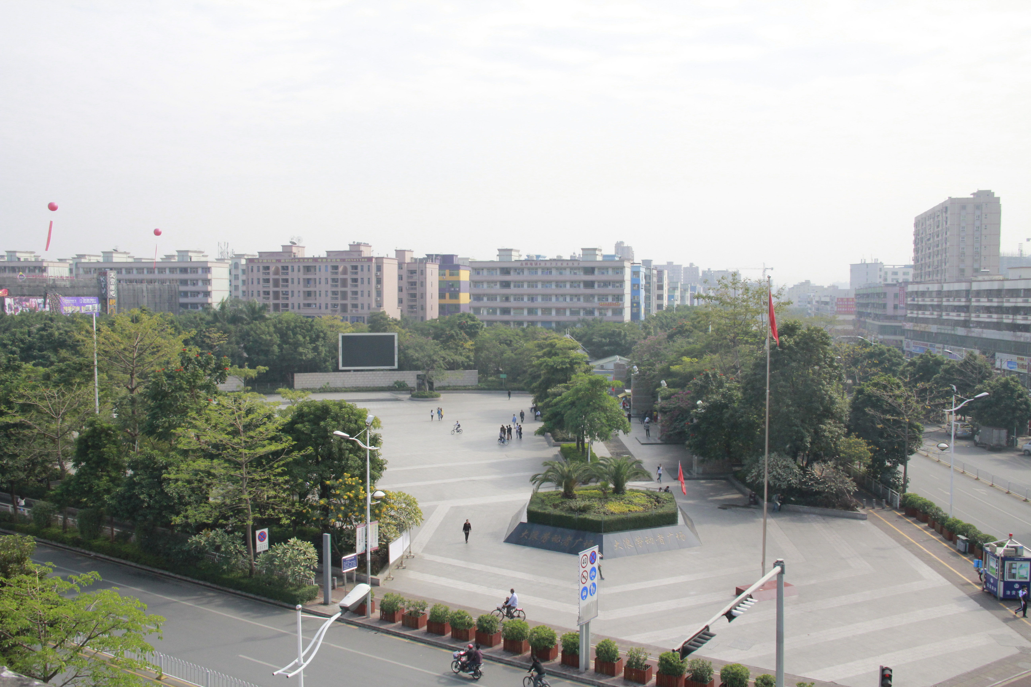

Slide 8
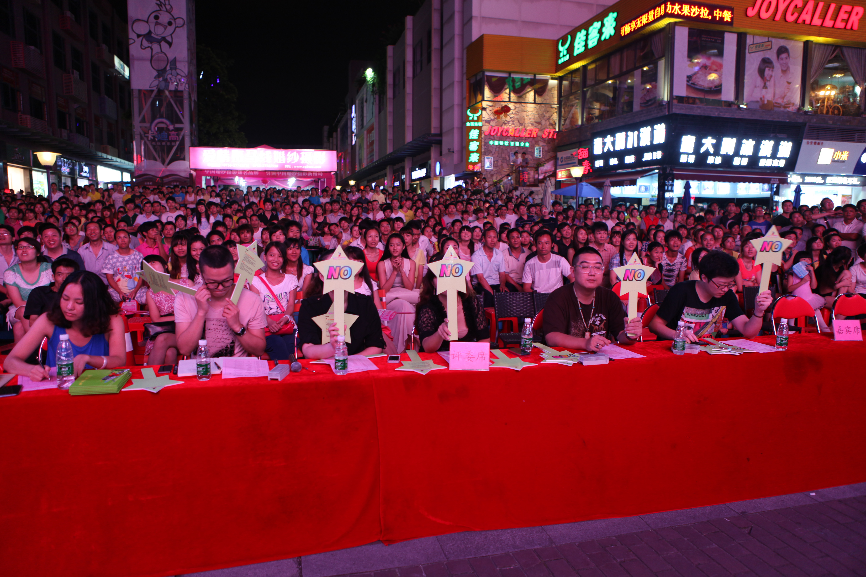

Slide 9
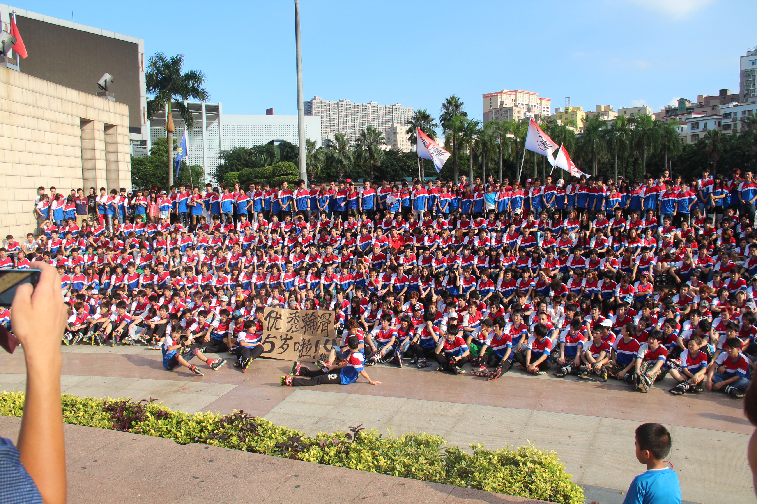

Slide 10
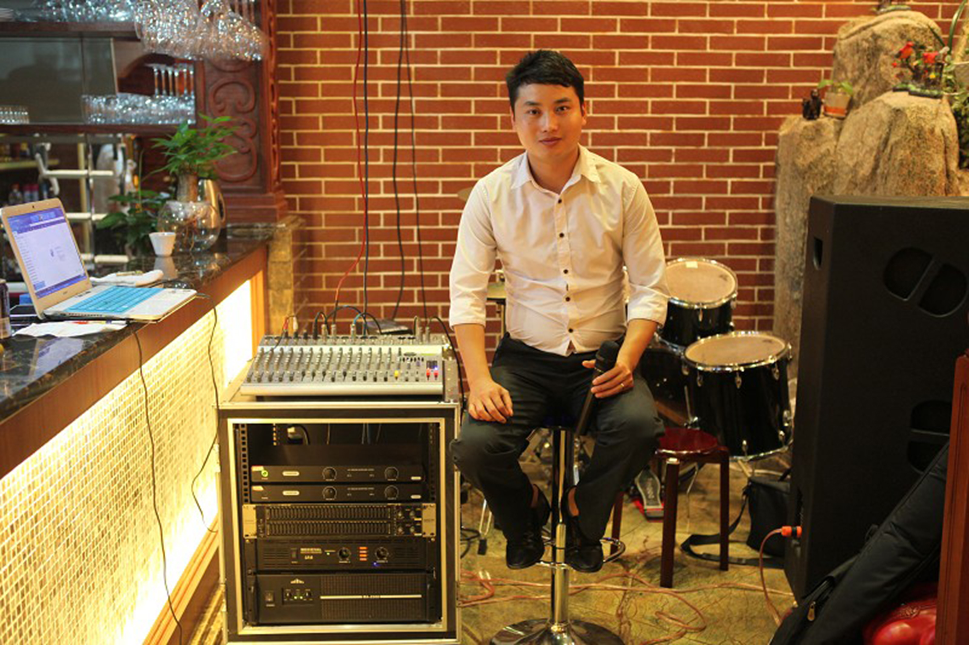
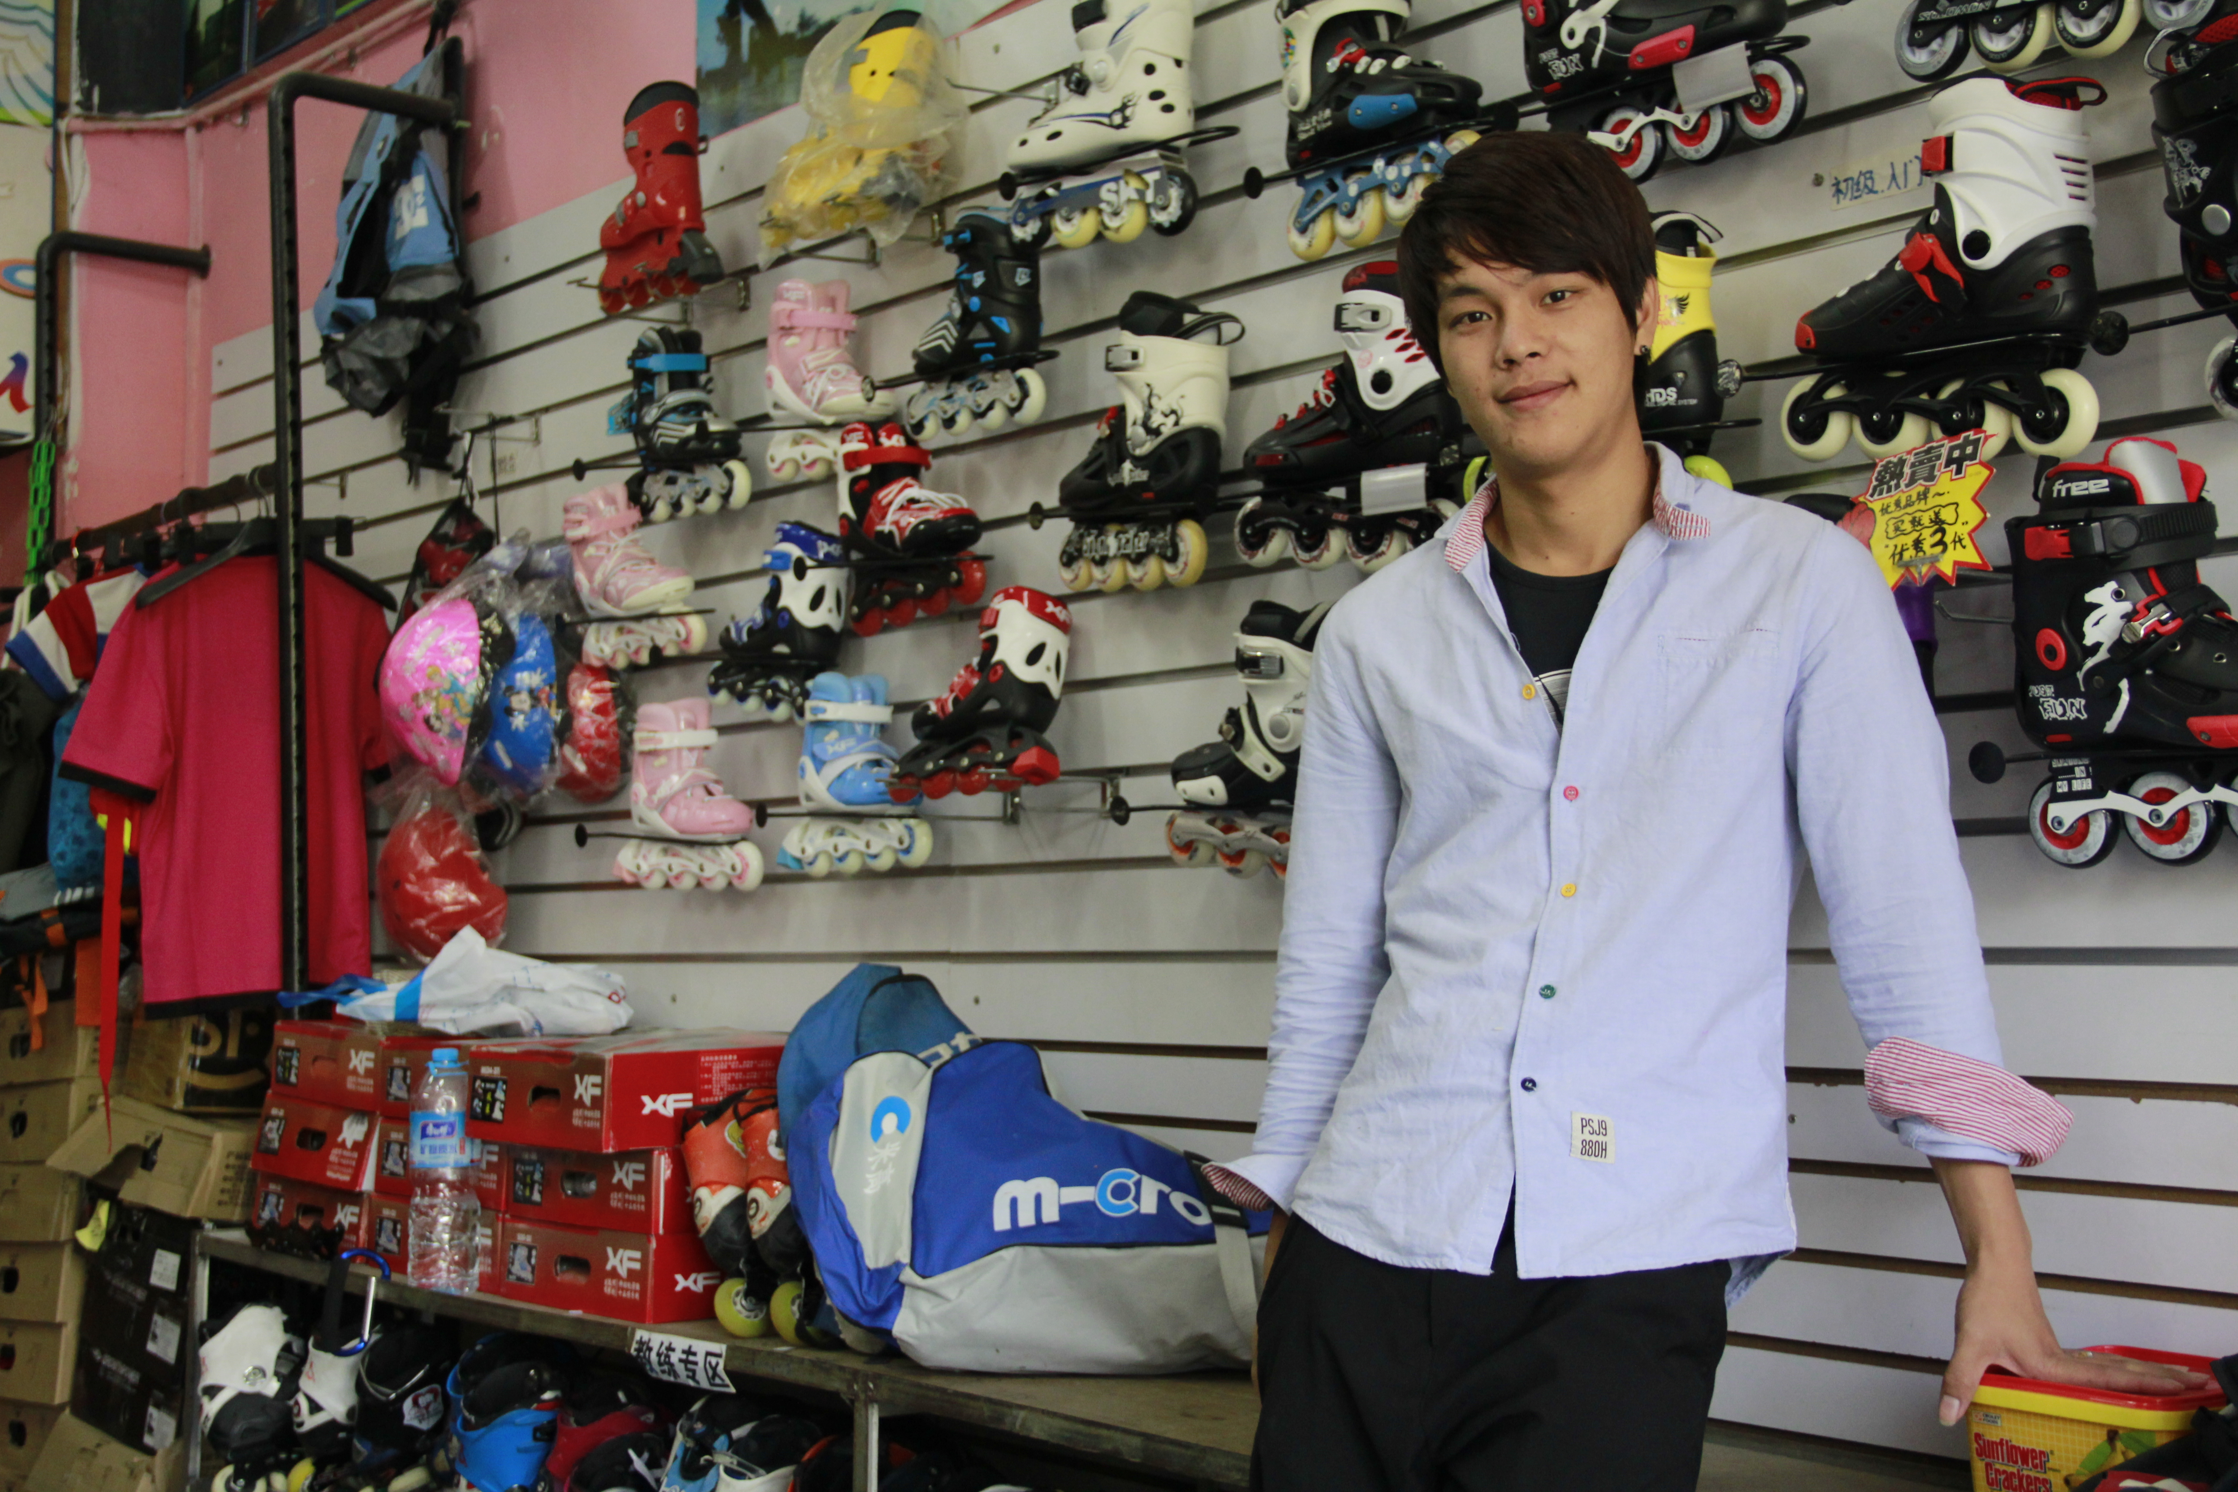

Slide 11
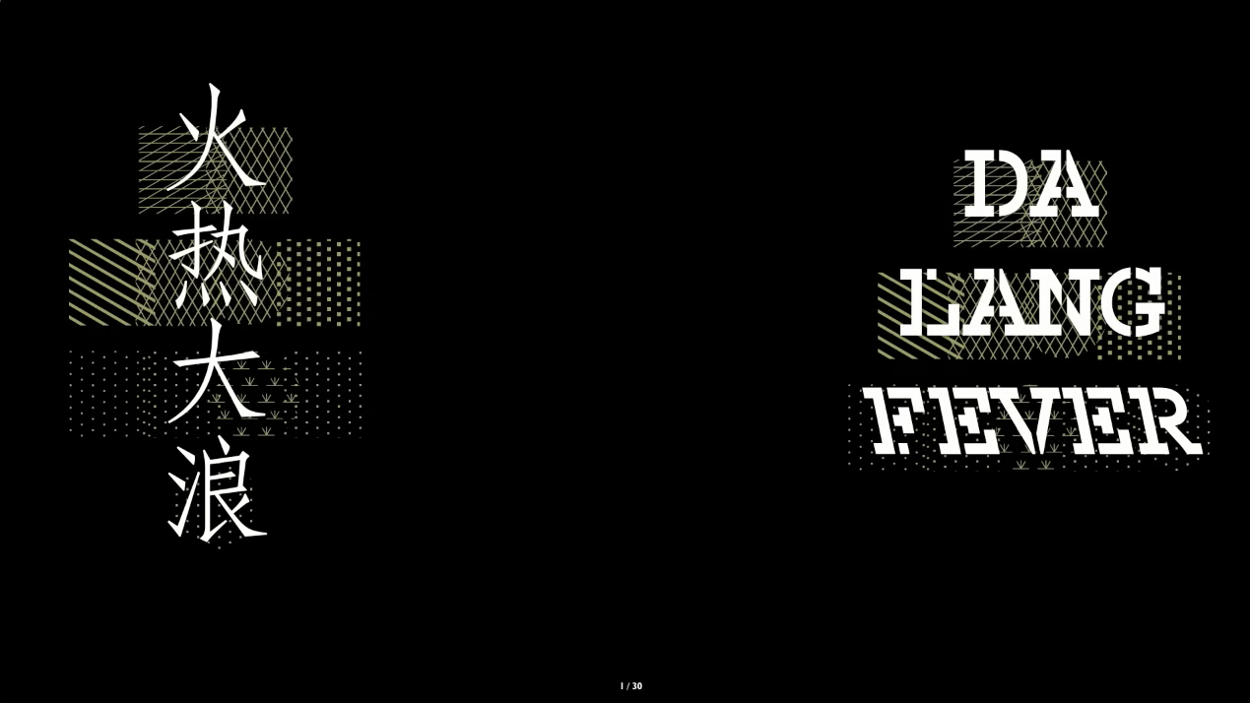

Slide 12
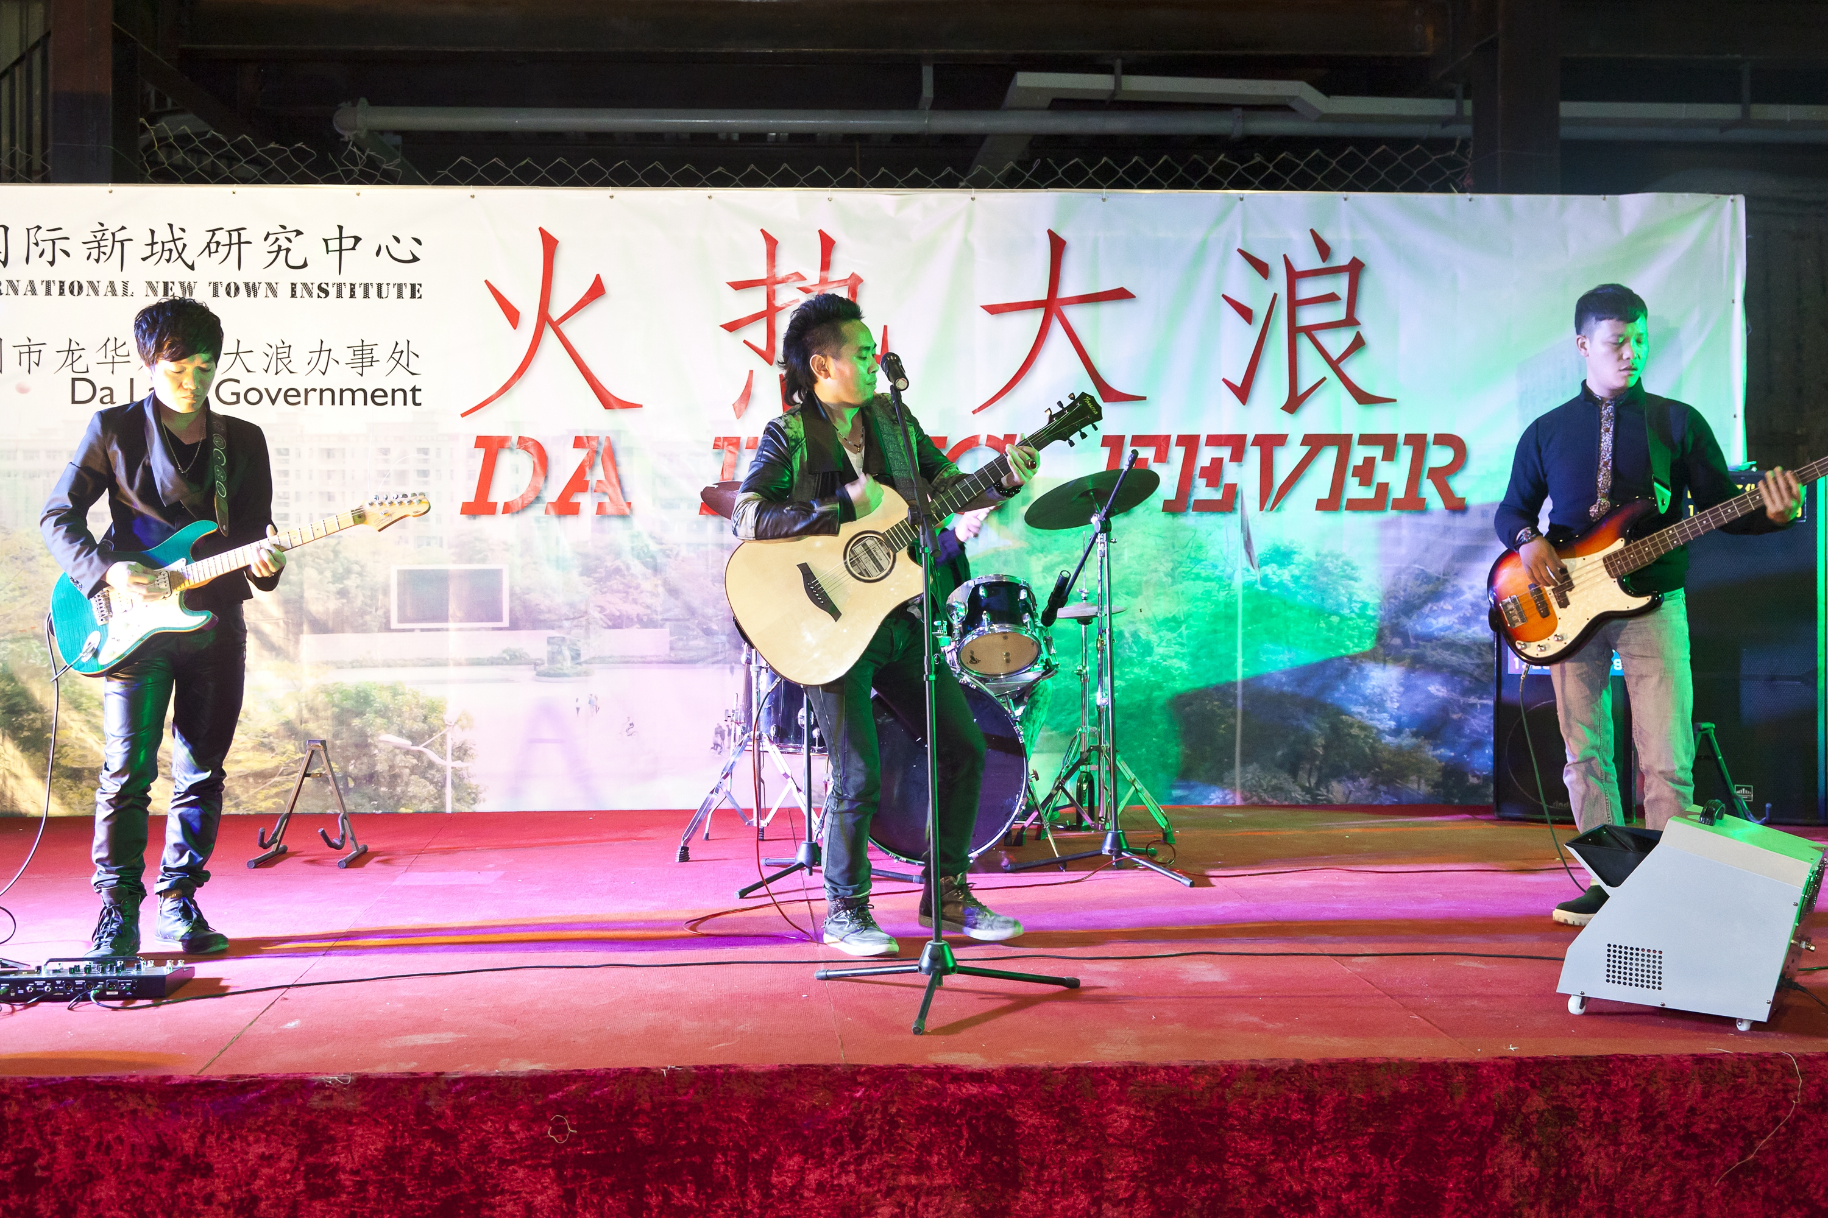

Slide 13
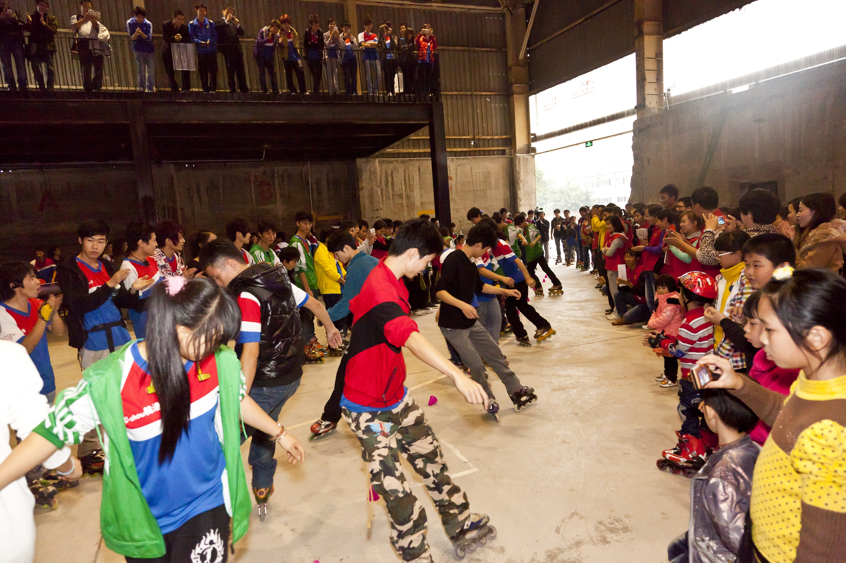

Slide 14
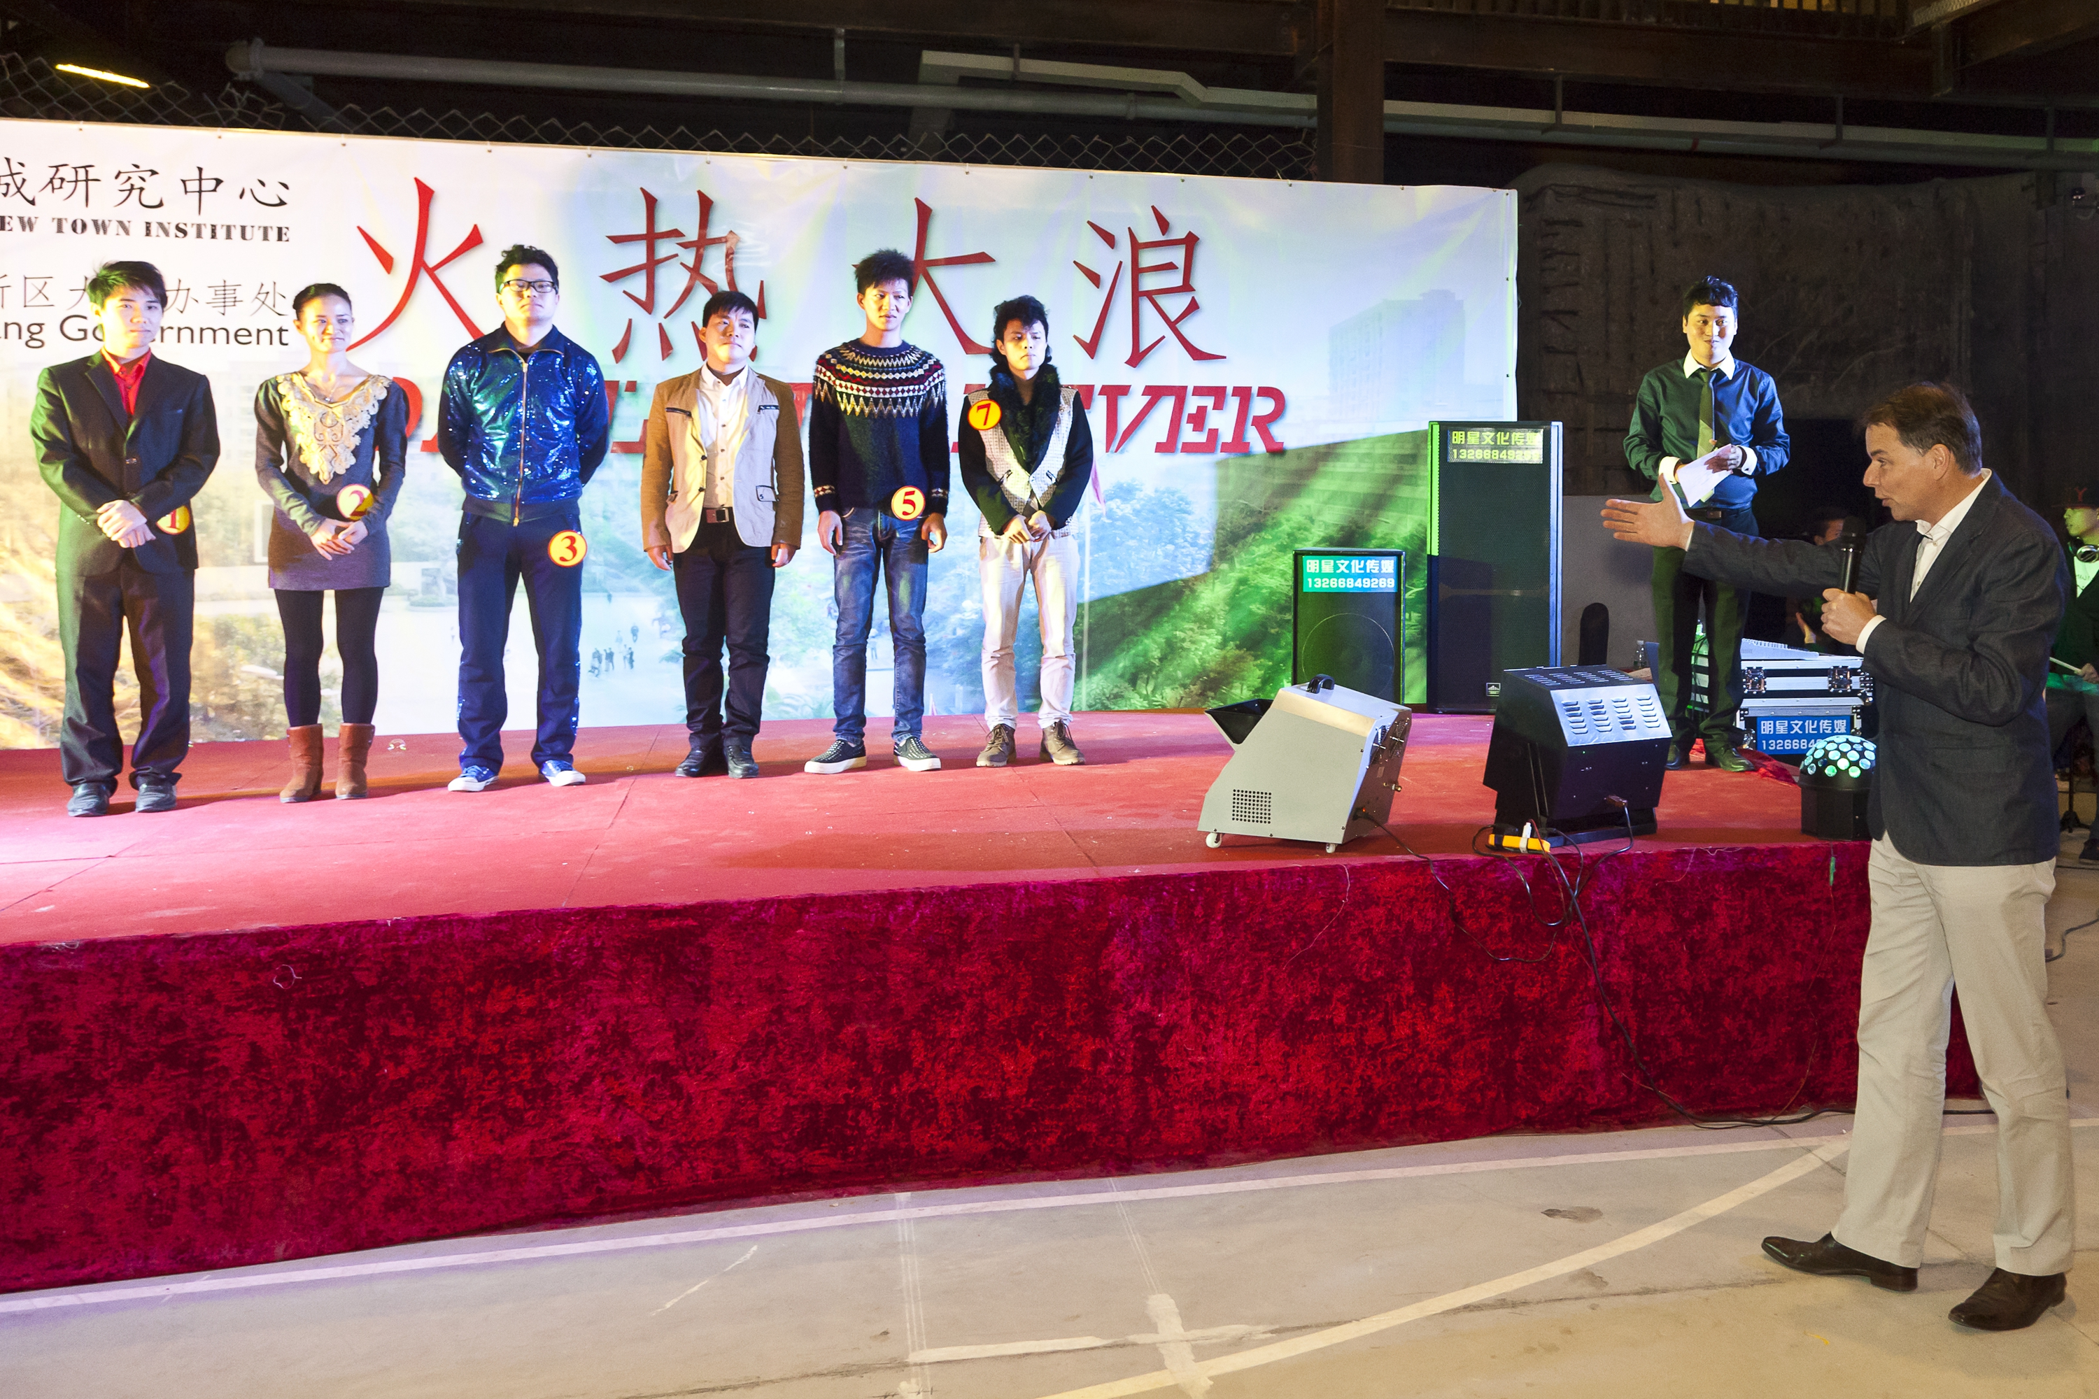

Slide 15
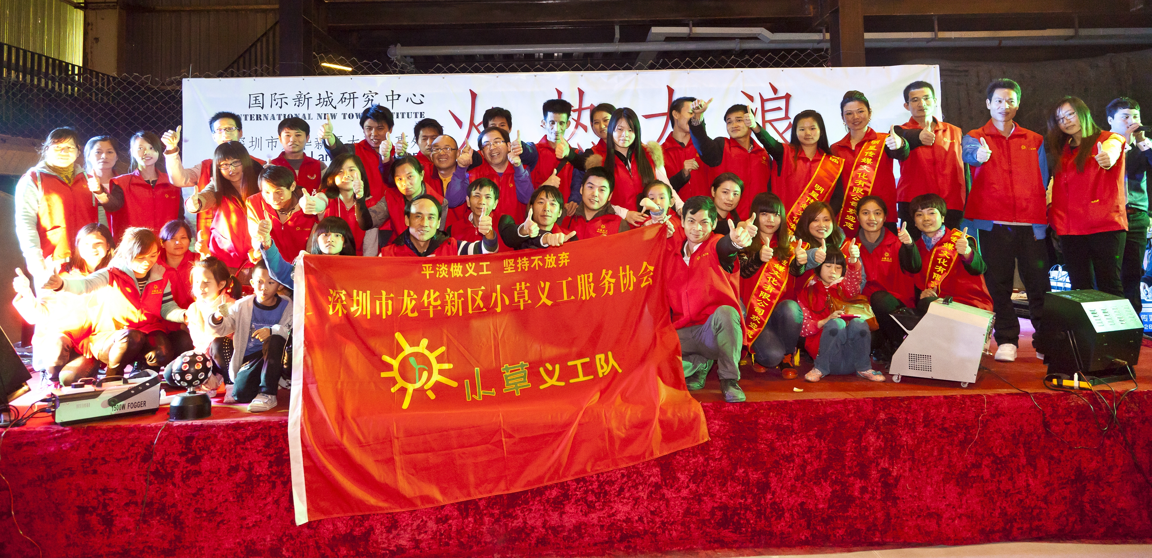

Slide 16
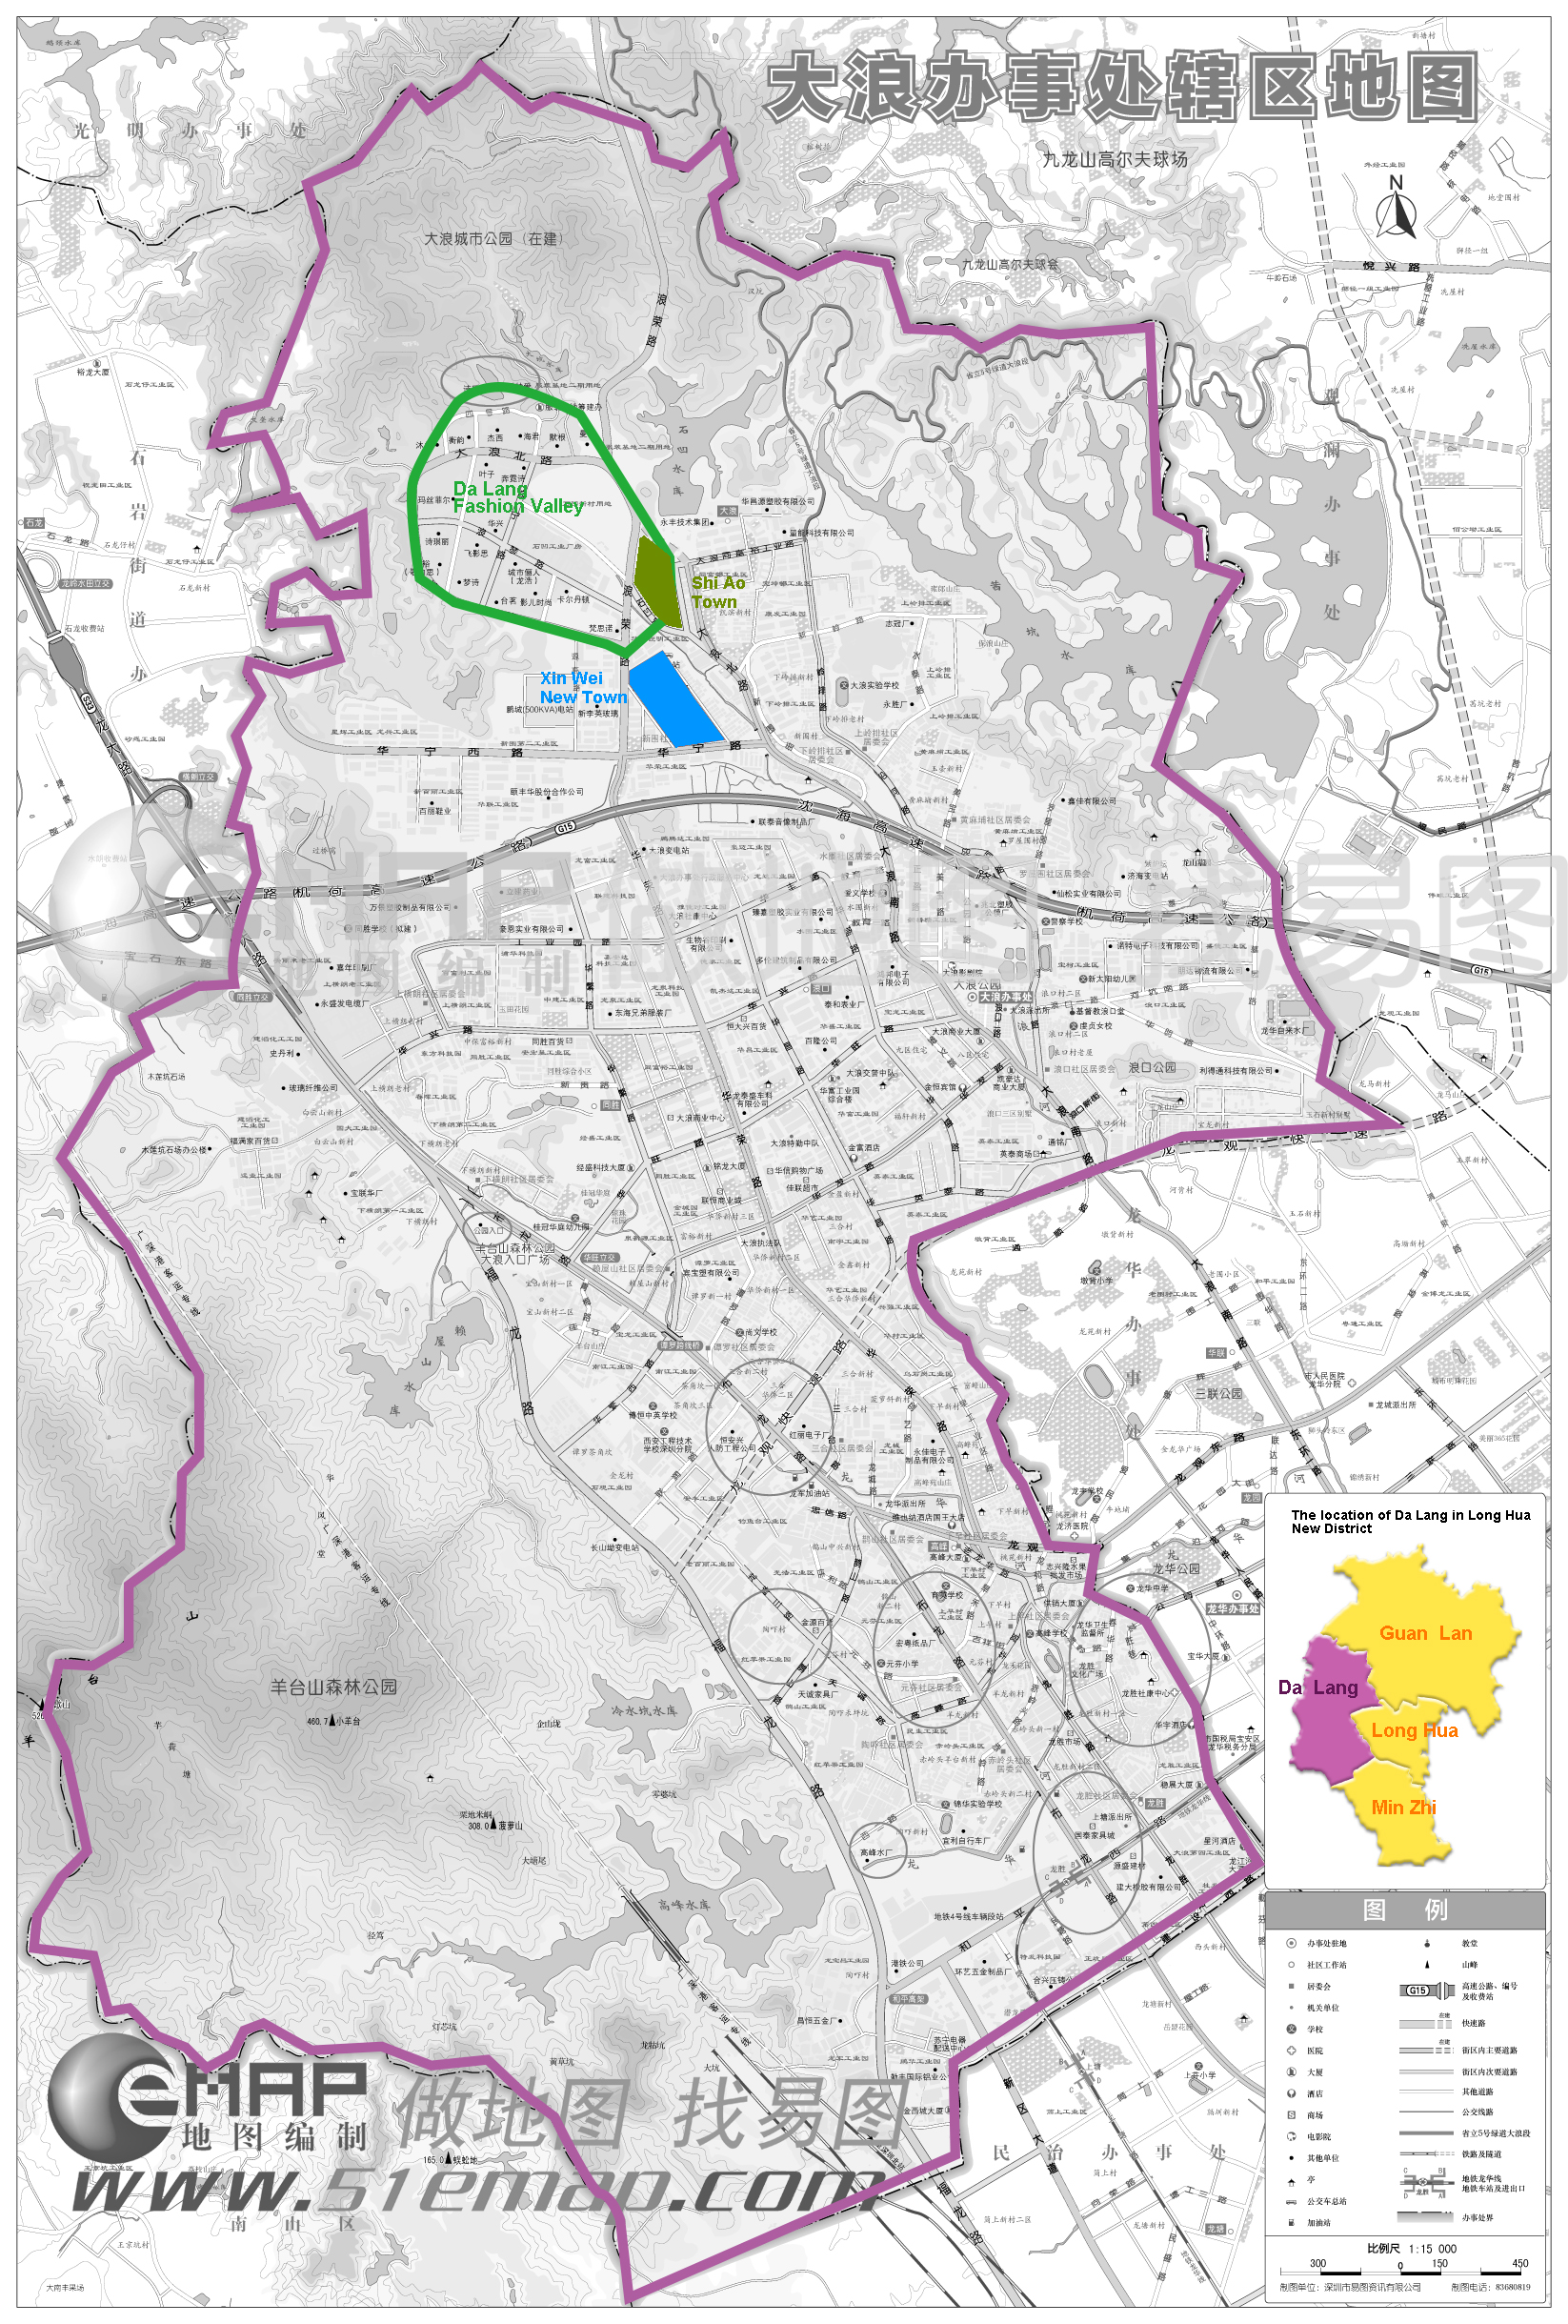

Slide 17
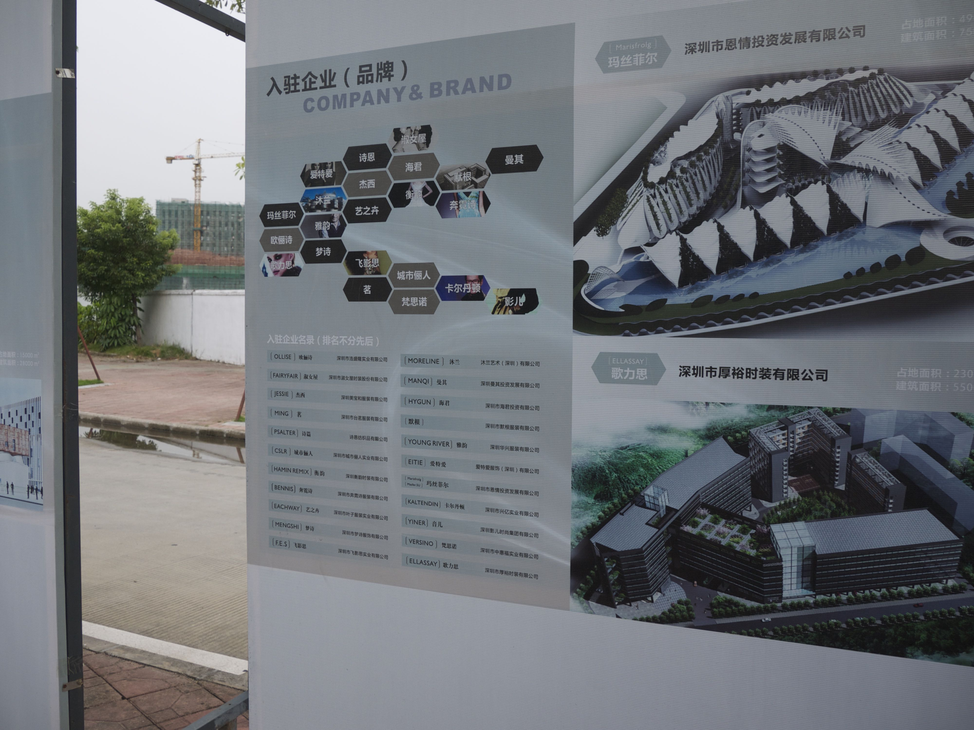

Slide 18
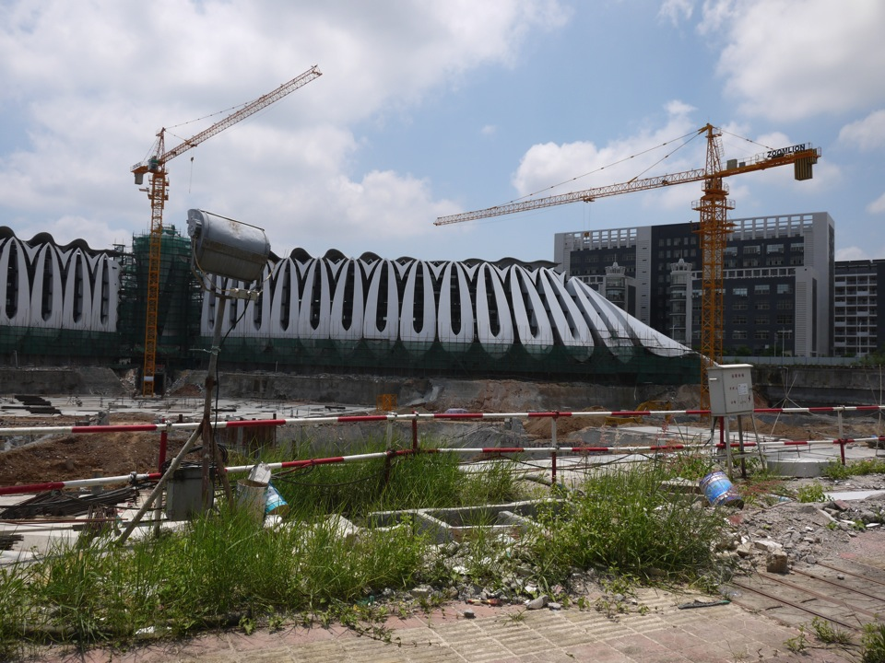

Slide 19
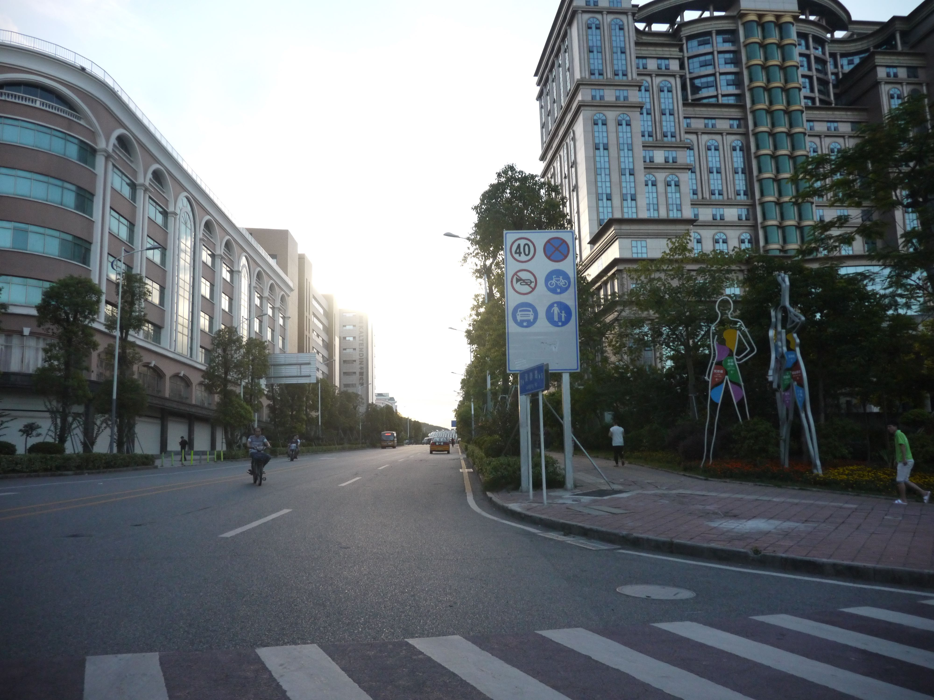

Slide 20
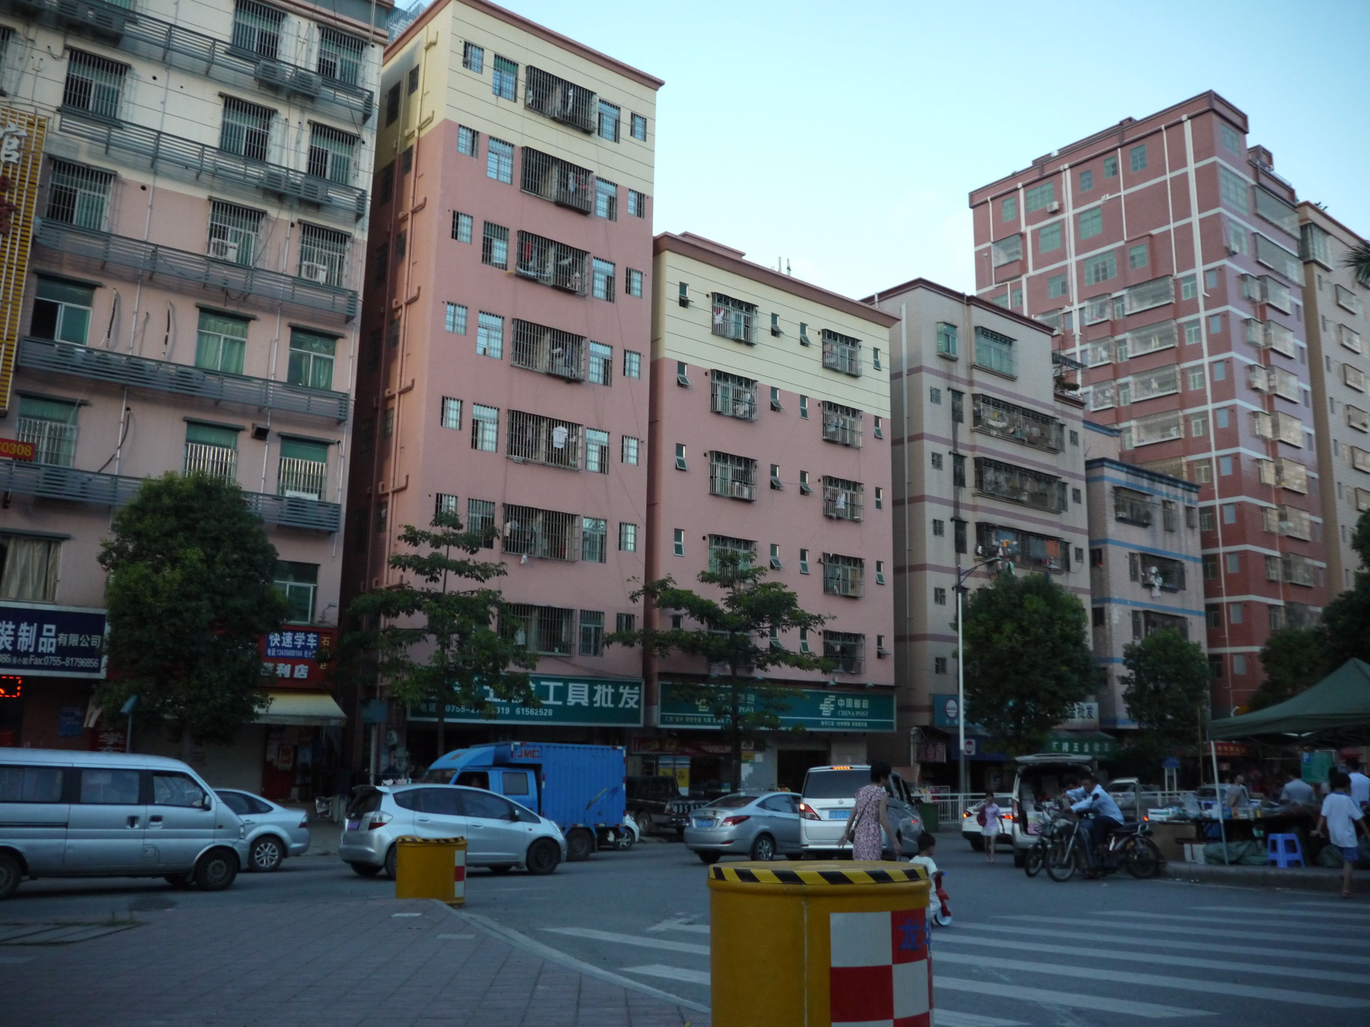

Slide 21
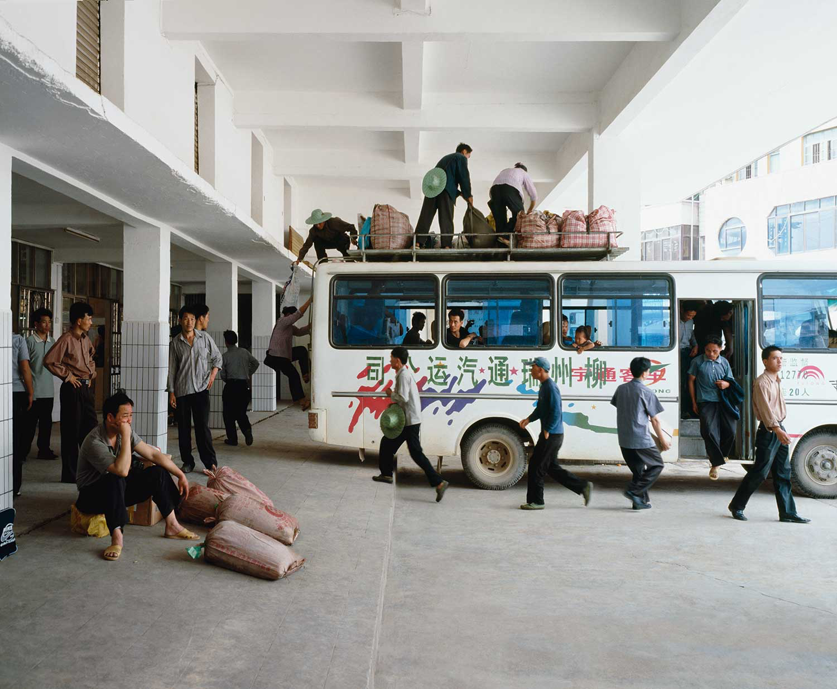
LARD BUURMAN

Slide 22
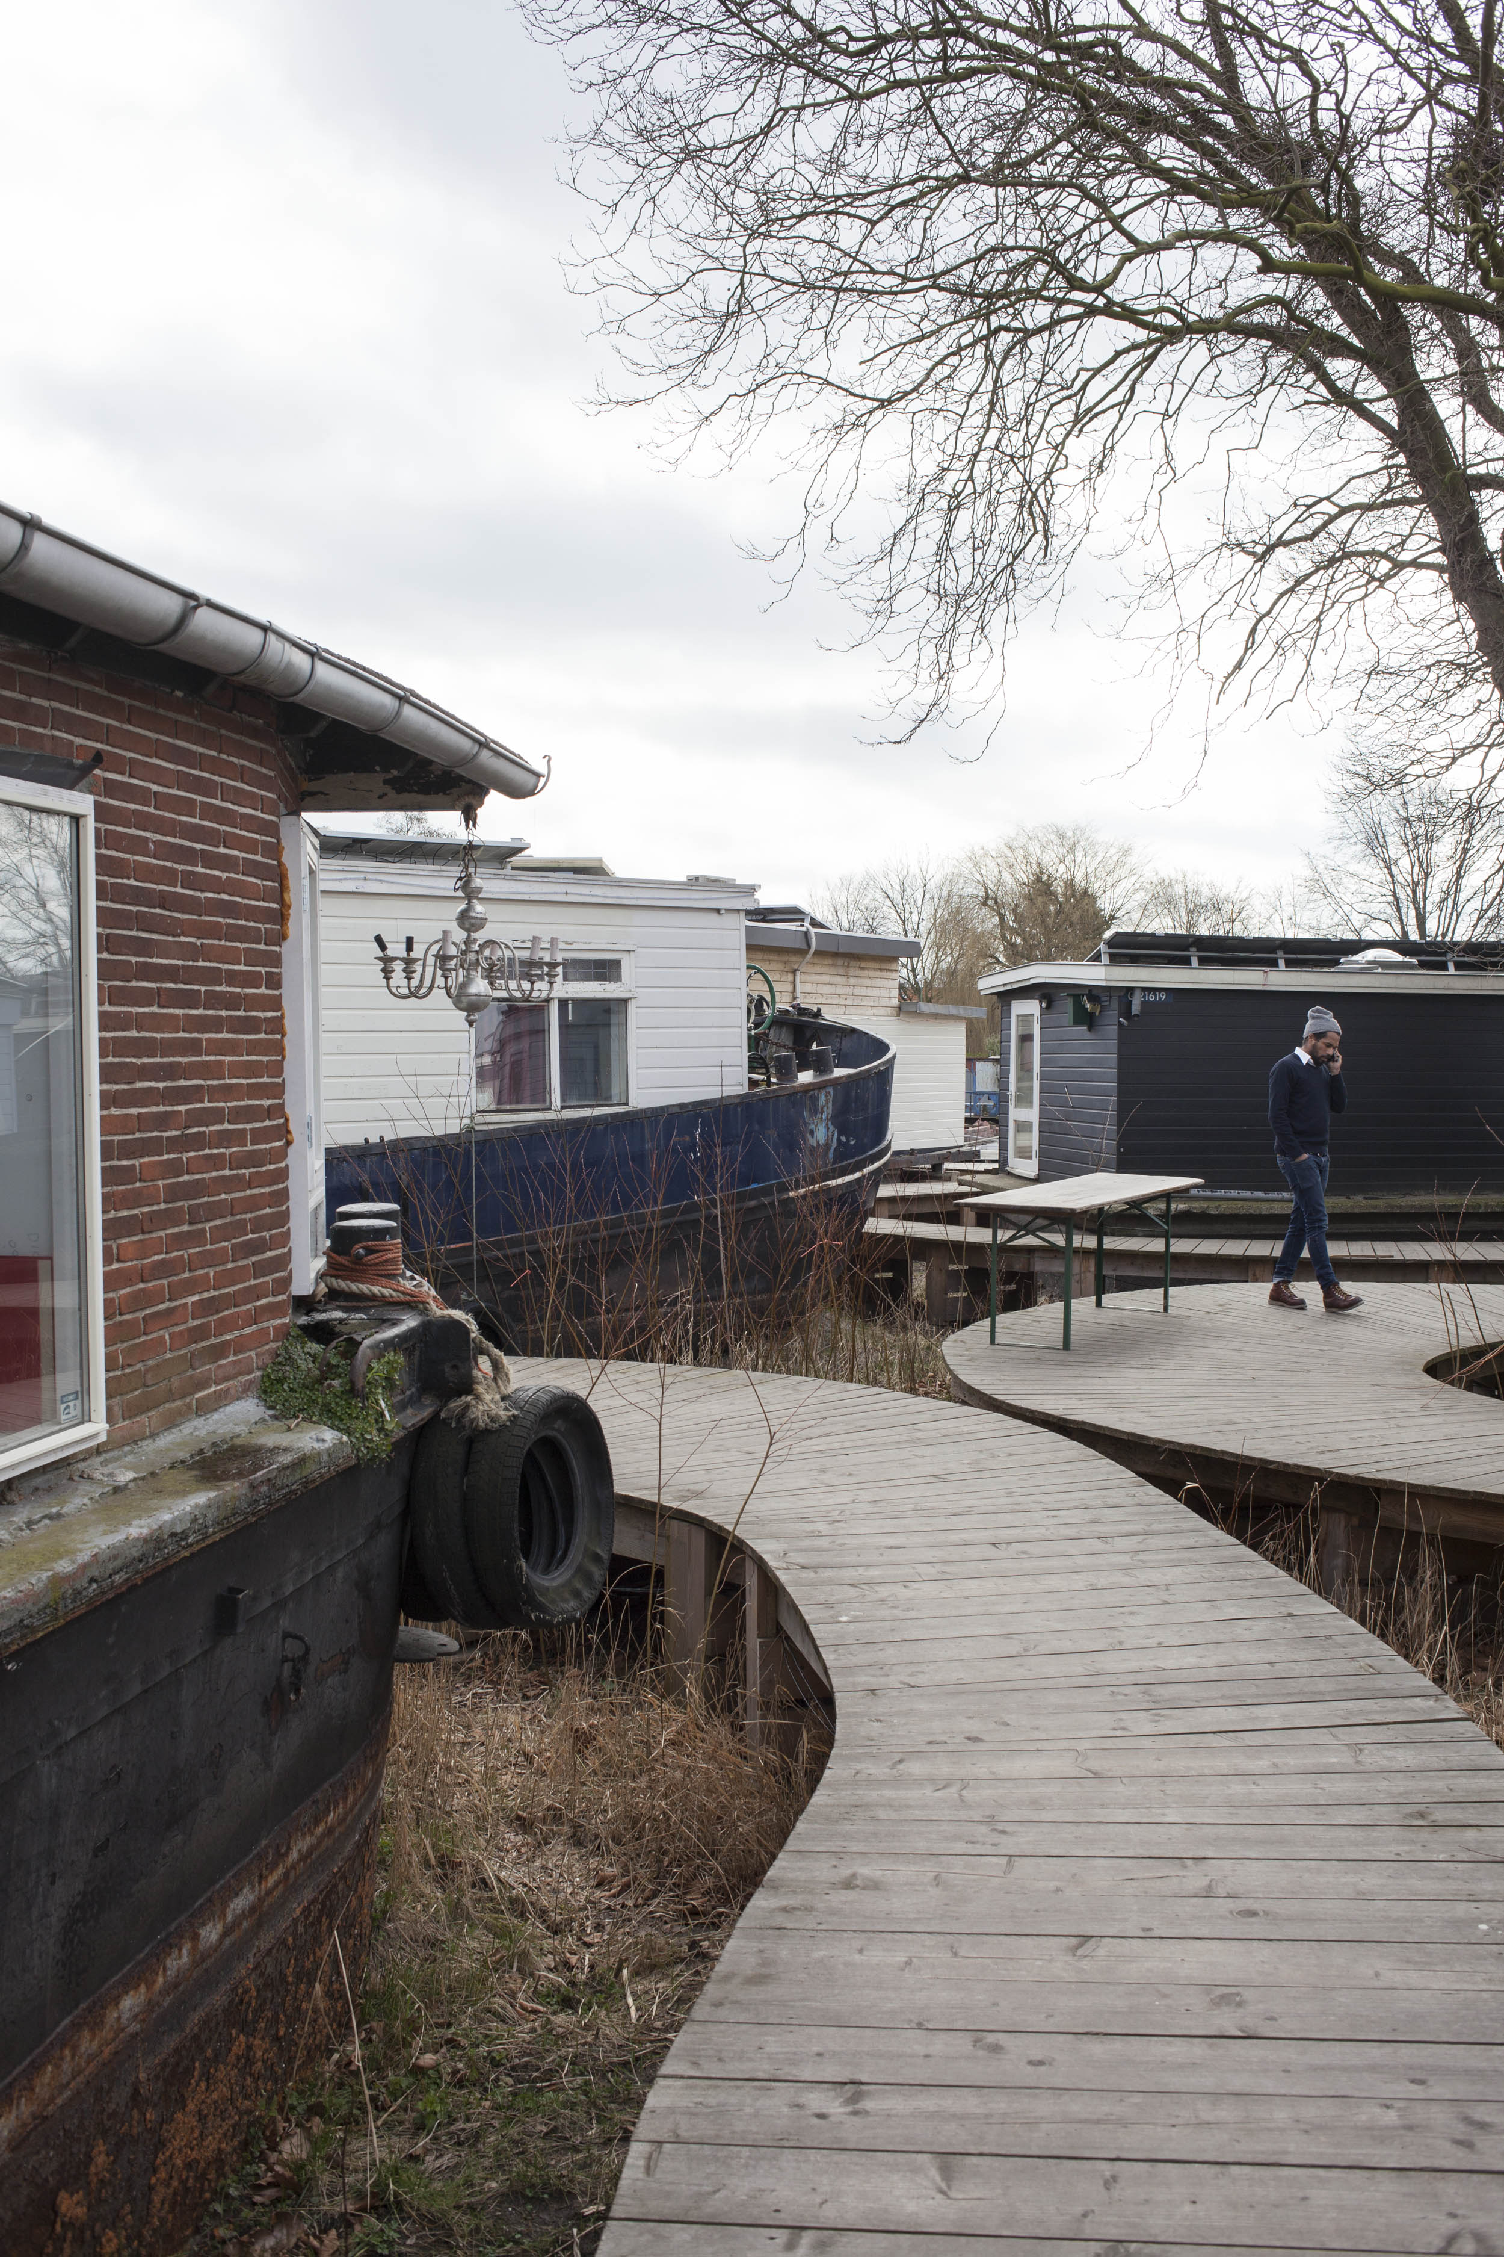
SPACE AND MATTER

Slide 23
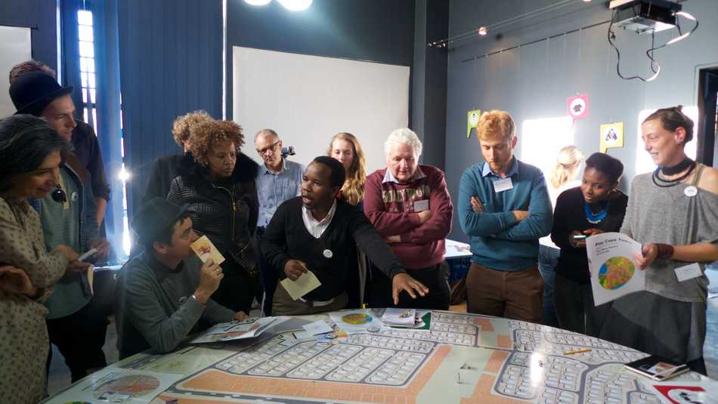
PLAY THE CITY

Slide 24
