Slide 1
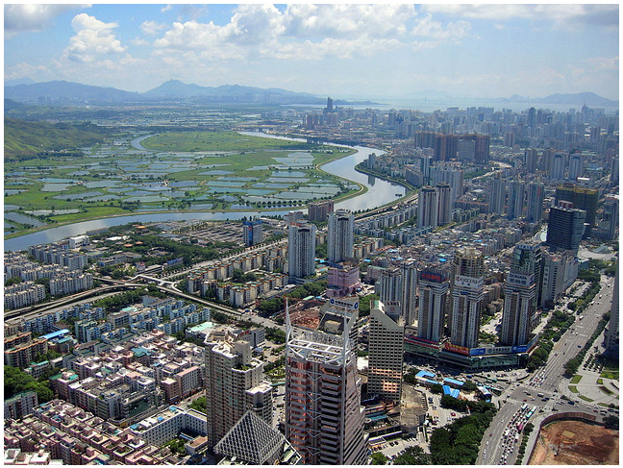
Shenzhen Scenarios 4.0
Inclusive Development
Dr. Lei QU
Assistant Professor
Department of Urbanism, L.Qu@tudelft.nl

Slide 2
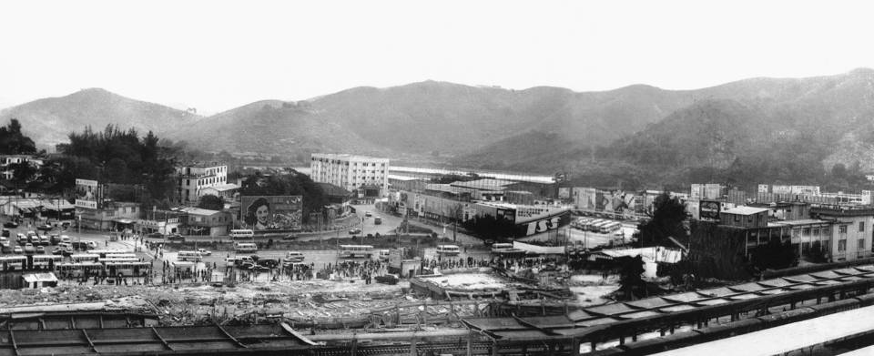
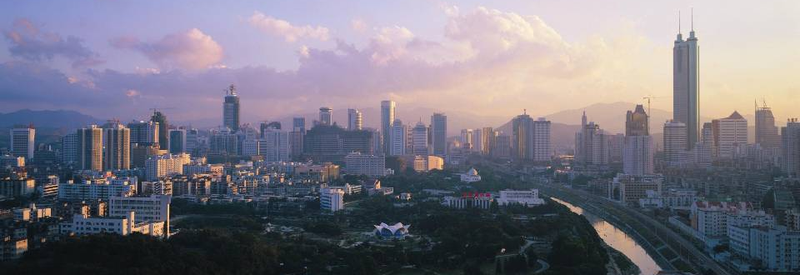
Shenzhen speed: 30 years of development, a miracle of planning
from a series of villages to a metropolis of 13 million population
Photos from Weiwen Huang

Slide 3
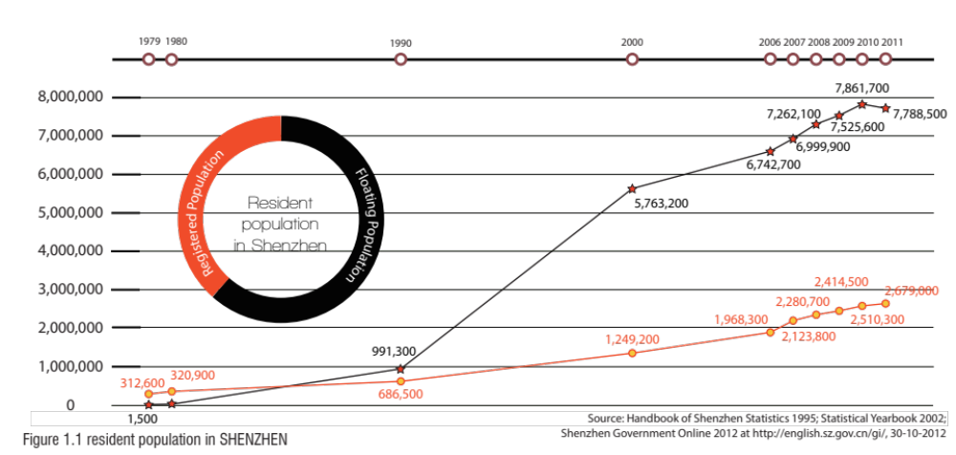
The “Floating population”
Diagram made by Fanying Zhang, master thesis TU Delft, 2013

Slide 4
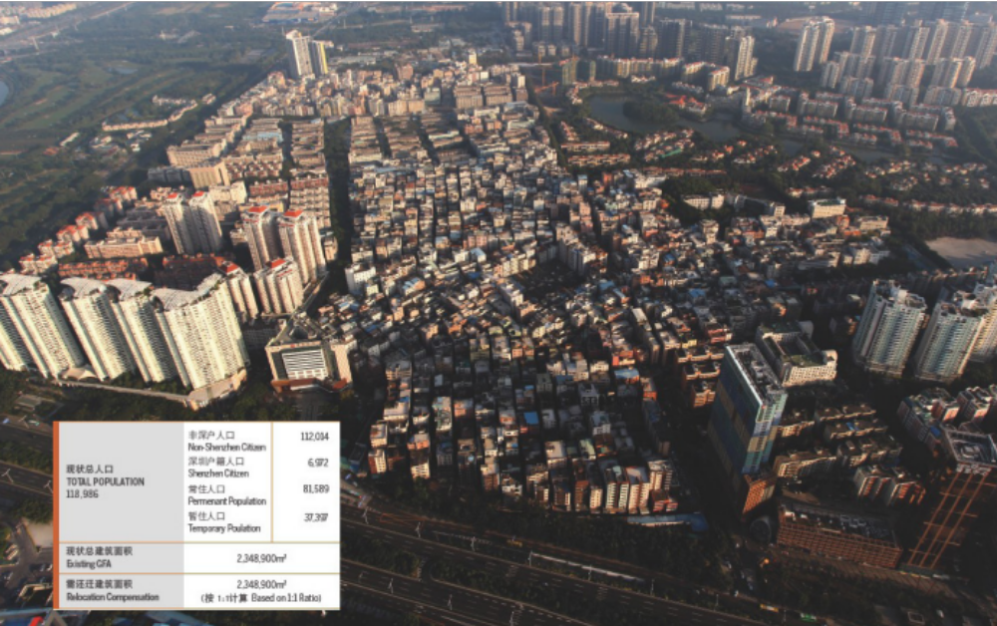
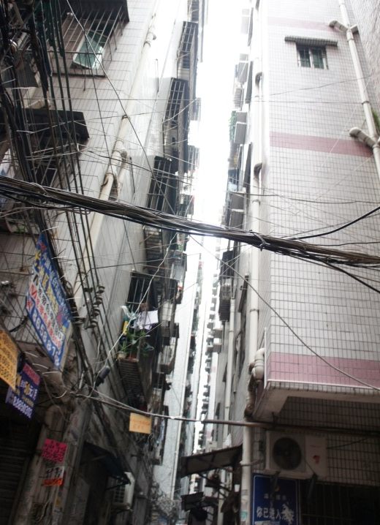
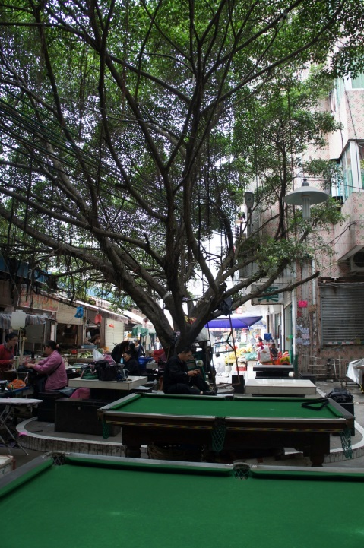
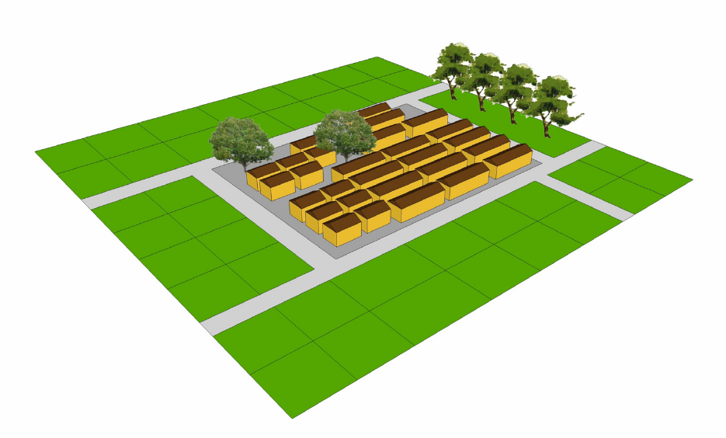
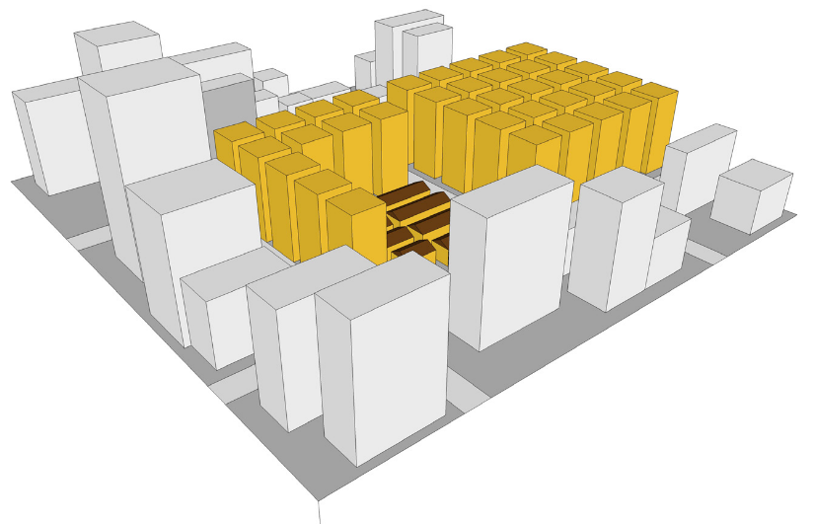
Urban villages
Baishizhou:
housing for 130,000 migrants
Source: Fanying Zhang, master thesis TU Delft, 2013

Slide 5
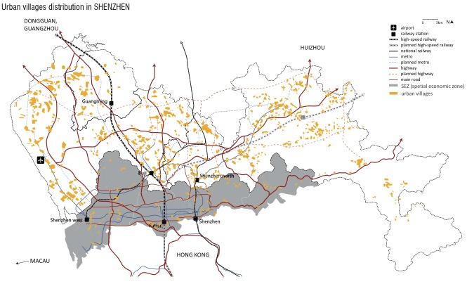
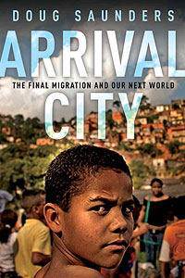
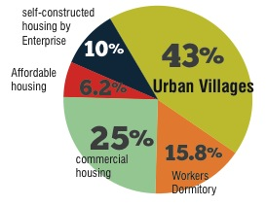
Distribution of Urban villages in Shenzhen
The current tenure structure of the housing stock in Shenzhen (Jiping Peng, master thesis TU Delft, 2014)

Slide 6
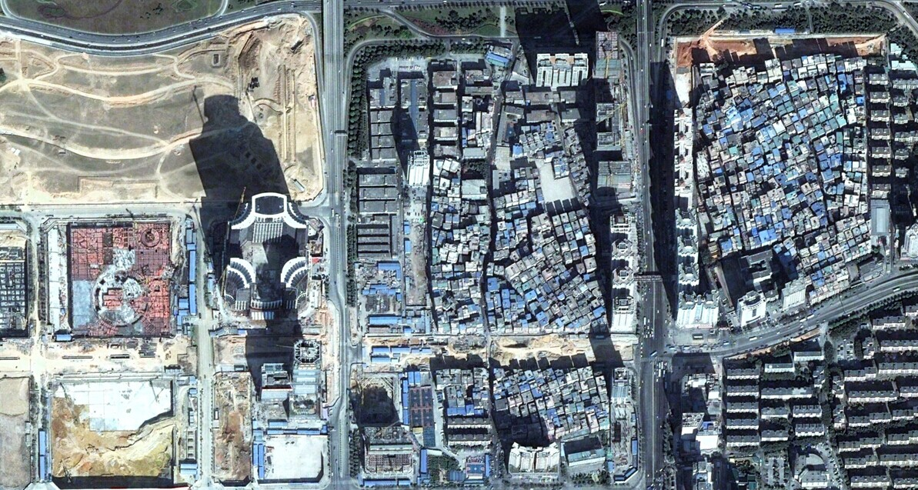
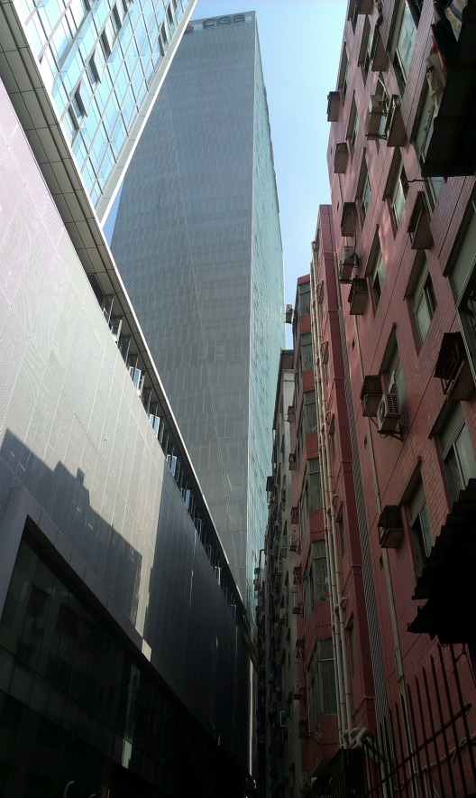

Slide 7

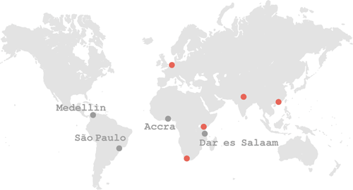




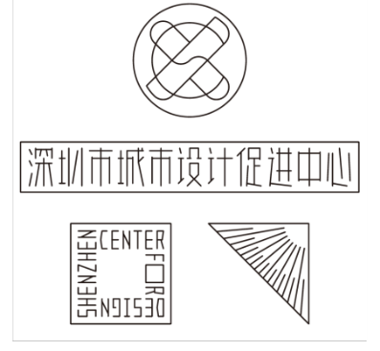

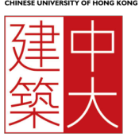
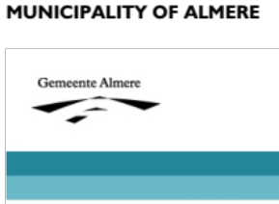

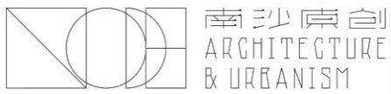
Shenzhen

Slide 8
Migration / Urban Transformation
^{Shenzhen Scenarios}
^{A} platform of research and education
In the past 3 years:
^{19 students enrolled:} 7Dutch, 1Australian, 1 Lithuanian, 1Indian, 9 Chinese
7 Mentors of Spatial Planning and ^{Strategy/ OTB:}
Stephen Read/ Diego Sepulveda/ Lei QU/ Verena Balz/ Fransisco Columbo/ Vincent Nadin/ Akkelies van Nes/ Evert Meijers/ Leeke Reinders
10 Mentors of Urban Design/ Environmental Technology and Design/ Landscape Architecture:
Machiel van Dorst/ Luisa Calabrese/ Maurice Harteveld/ Daan Zandbelt/ Henco Bekkering/ Arjan van Timmeren/Frank van der Hoeven/ Birgit Hausleitner
INTI program director: Linda Vlassenrood

Slide 9
Framework of the graduation projects:
Shenzhen Scenarios: to explore alternative ways of development, from the perspective of planning and design strategies.
2012 Shenzhen Scenarios 1.0: Local Scale
Informal development/ On-site upgrading/ Small interventions/ Social interaction/ Transit oriented development
2013 Shenzhen Scenarios 2.0: Liveability
Affordable housing/ Agriculture landscape/ Memory of the city/ Civic space / Socio-spatial integration
2014 Shenzhen Scenarios 3.0: Systems in Transition
Informal settlements/ city networks/ green infrastructure

Slide 10
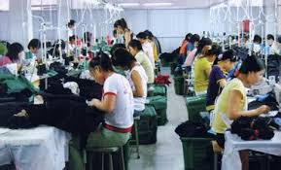
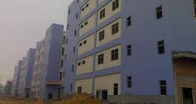
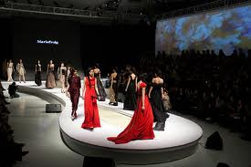
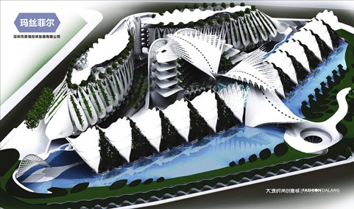
From the “world factory” to an “international city”

Slide 11
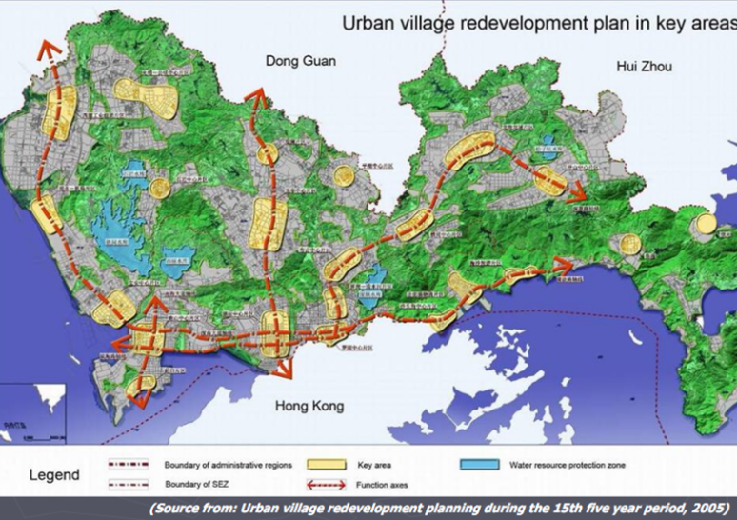
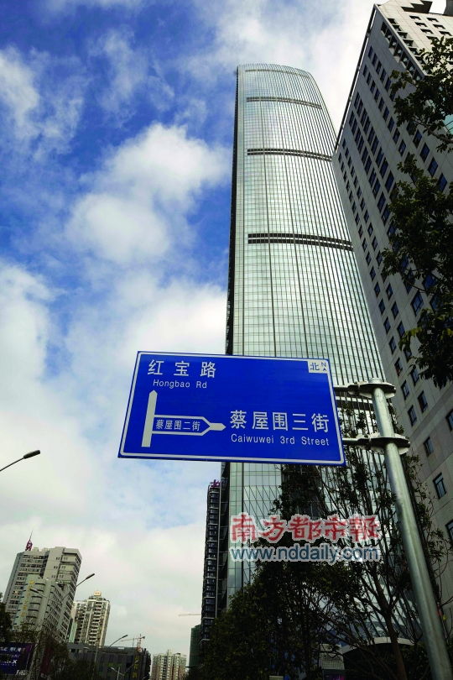
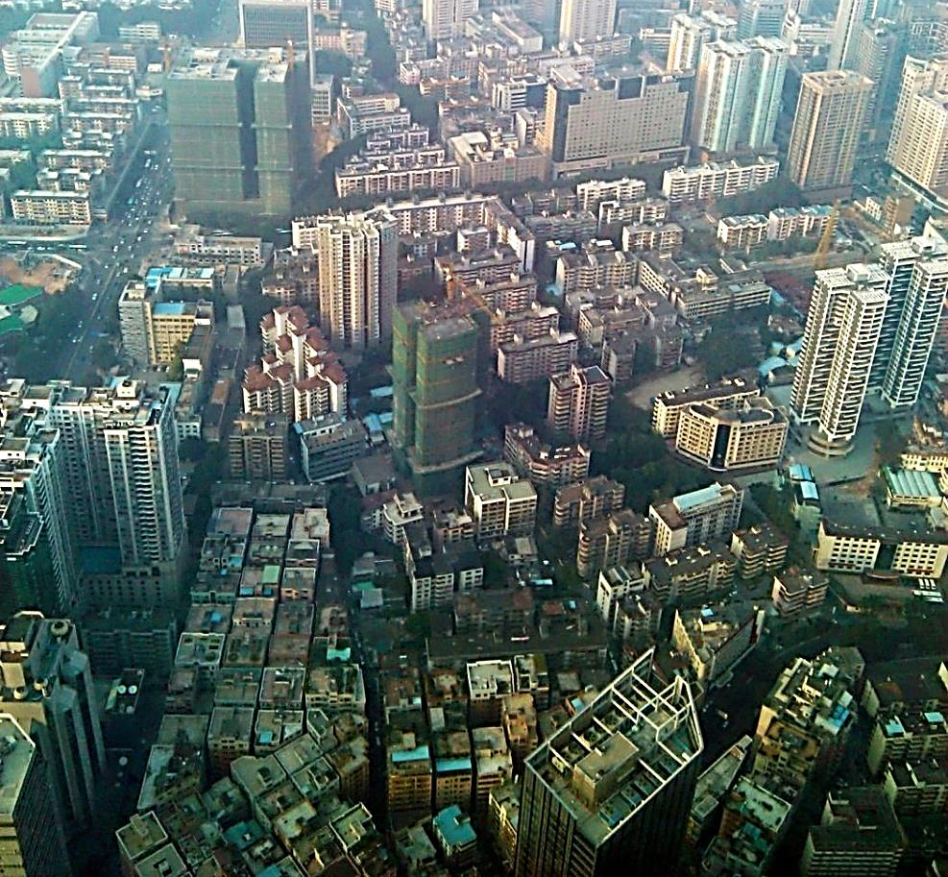

Slide 12
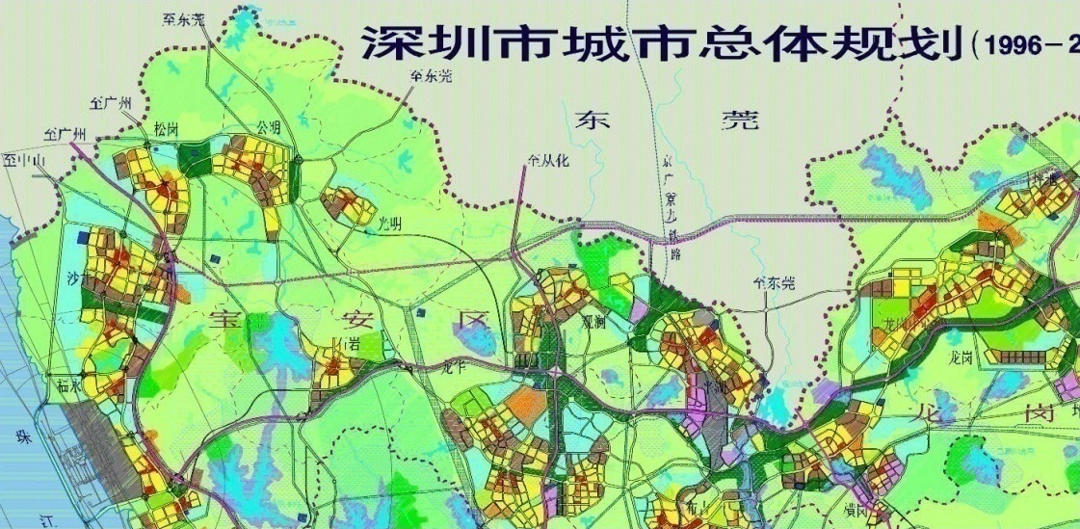
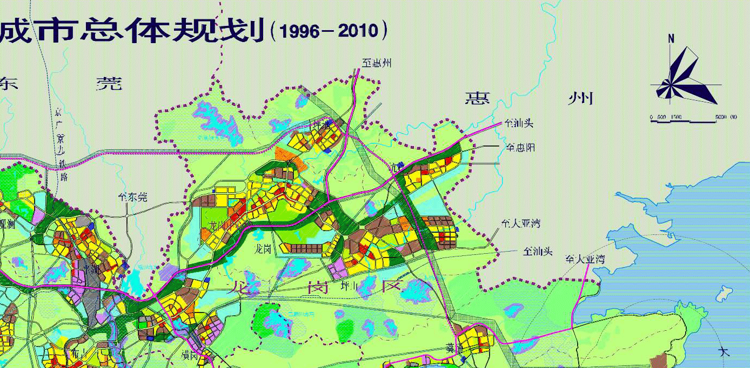
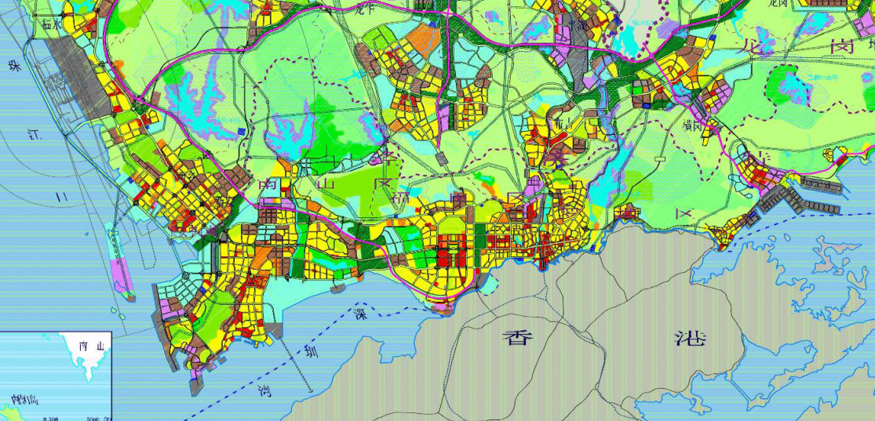
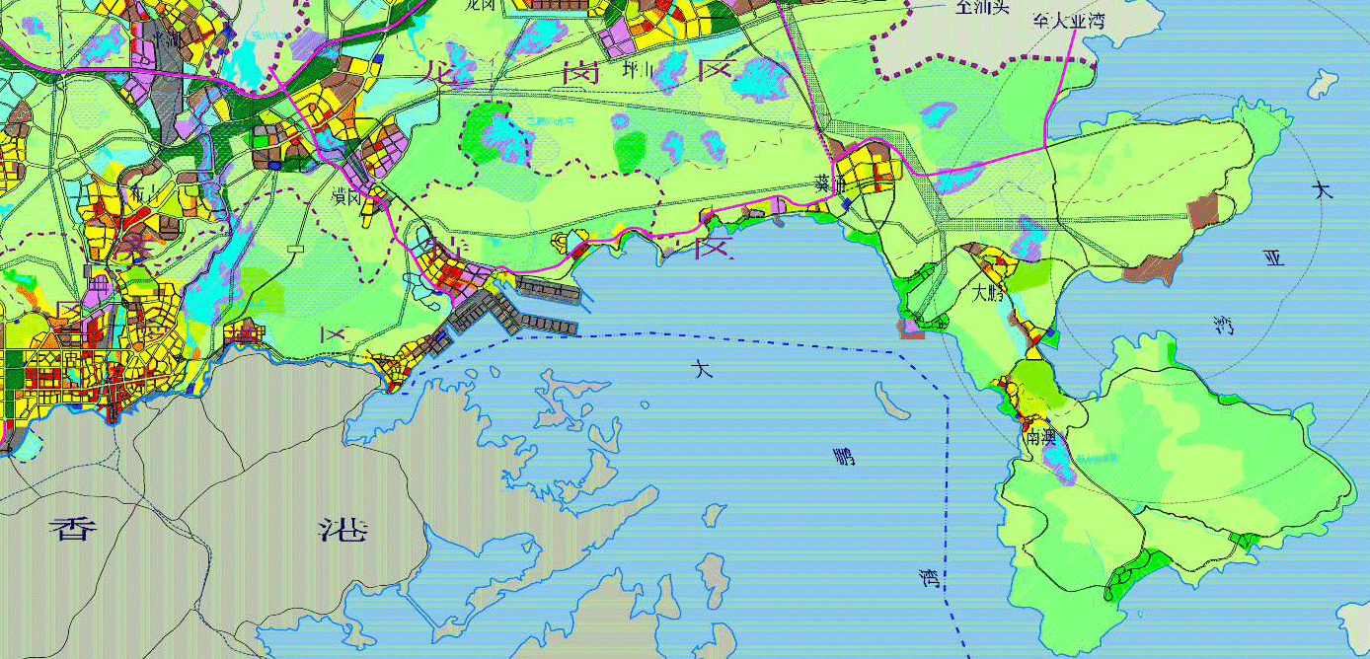
The comprehensive plan of Shenzhen city (1996-2010)- Land use planning
Source: Shenzhen municipality
Spatial development in suburban districts

Slide 13
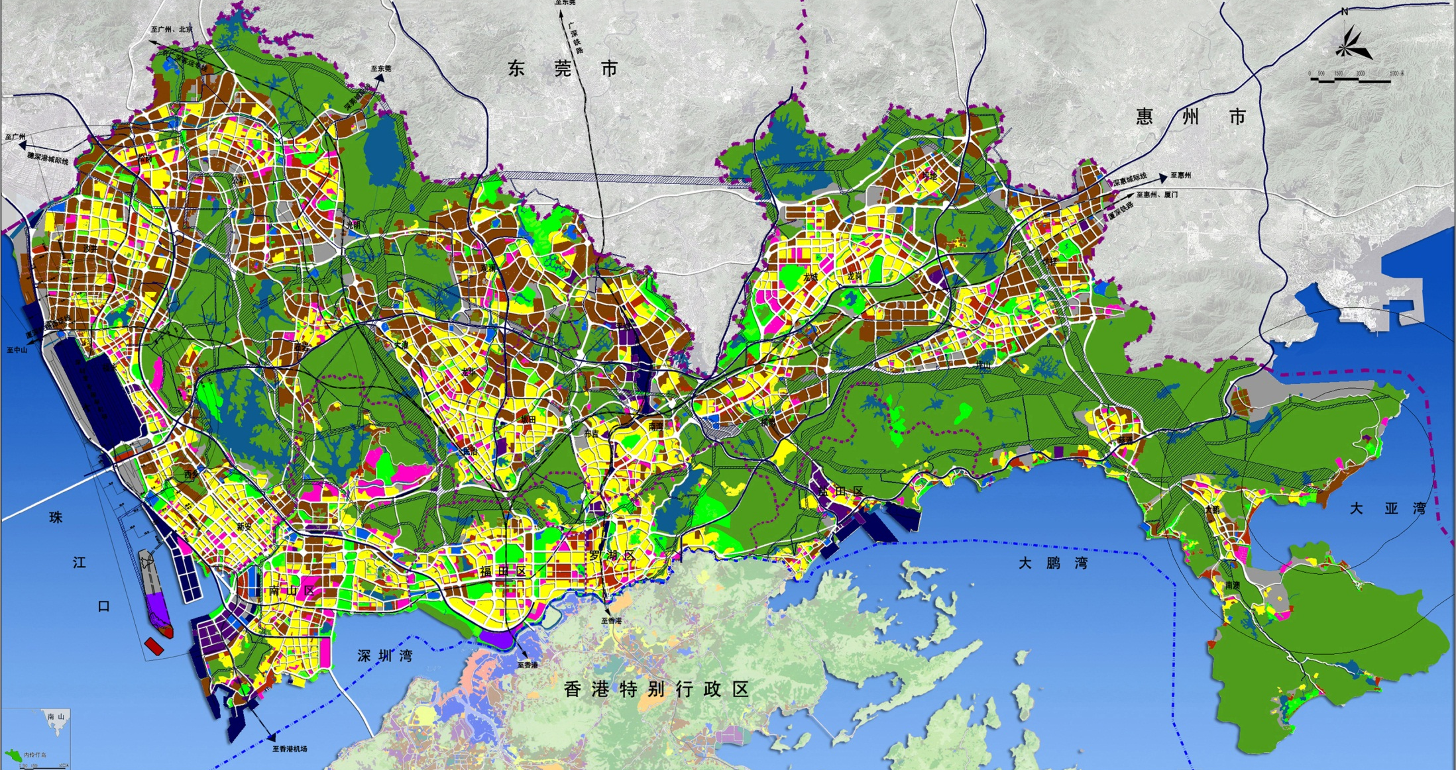
The comprehensive plan of Shenzhen city (2010-2020)- Land use planning
Source: Shenzhen municipality, 2010
Spatial development in suburban district

Slide 14
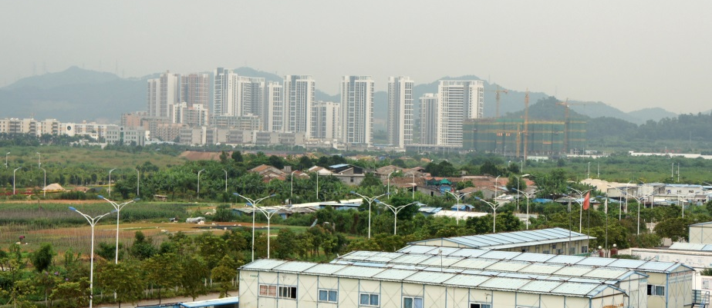
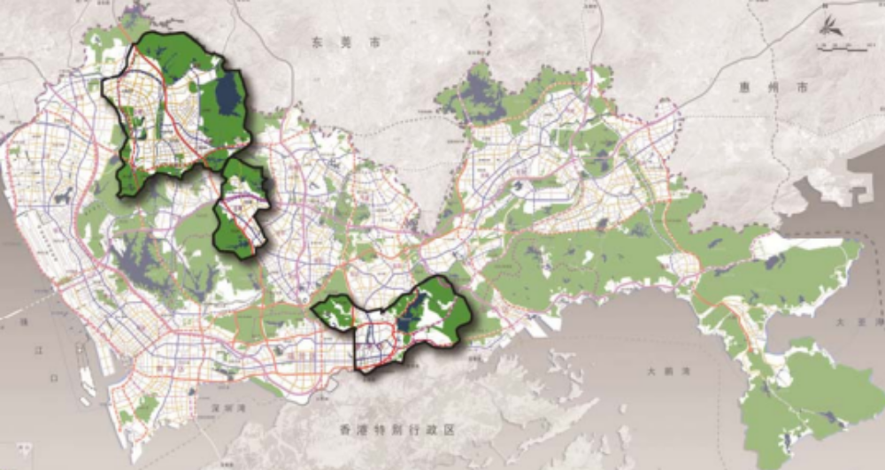
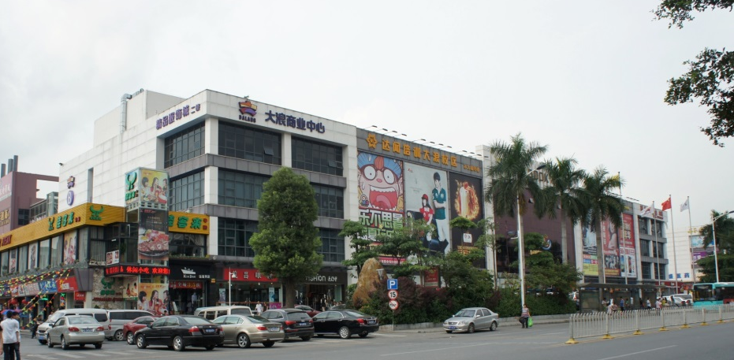
Sites (Shenzhen Scenarios 4.0)
Guangming
New Town
Dalang

Slide 15
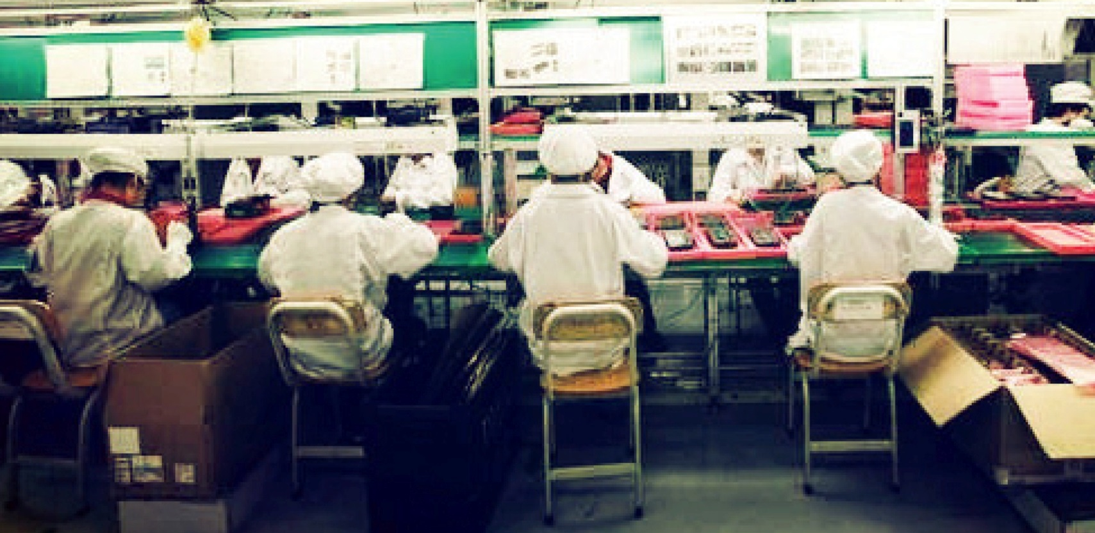

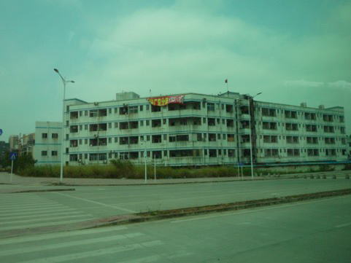
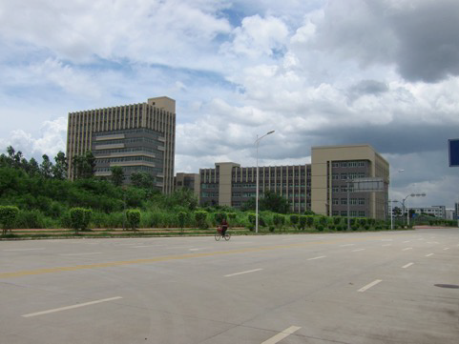
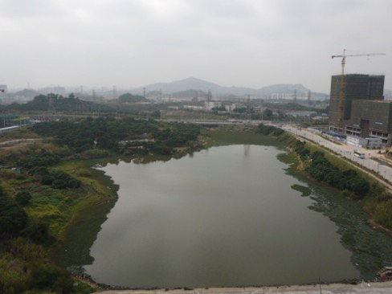
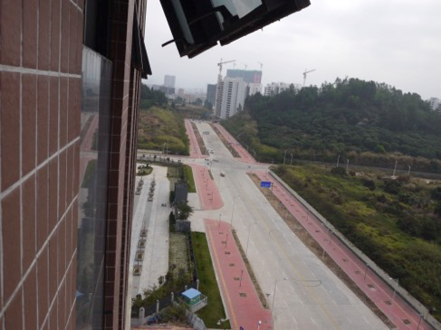
2015 Shenzhen Scenarios 4.0
Inclusive Development
Industrial upgrading
Social construction
Environmental recovery

Slide 16
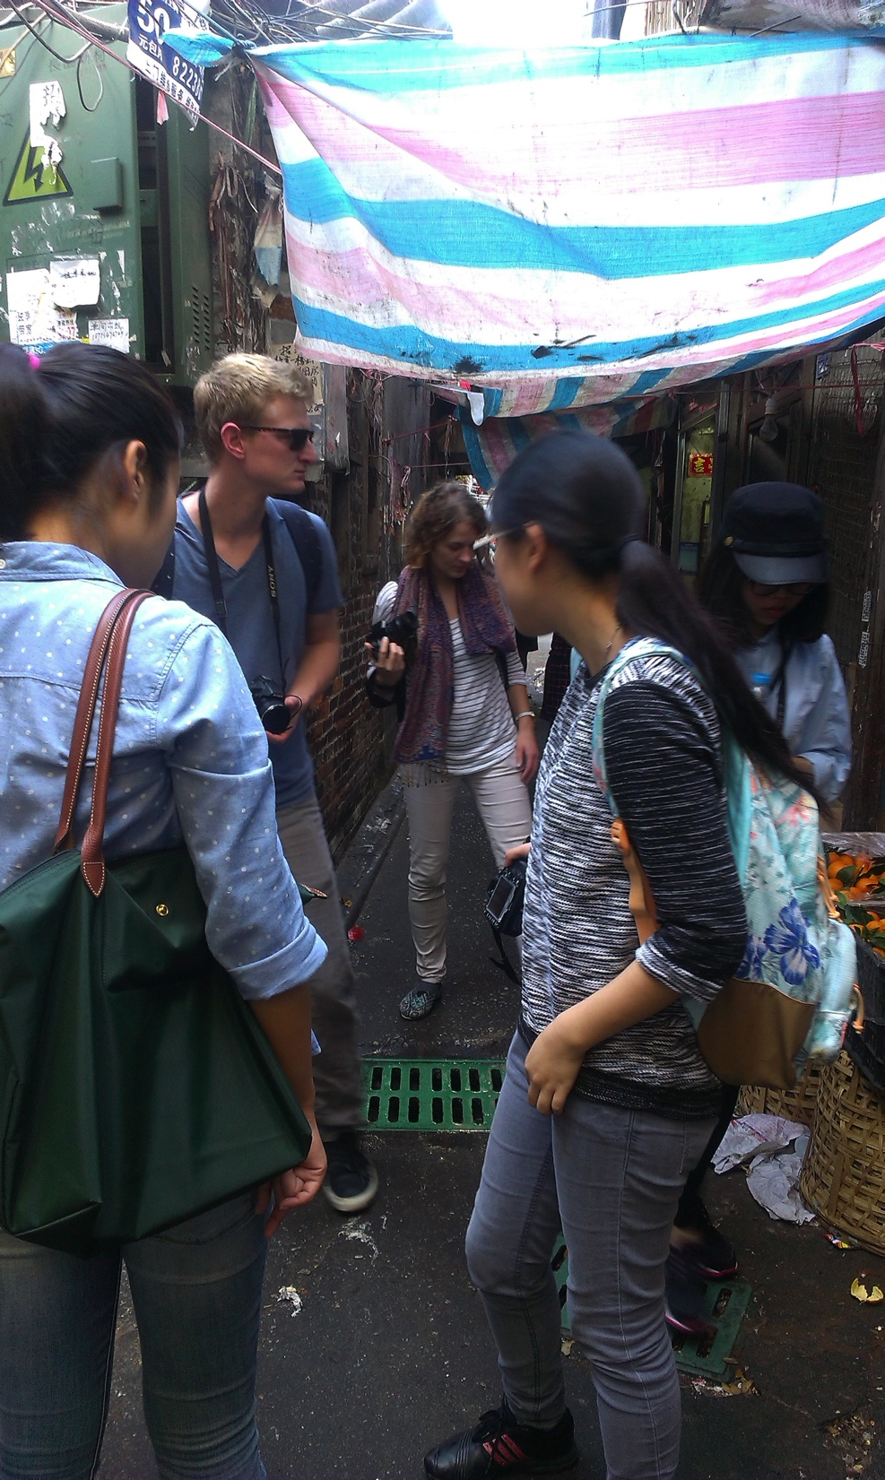
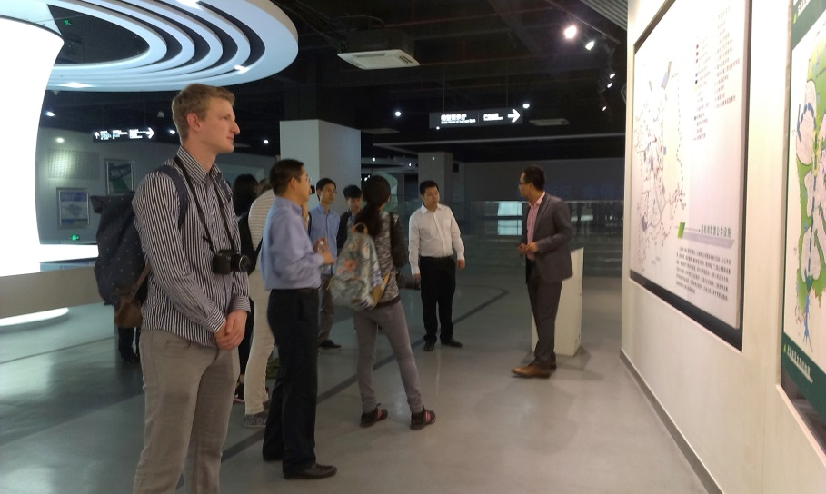
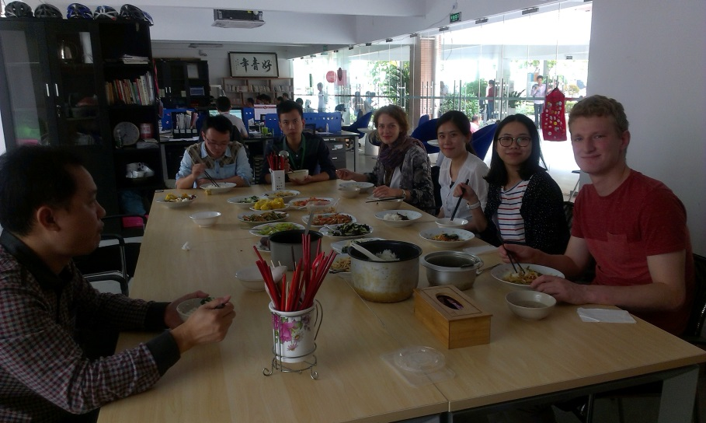
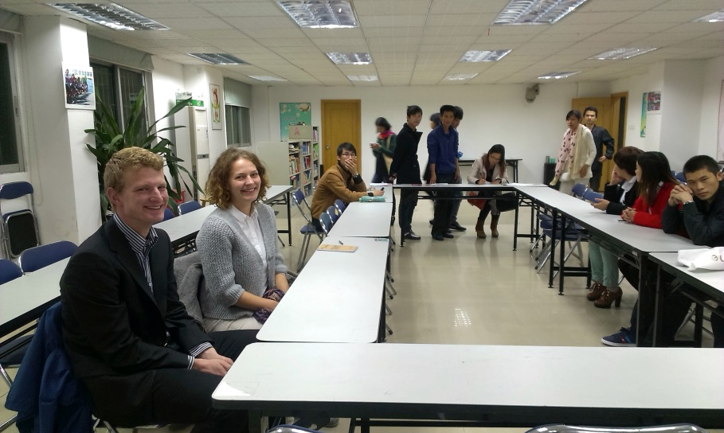
Field study in November
Meeting People
migrants, planners, designers, and scholars
Walking in the city
urban villages, industrial parks and community centers
(The ‘Shenzhen Scenarios’ group of 2014)

