Slide 1
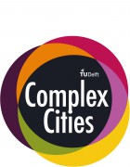
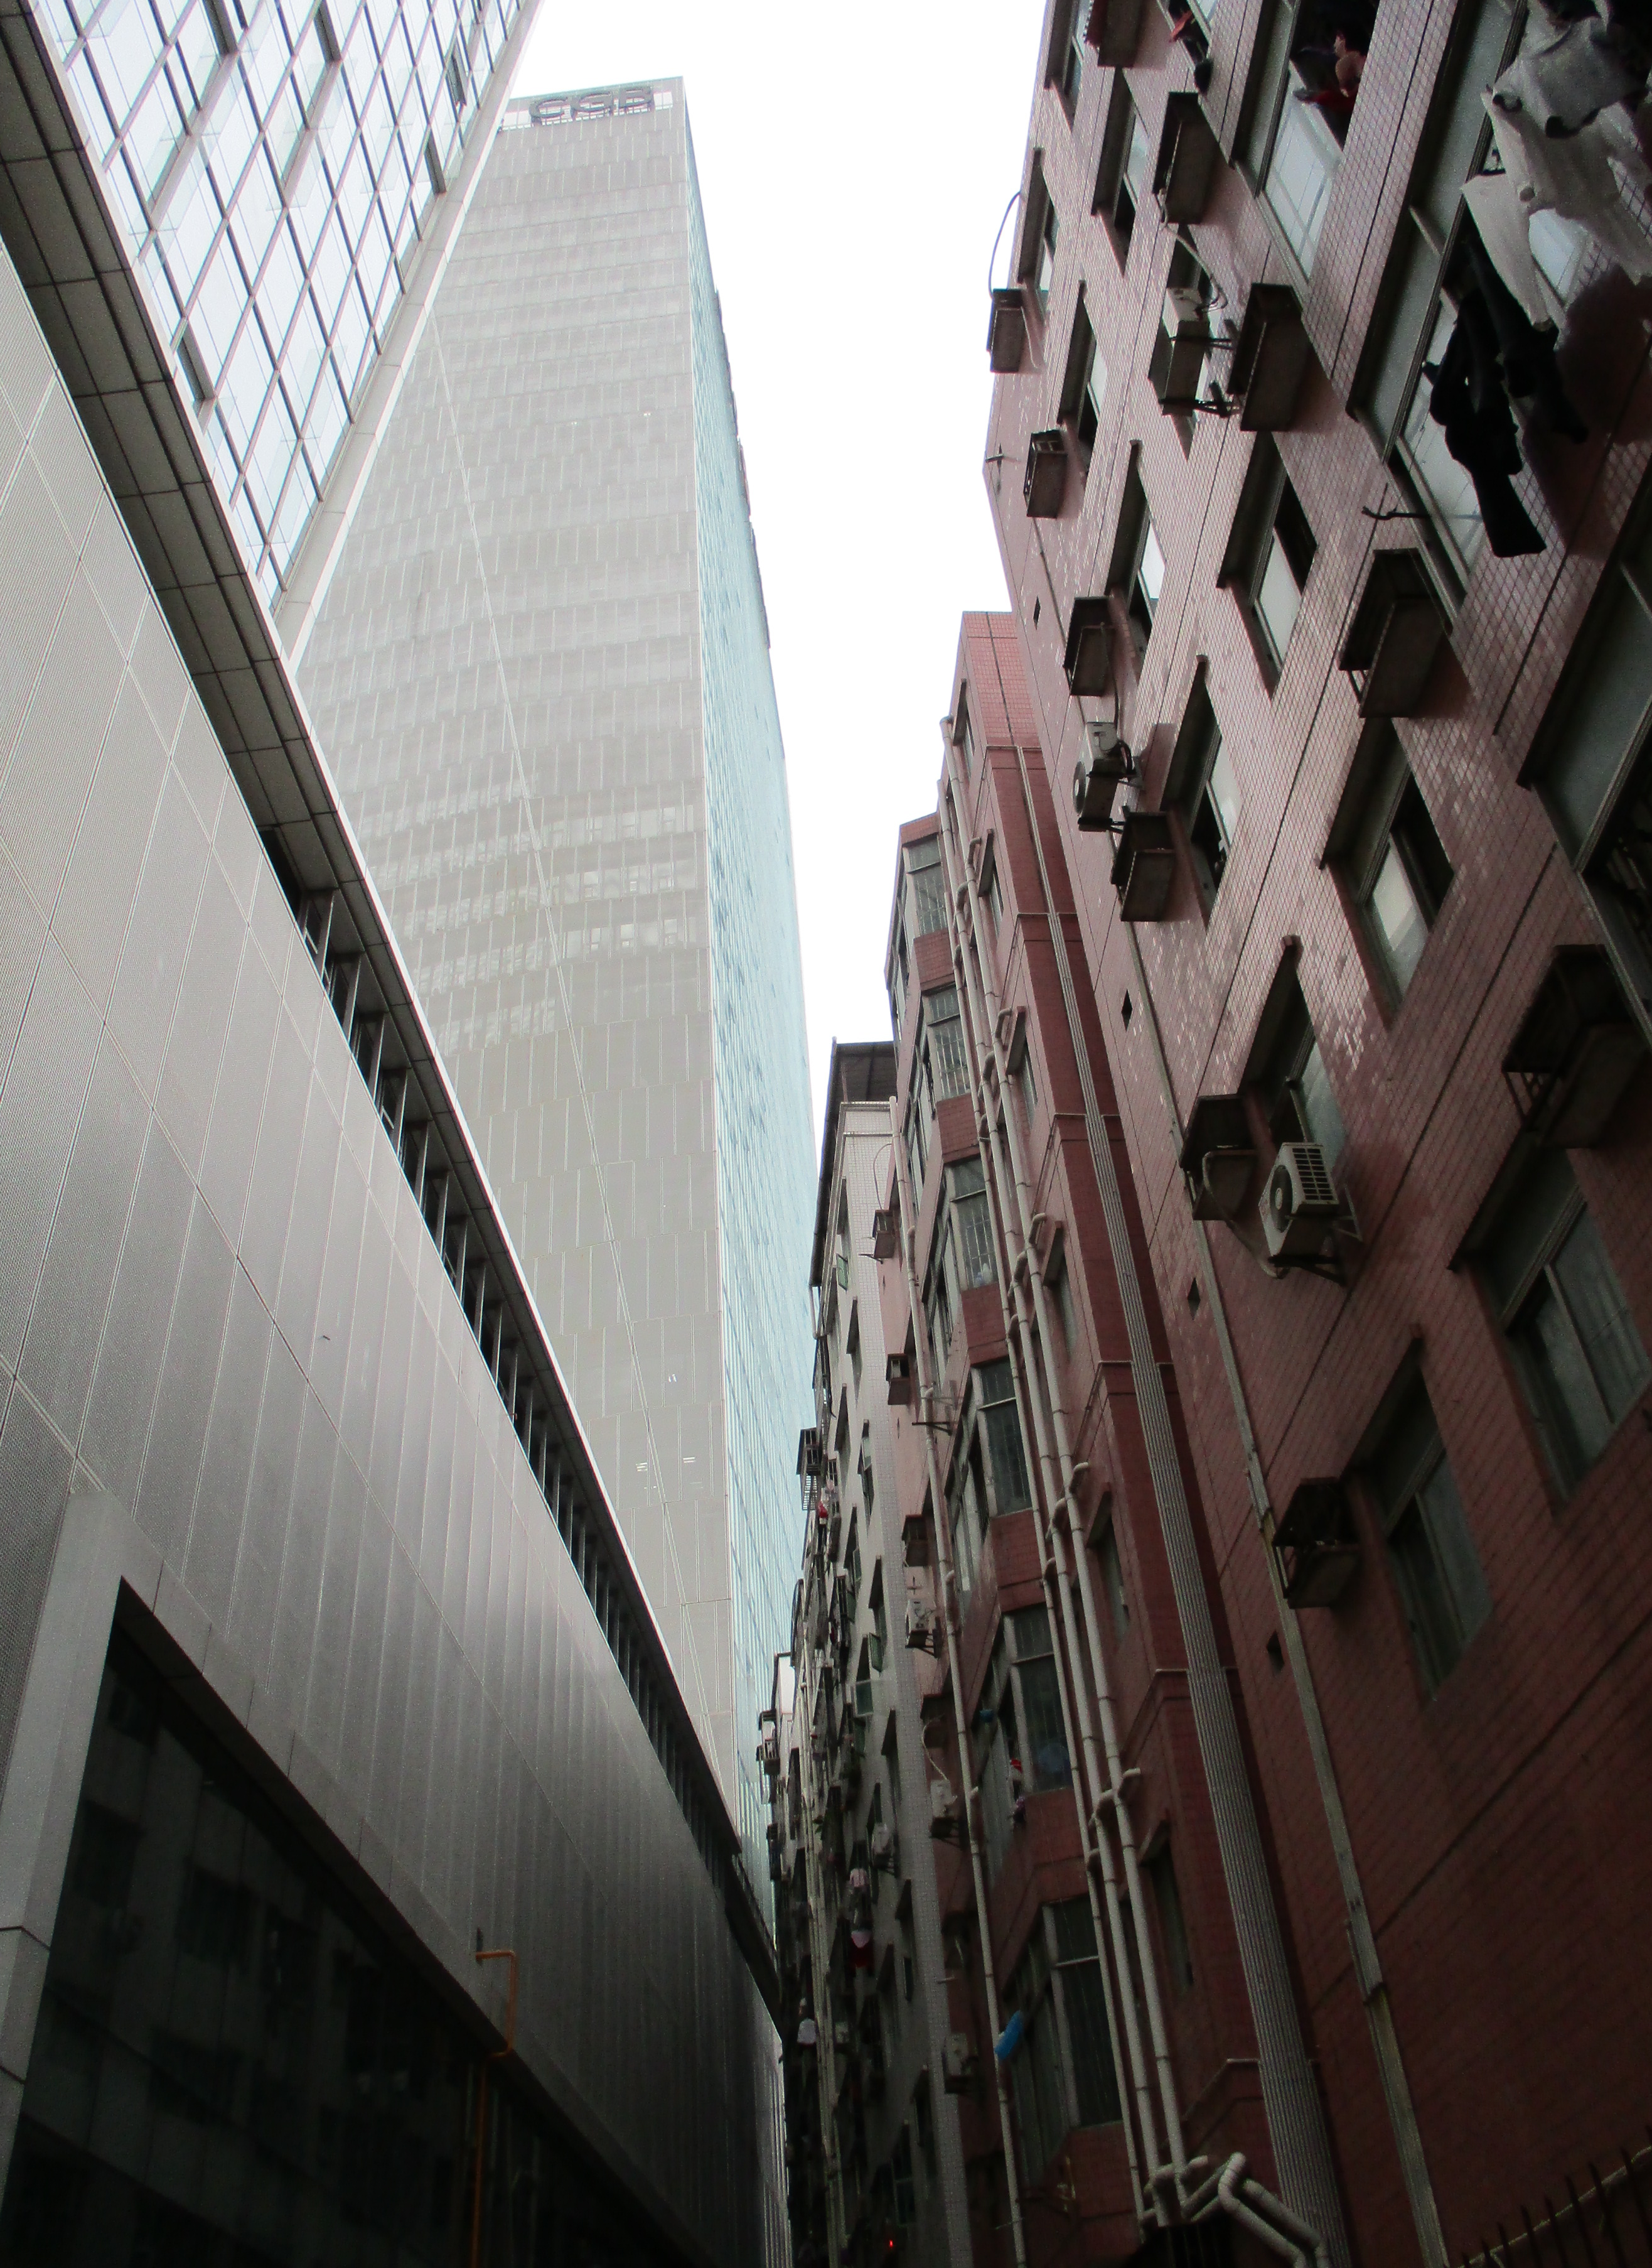


Transforming
Chinese
Cities
Migration
Industrial upgrading
Urban regeneration
History/Heritage
Green blue city

Slide 2
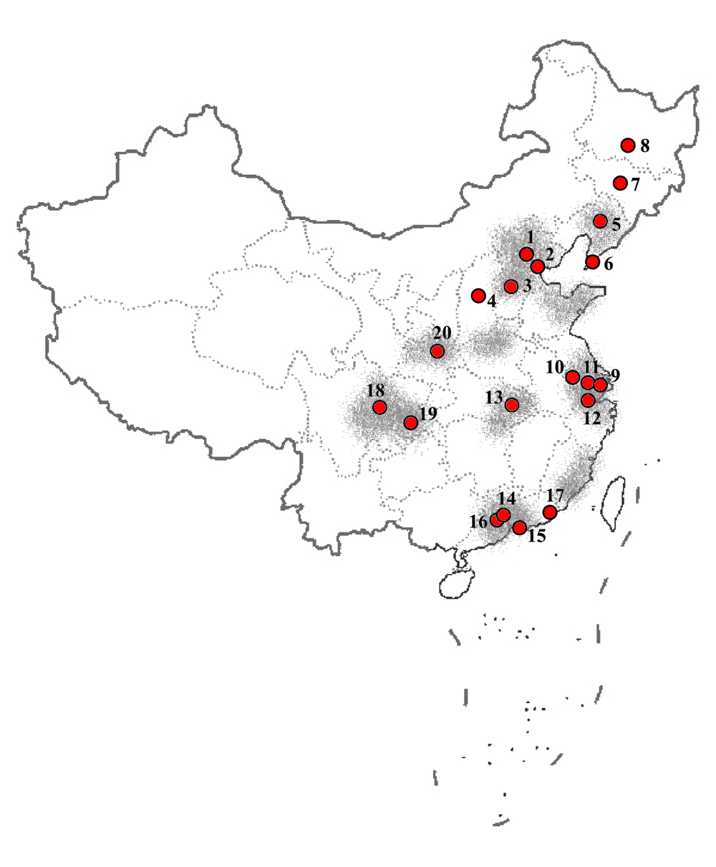
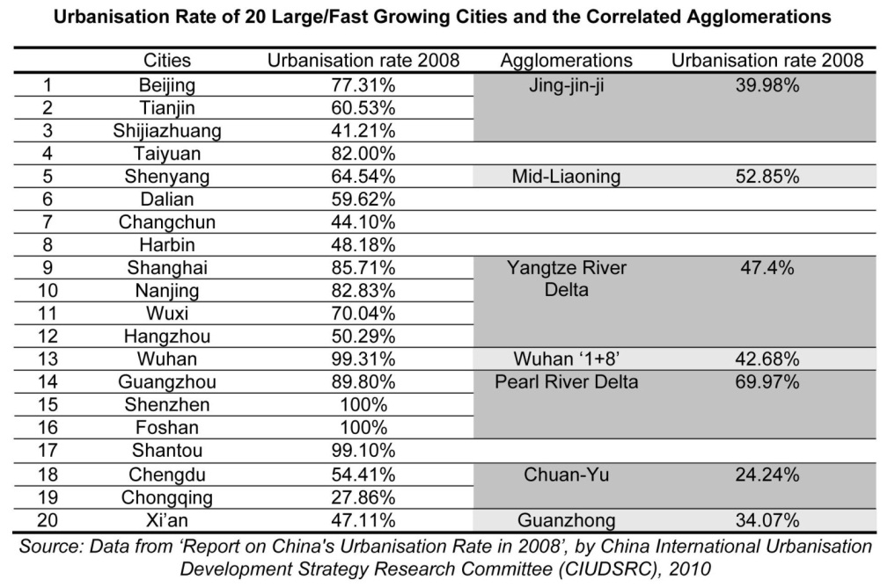
Urban and regional development in China
The growth of big cities and (10) large agglomerations
1/10 Land
1/3 population
1/2 GDP

Slide 3
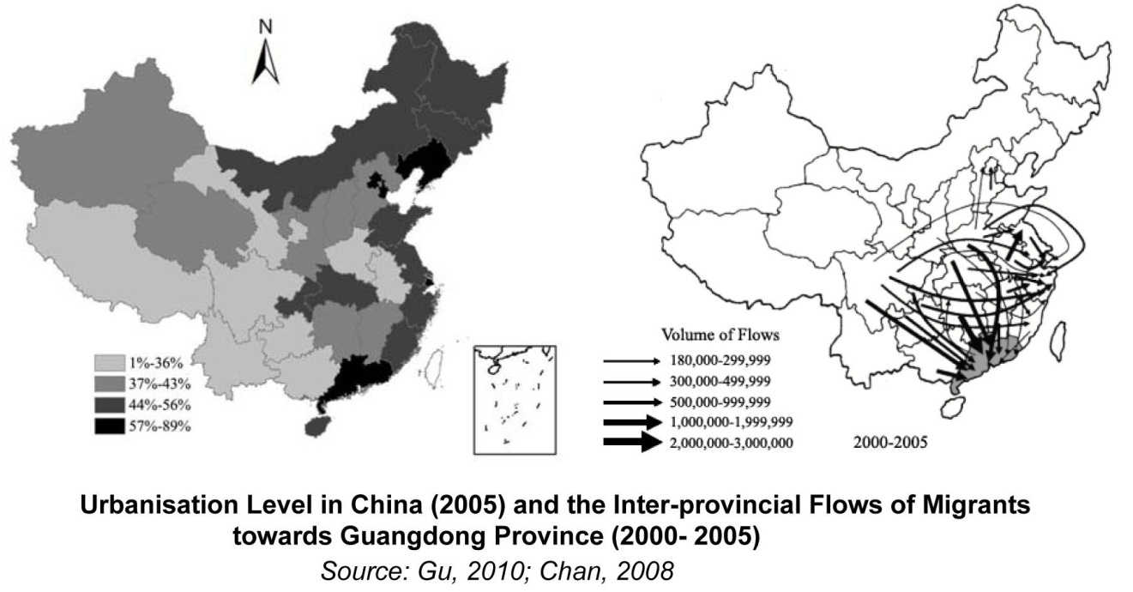

Slide 4
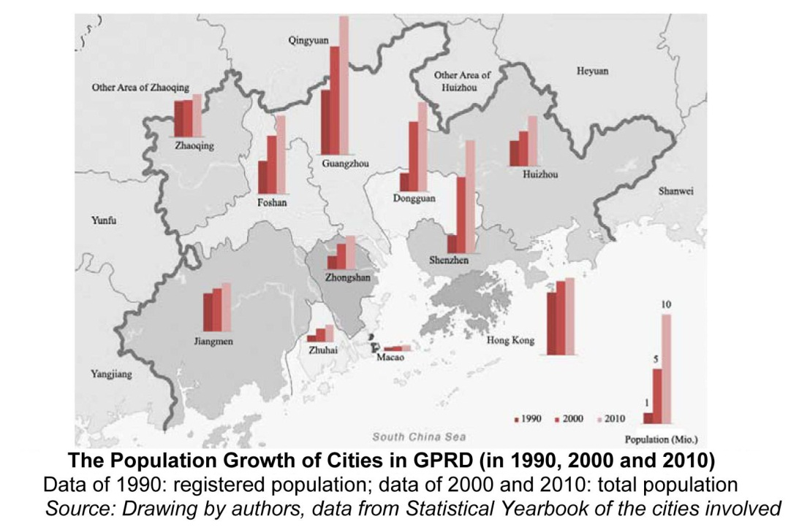
Guangzhou
Shenzhen

Slide 5
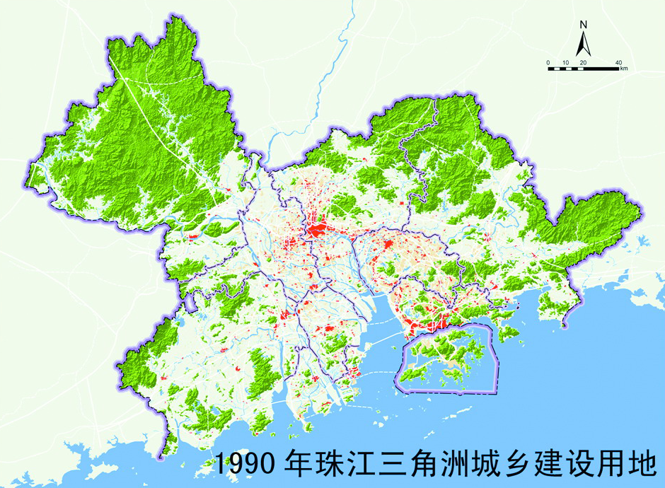
Guangzhou
Shenzhen

Slide 6
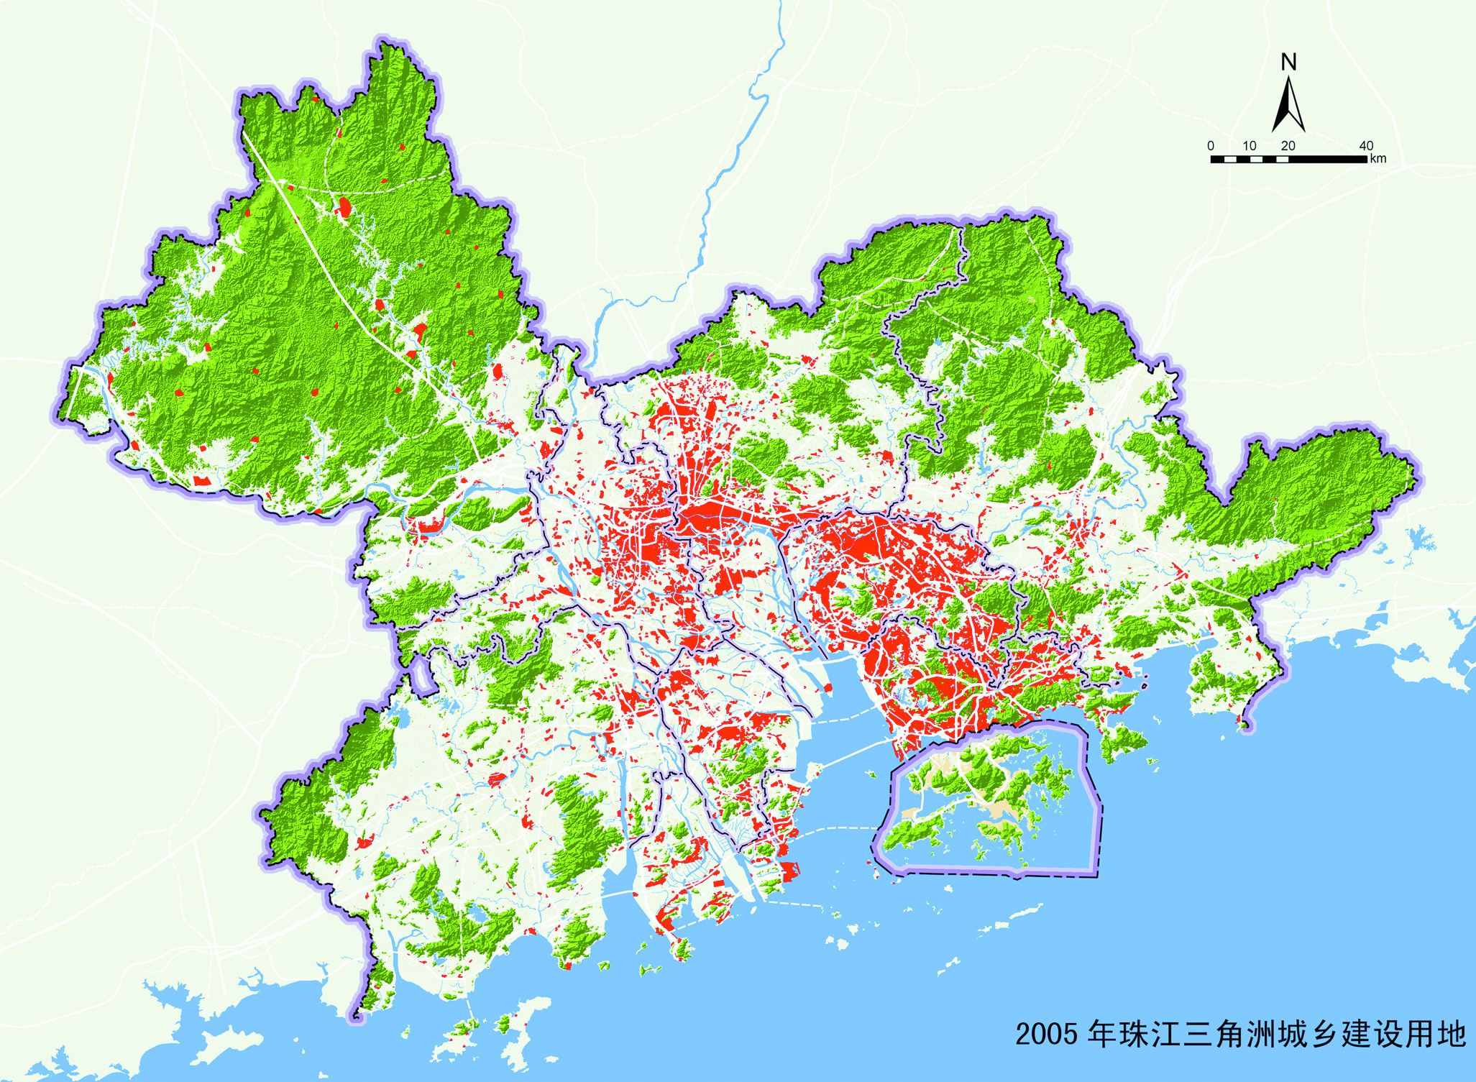
Guangzhou
Shenzhen

Slide 7
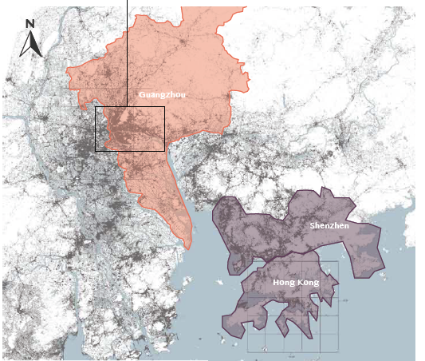
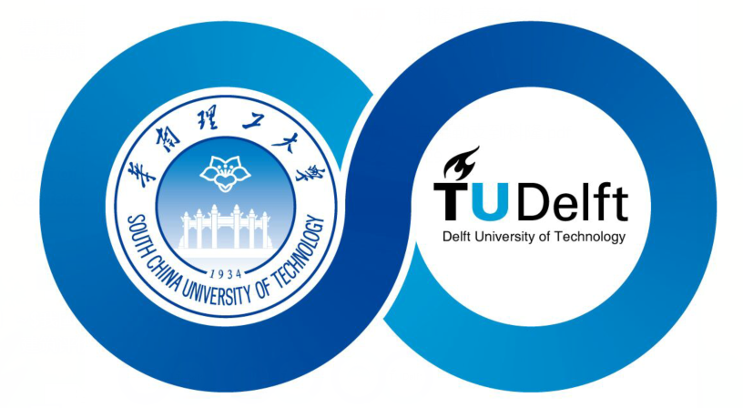

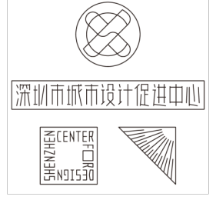

Guangzhou
Shenzhen
Hong Kong

Slide 8
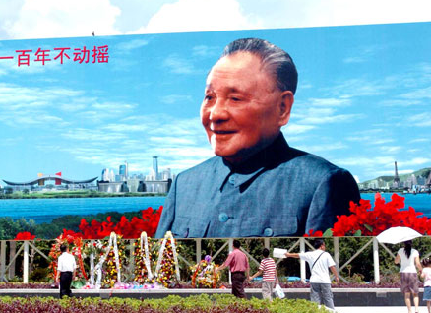
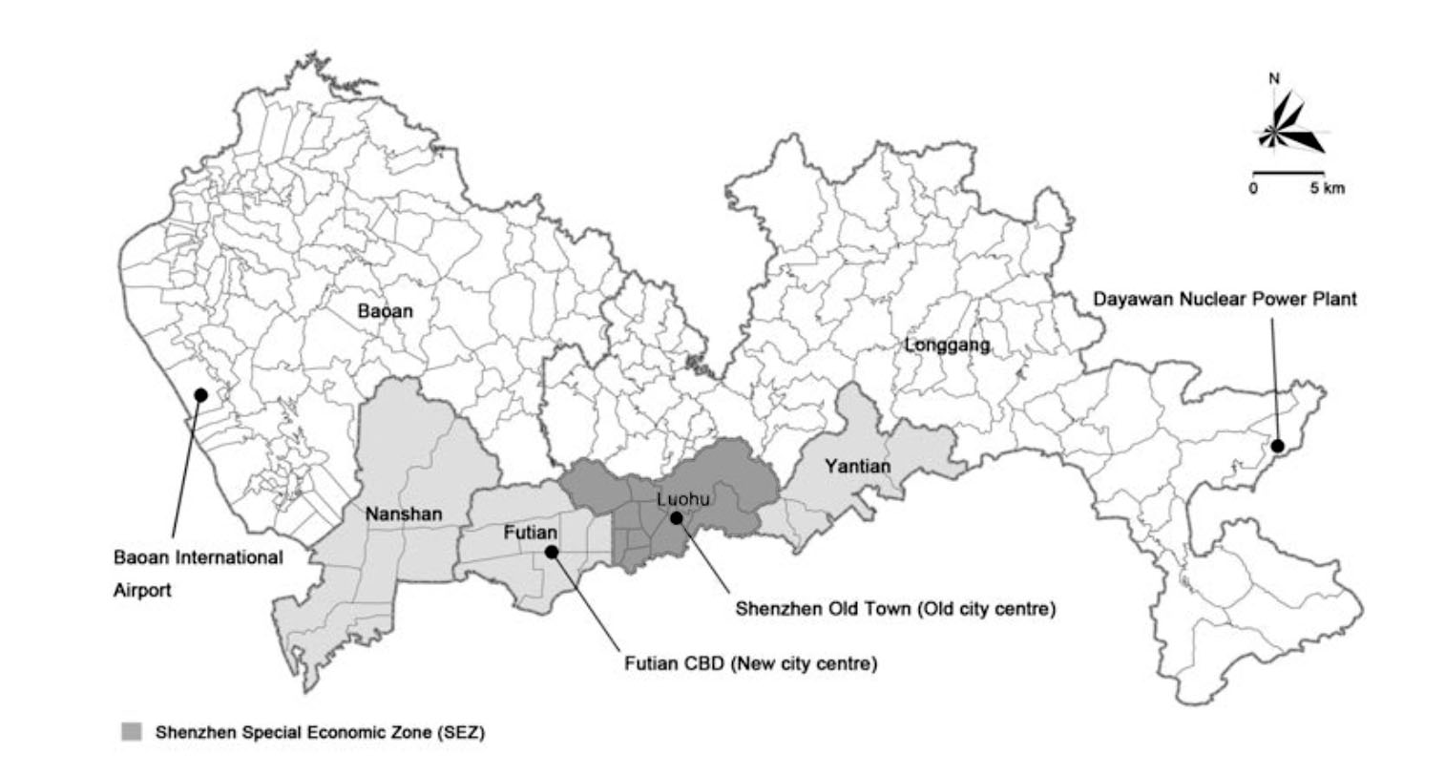
Shenzhen in 1980s
-planning for a Special Economic Zone (SEZ)
-planning for a city at the same time
-starting with infrastructure
The boundary of Shenzhen SEZ
image source: Hao, 2012
Department of Urbanism, Faculty of Architecture

Slide 9
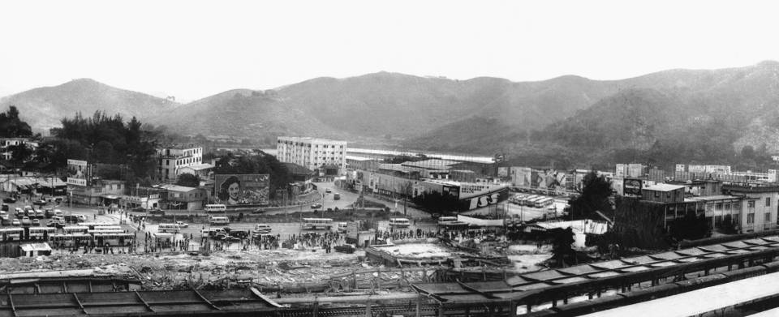
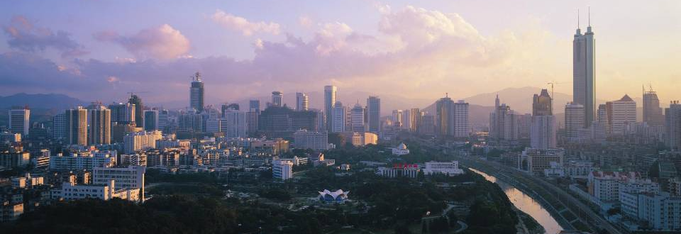
Shenzhen speed: 30 years of development, a miracle of planning
from a series of villages to a metropolis of 13 million population
Photos from Weiwen Huang

Slide 10
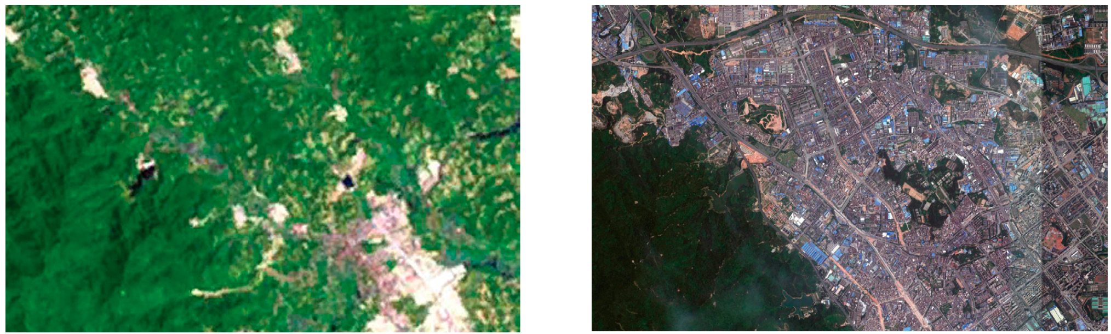
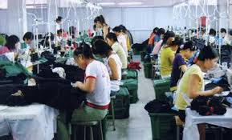
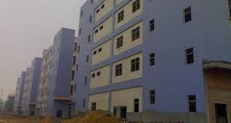
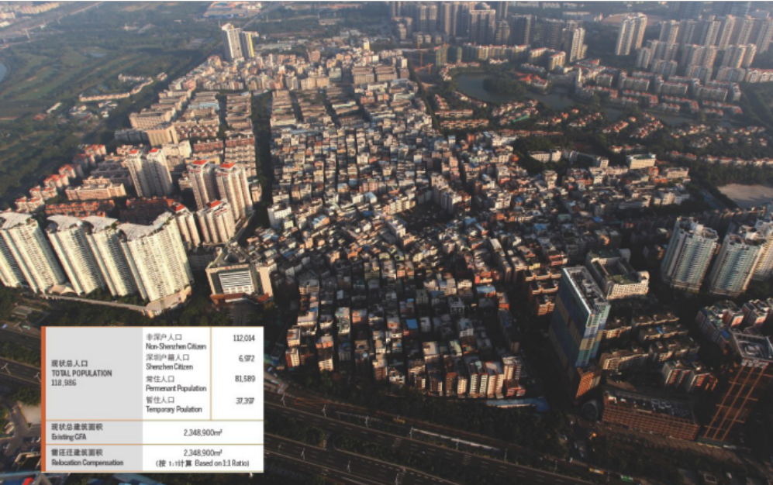

Slide 11
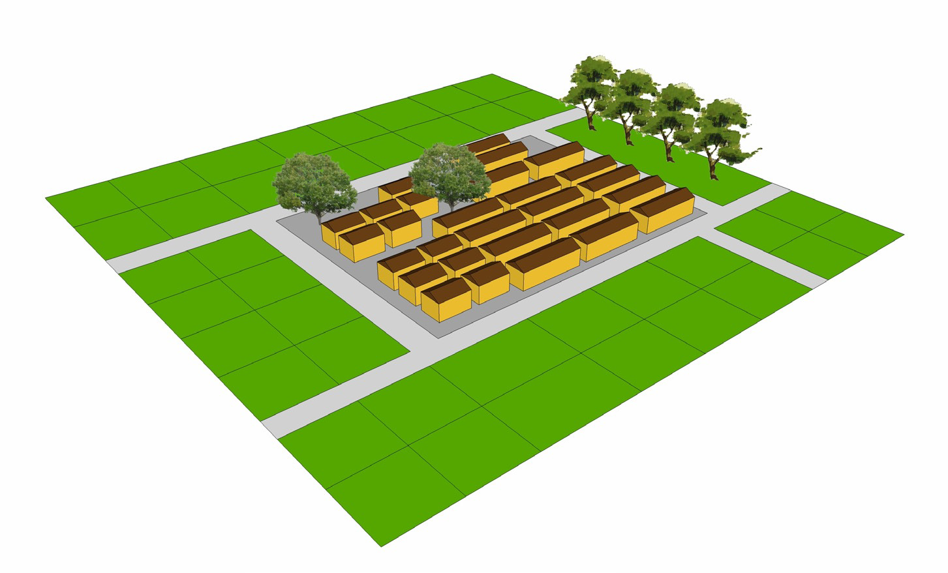
The formation process of urban villages in Shenzhen and the image of Hubei village.
Source: drawings from Zhang, F., 2013: P.24, P.25

Slide 12
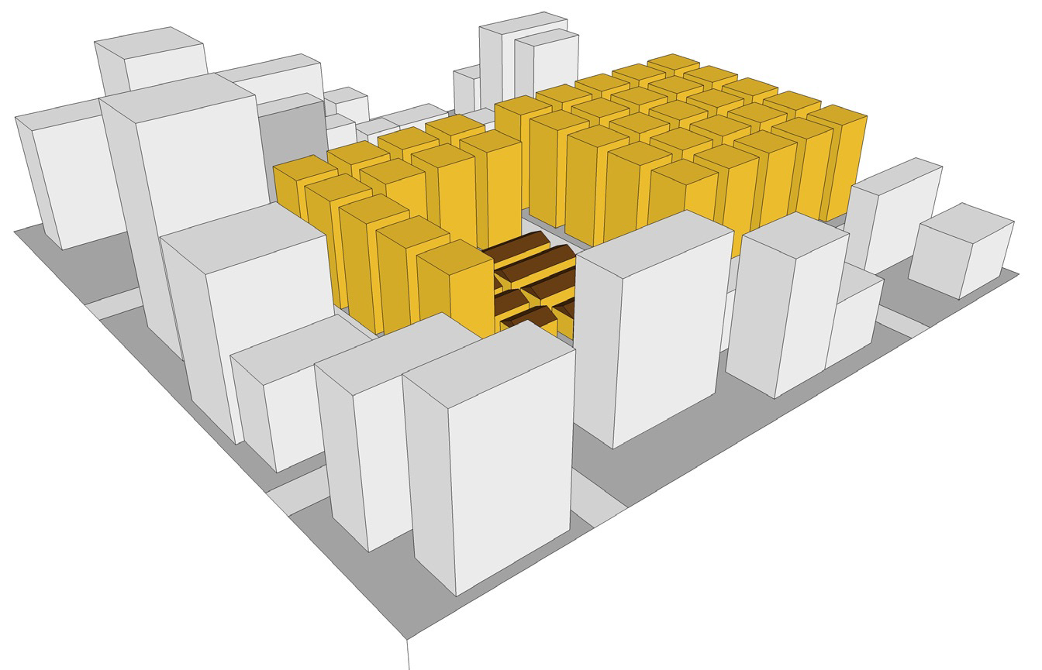
The formation process of urban villages in Shenzhen
Source: drawings from Zhang, F., 2013: P.24, P.25

Slide 13
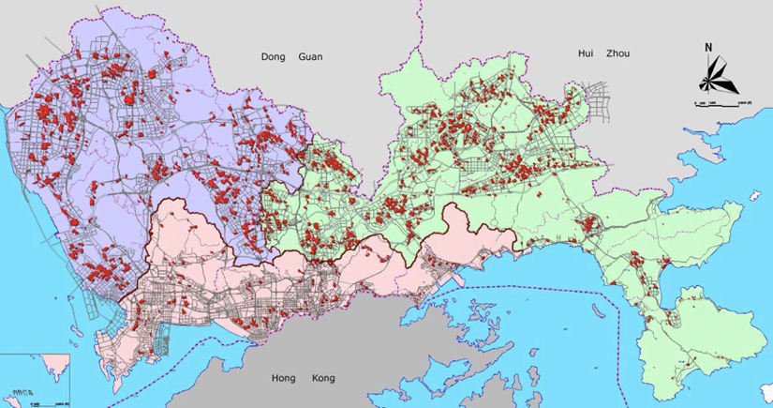
Locations of urban villages in Shenzhen, most of which are concentrated in peripheral districts (Source: Urban Planning & Design Institute of Shenzhen)

Slide 14
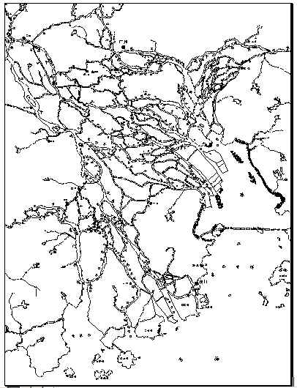
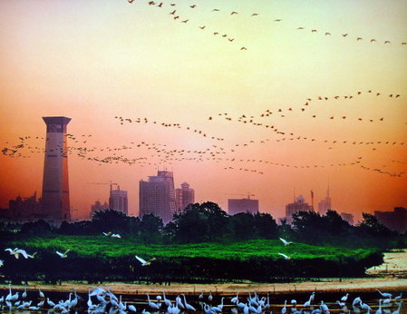
Rural industrialization and its impacts
on the natural environment
Water system
Mangroves

Slide 15
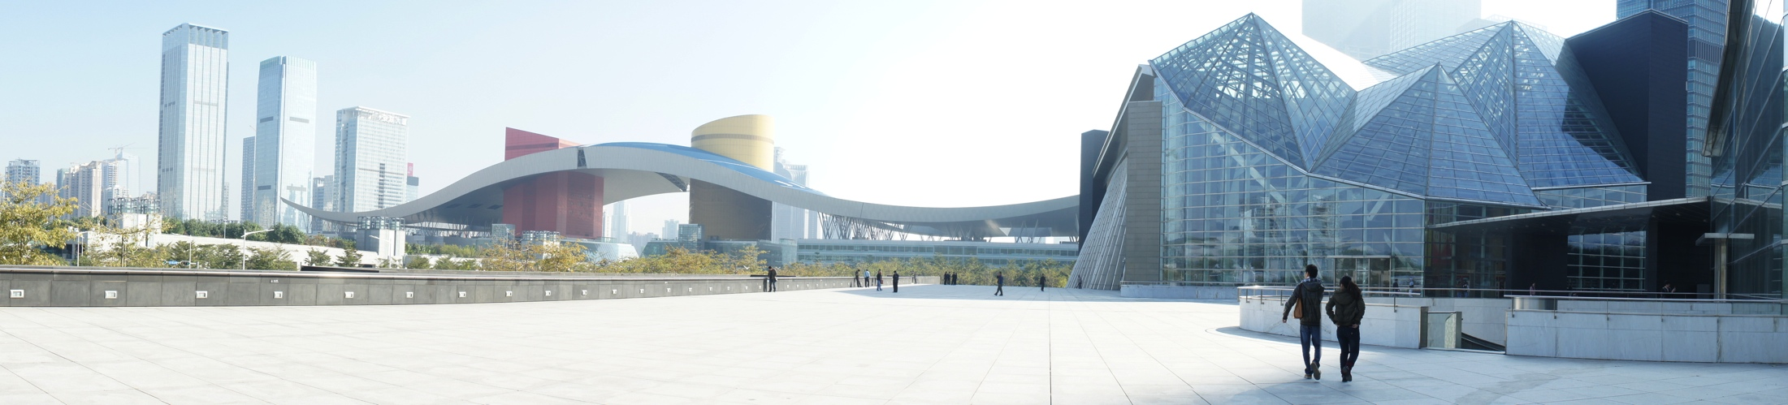
Shenzhen- from the “world factory” to an “international city”

Slide 16
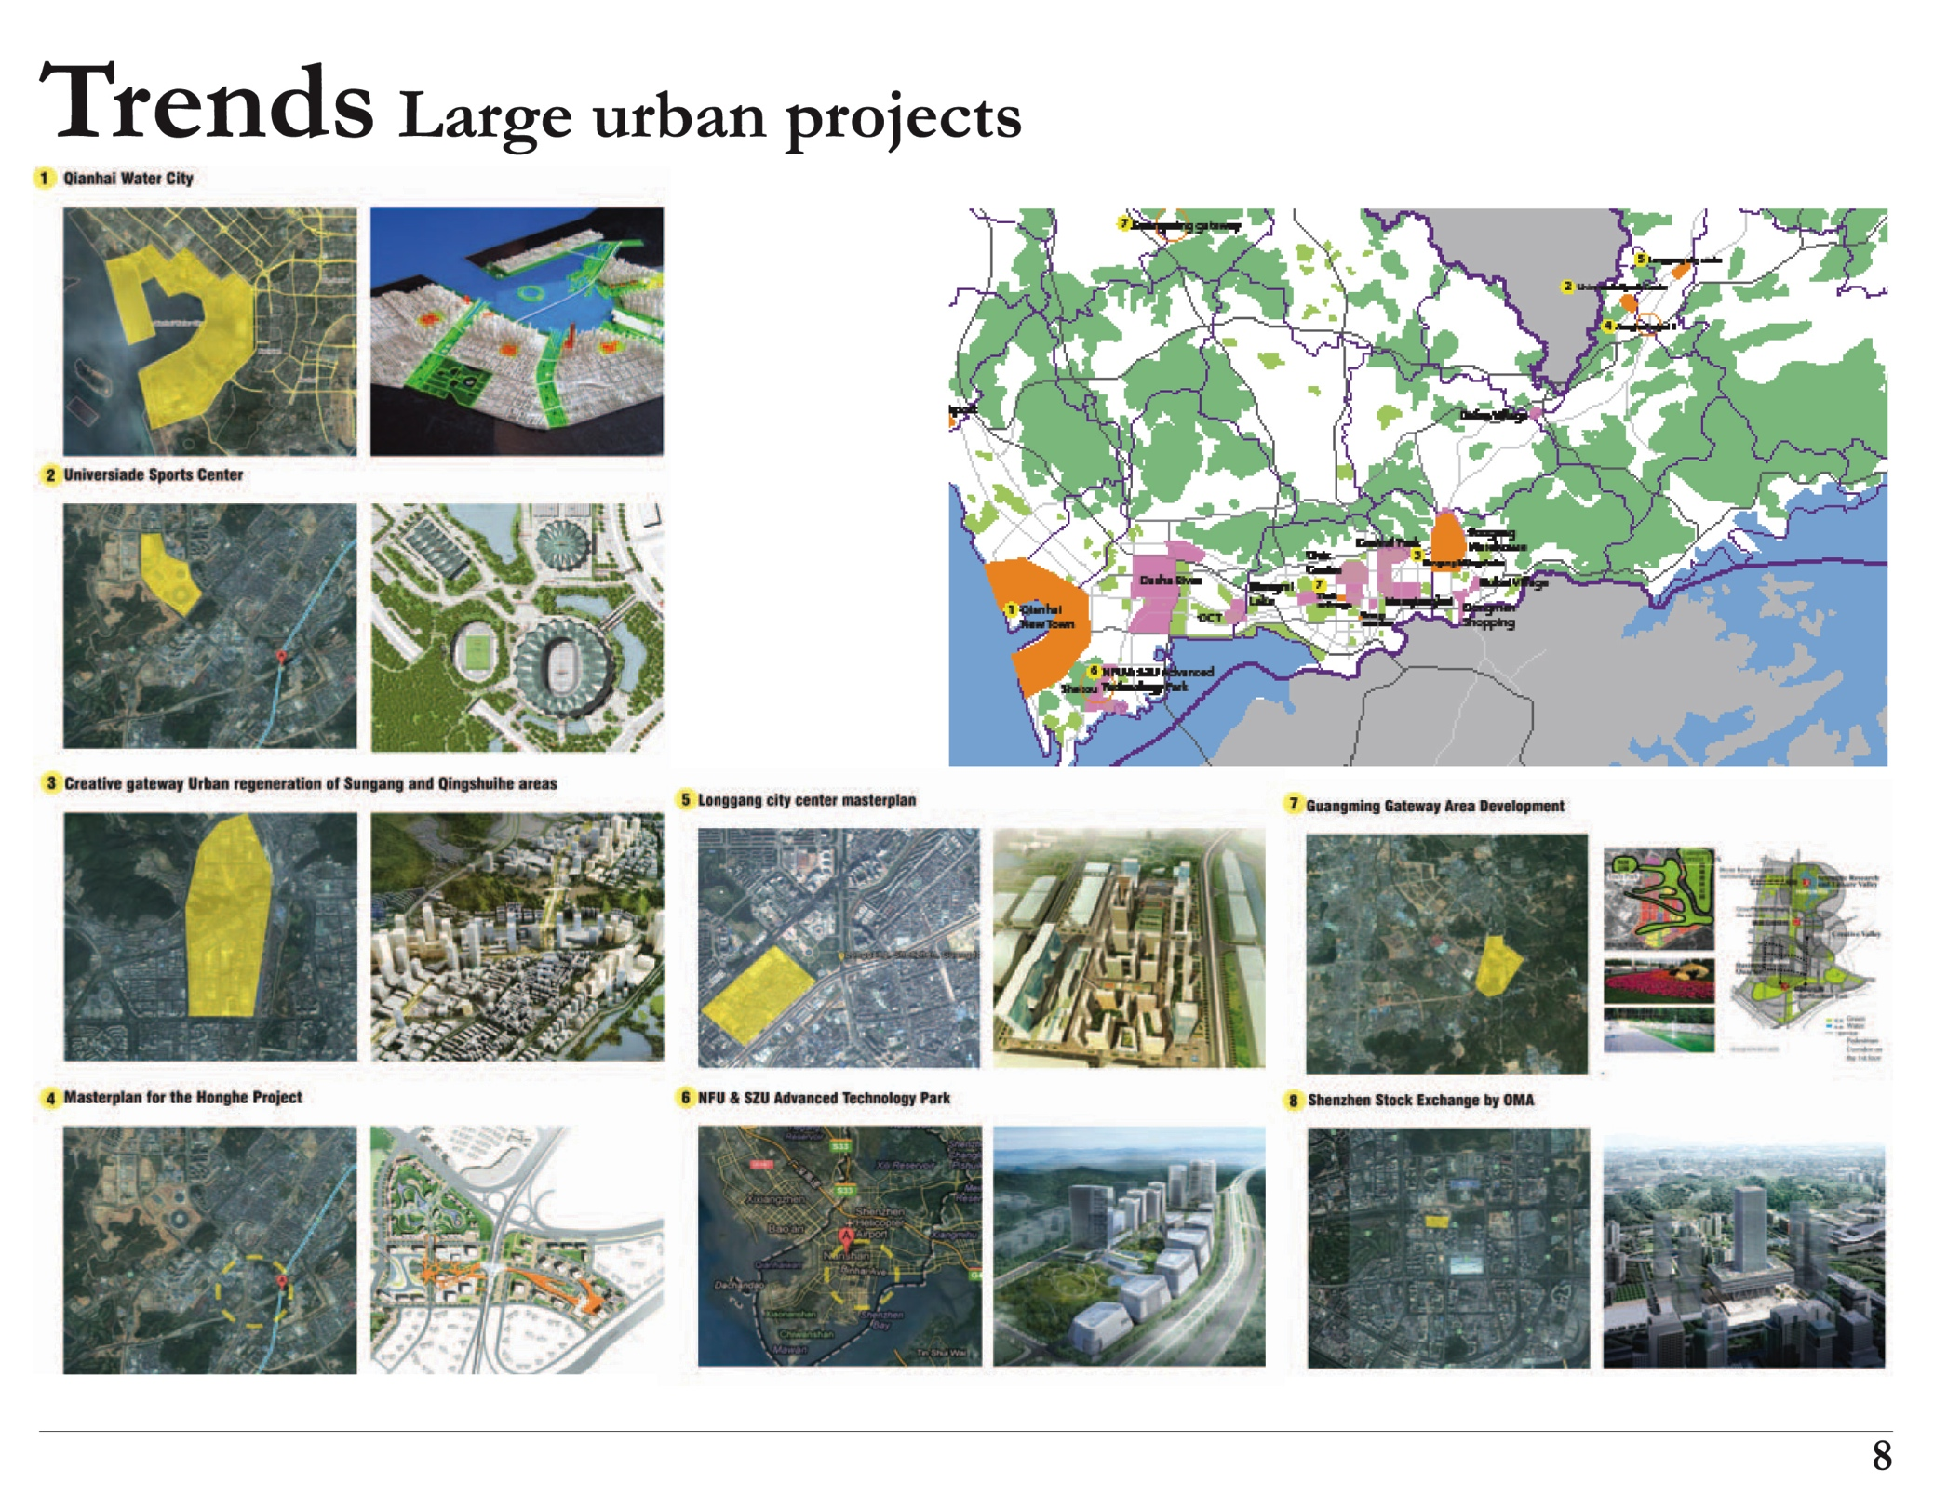
Source: Andrew Reynolds, master thesis TU Delft, 2013

Slide 17
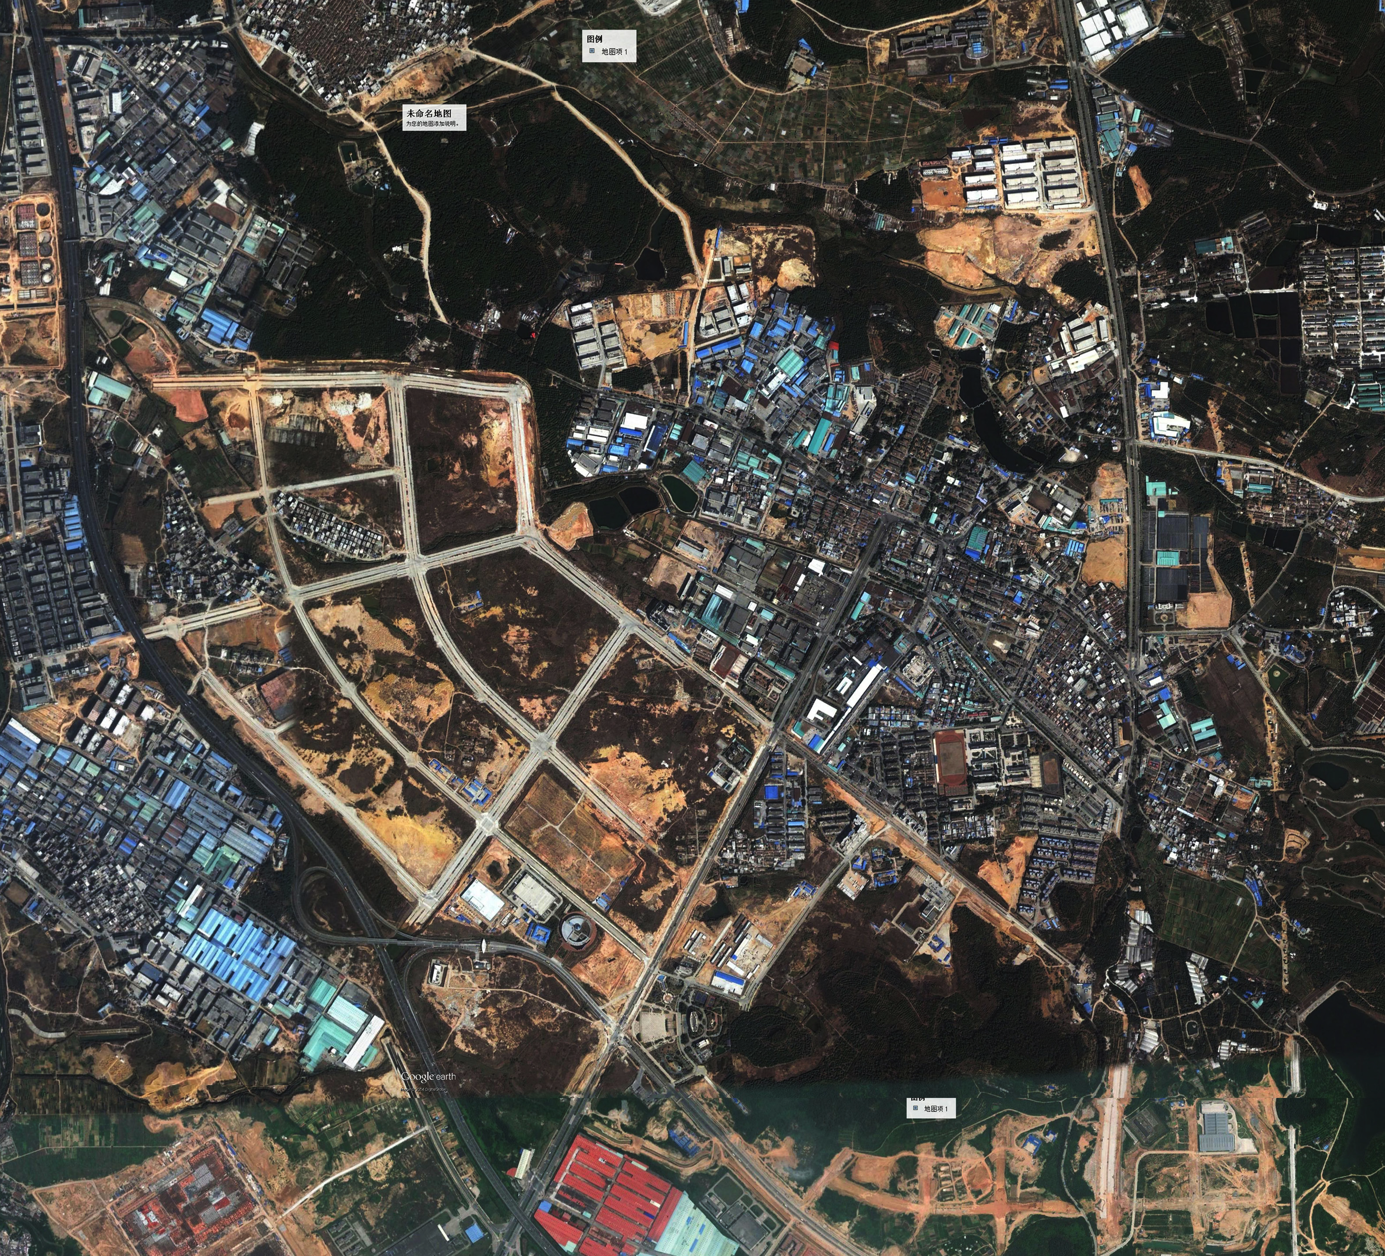

Slide 18
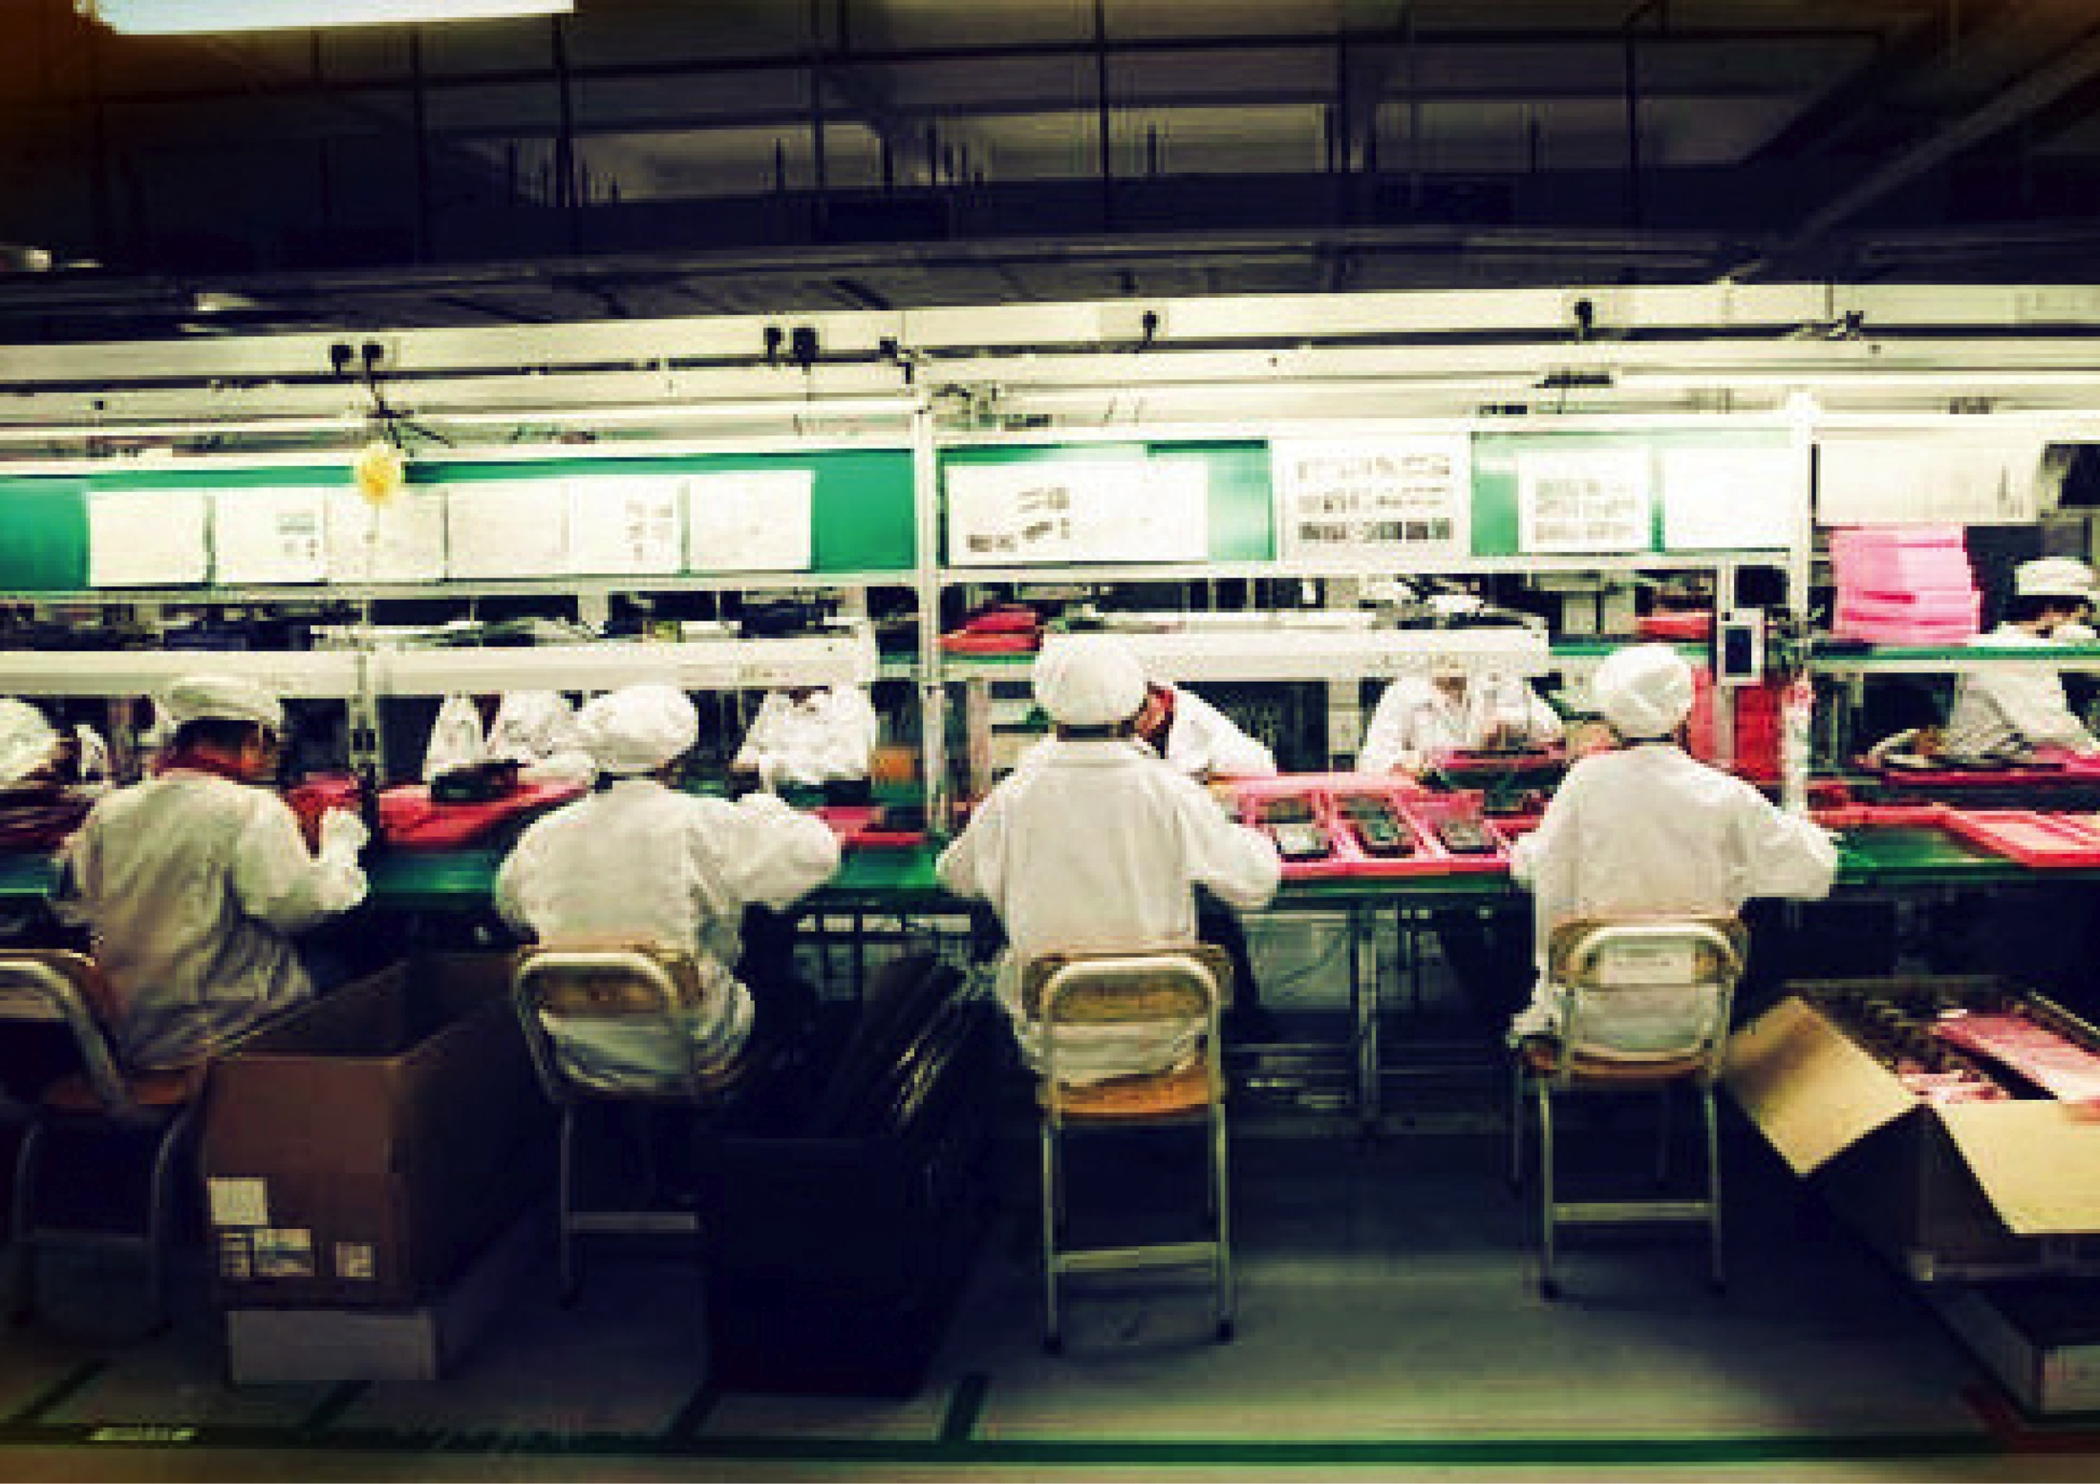

Slide 19
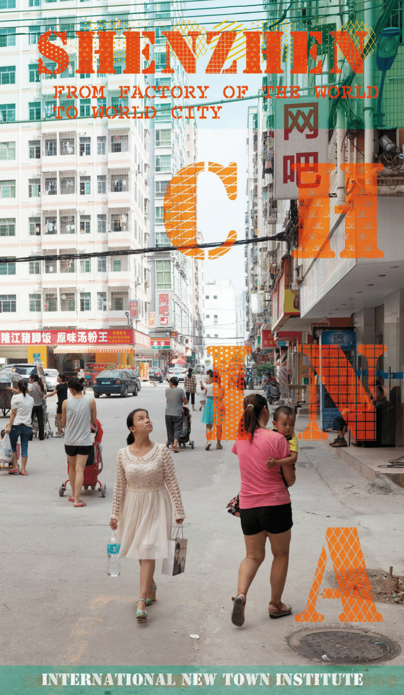

Slide 20
Scenario building
“What is being argued for here is a locally based, in-depth exploration of strategic issues of urban development under different sets of assumptions or ‘scenarios’ as a way to assess potential outcomes and their effect on local populations, the economy and the ecology of cities. It is a way of probing the future in order to make more intelligent and informed decisions in the present. The object of these studies would be not to produce ‘plans’ (not even strategic plans), but insights into prospective change to encourage and promote public debates about them” (John Friedmann 2004: 56)

Slide 21
Shenzhen Scenarios:
^{A} platform of research and education
to explore alternative ways of development, from the perspective of planning and design strategies.
In the past 4 years:
^{25 students enrolled:} 8Dutch, 1Australian, 1 Lithuanian, 1Indian, 14 Chinese
11 Mentors of Spatial Planning and ^{Strategy/ OTB:}
Stephen Read/ Diego Sepulveda/ Lei QU/ Verena Balz/ Fransisco Columbo/ Vincent Nadin/ Akkelies van Nes/ Marta Relats/ Marcin Dabrowski/ ^{Evert Meijers/ Leeke Reinders}
10 Mentors of Urban Design/ Environmental Technology and Design/ Landscape Architecture:
Machiel van Dorst/ Luisa Calabrese/ Maurice Harteveld/ Daan Zandbelt/ Henco Bekkering/ Arjan van Timmeren/Frank van der Hoeven/ Birgit Hausleitner/ Taneha K. Bacchin
INTI program director: Linda Vlassenrood

Slide 22
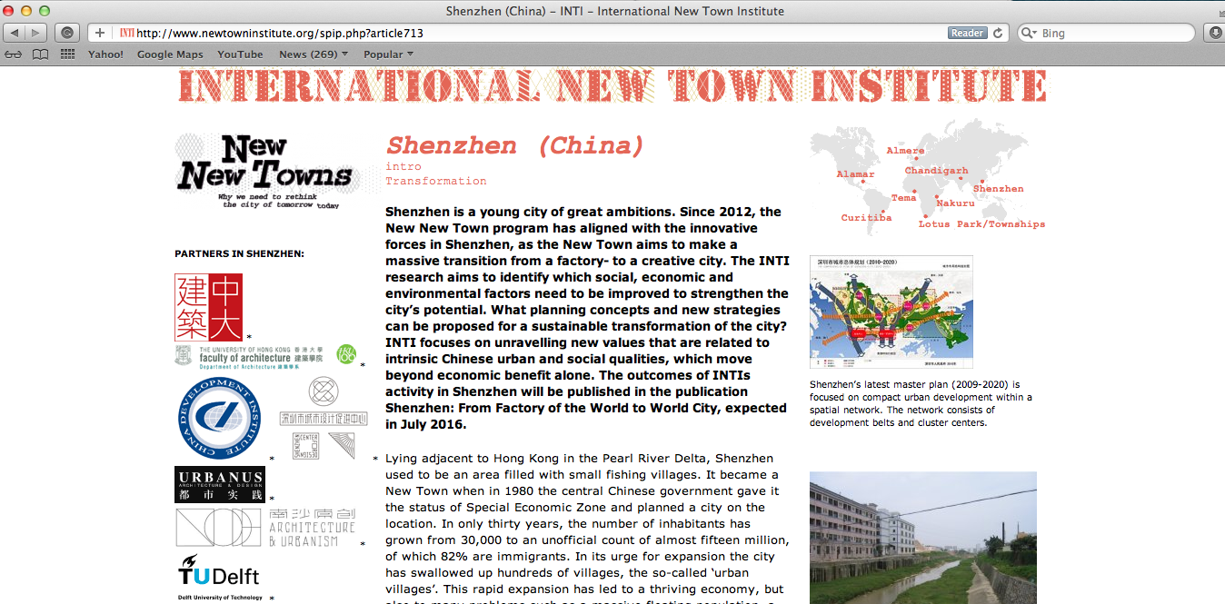

Slide 23
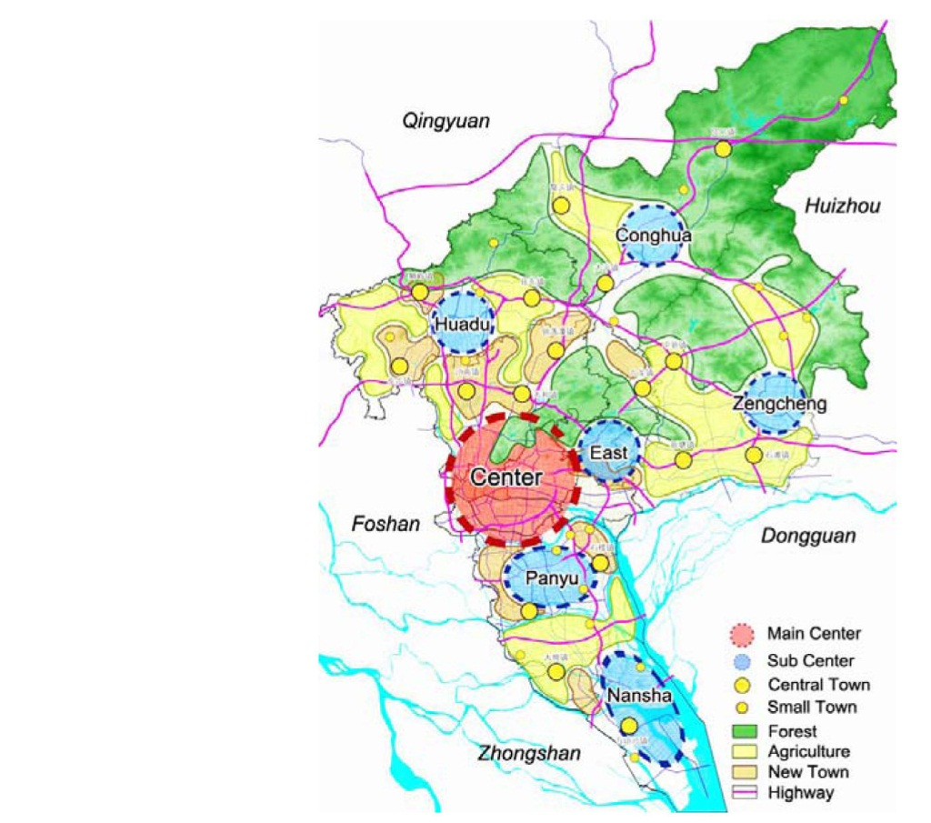
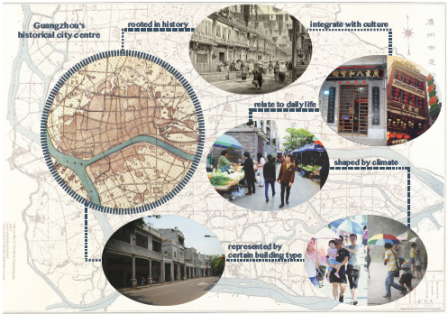
Guangzhou
The old city of Guangzhou
Source: Master thesis of Xuwei He, 2015
Spatial Structure Plan of Guangzhou (2020)
Source: Overall Development Strategy of Guangzhou 2020, Guangzhou Planning Bureau

Slide 24
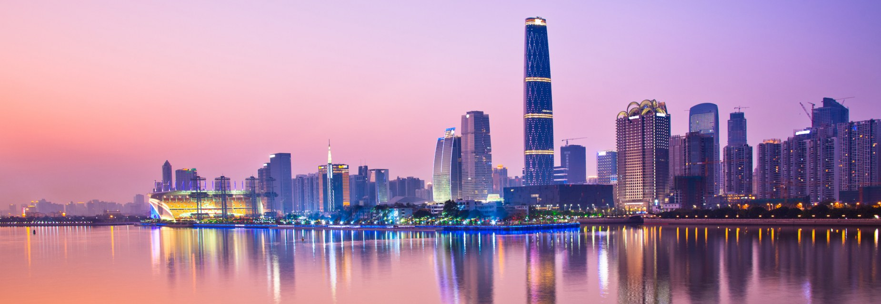
Photo © motivetravel.com.au

Slide 25
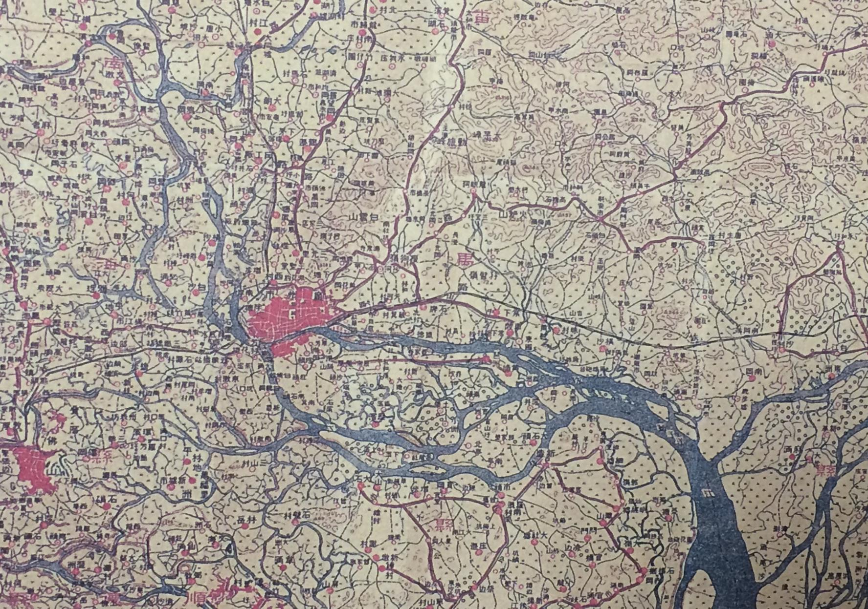
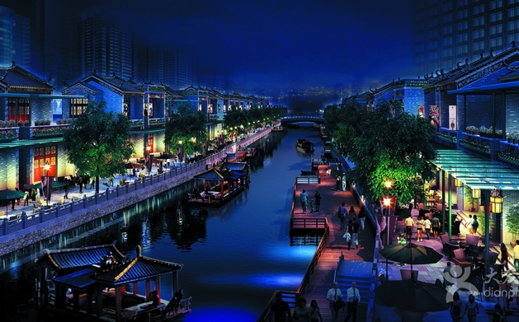
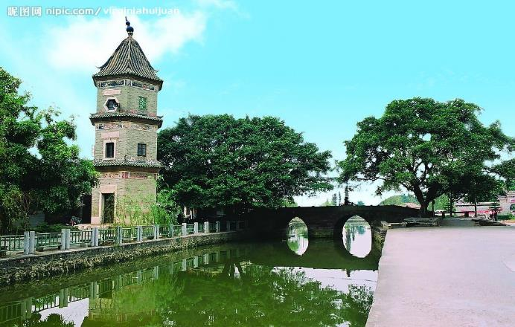
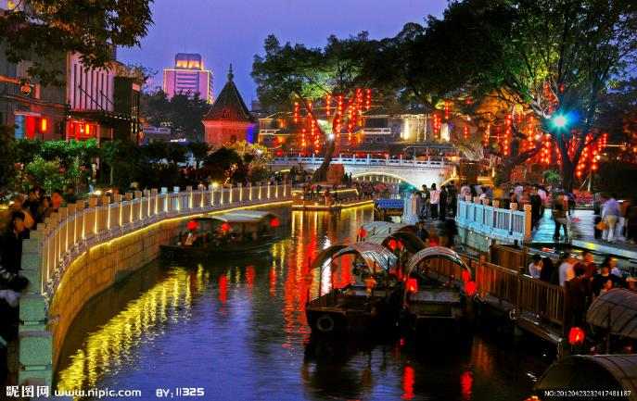
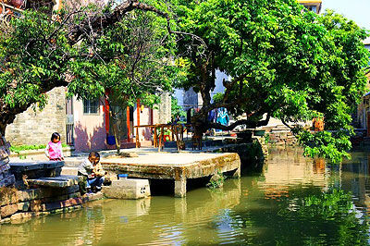
Study case: Lijiao village 沥滘村
猎德
泮塘
沥滘
小洲
大岭村

Slide 26
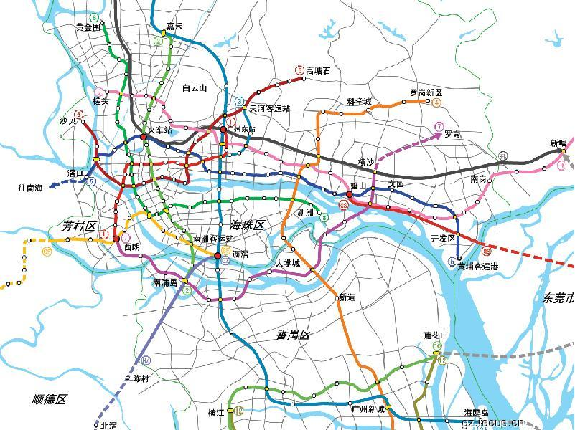

Slide 27
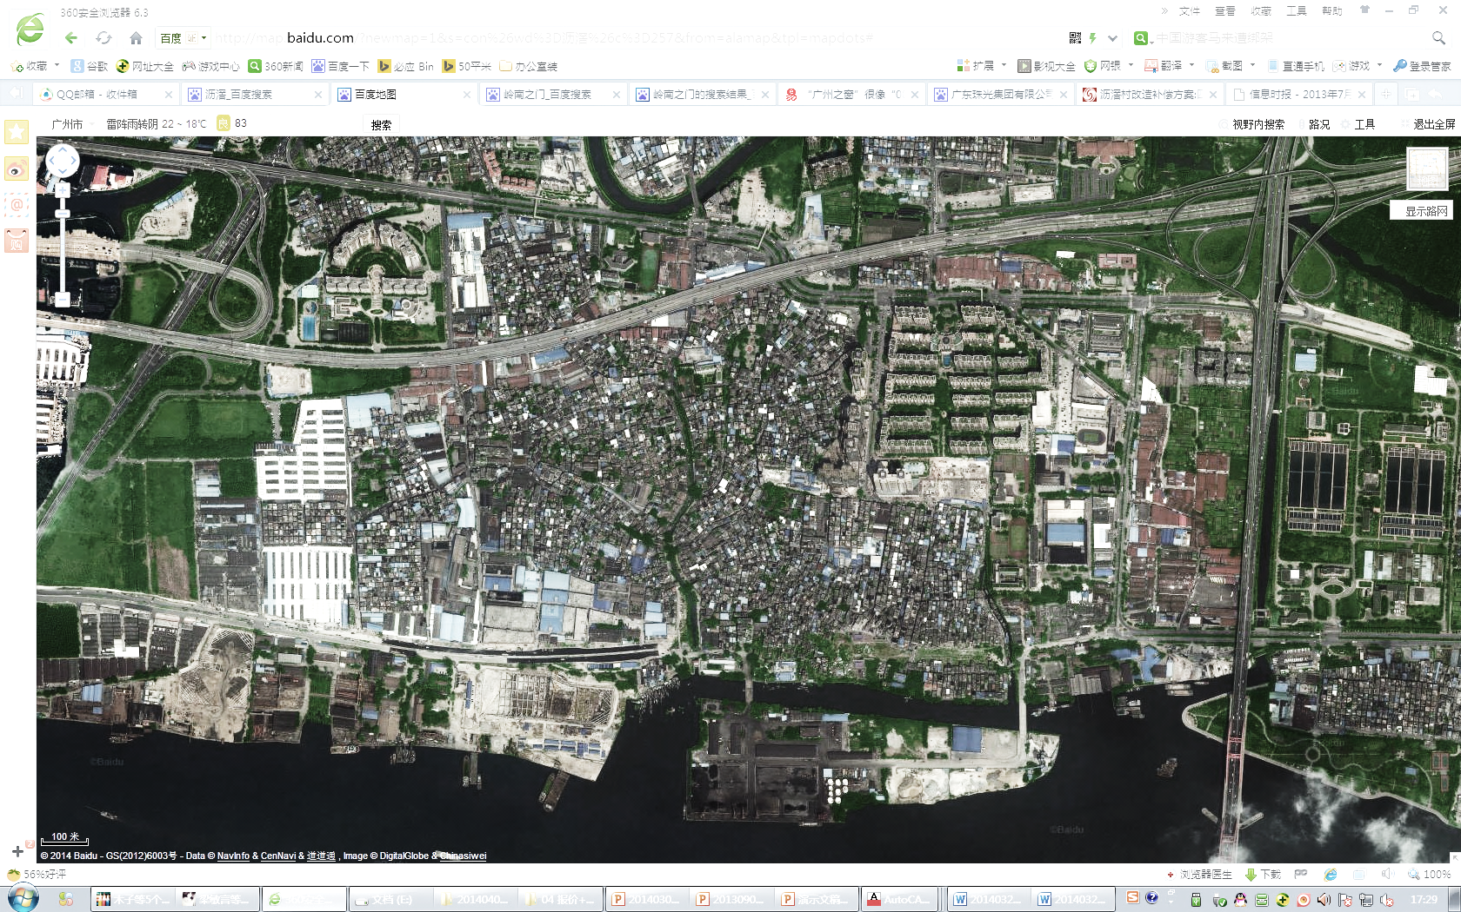
Total area: 173ha

Slide 28
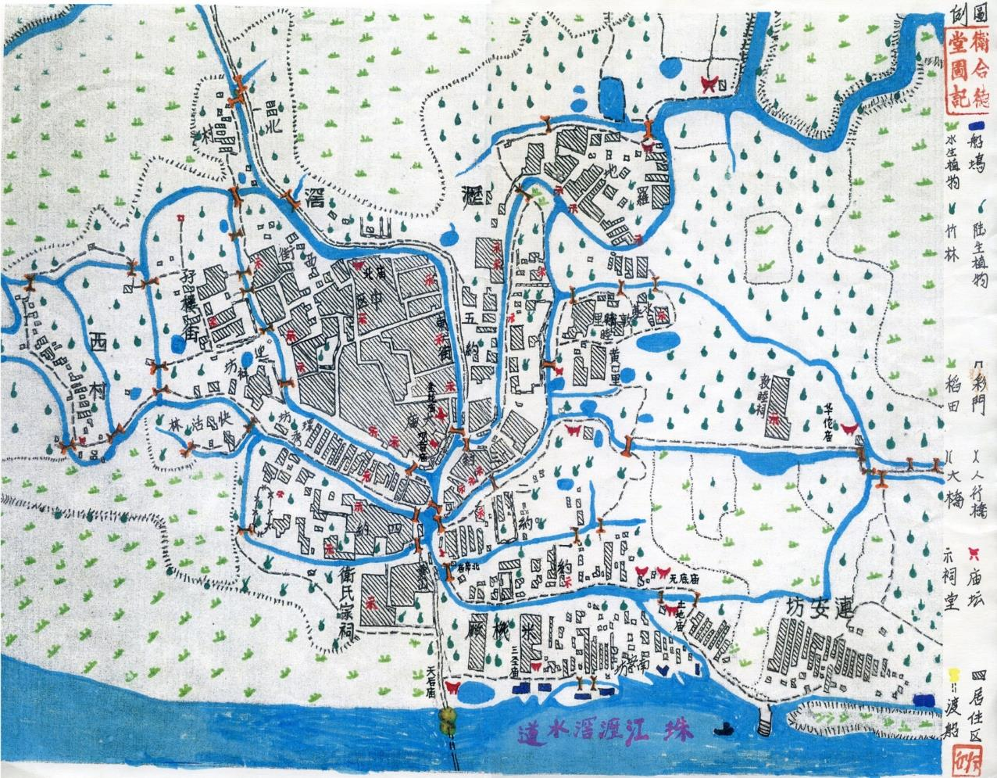

Slide 29
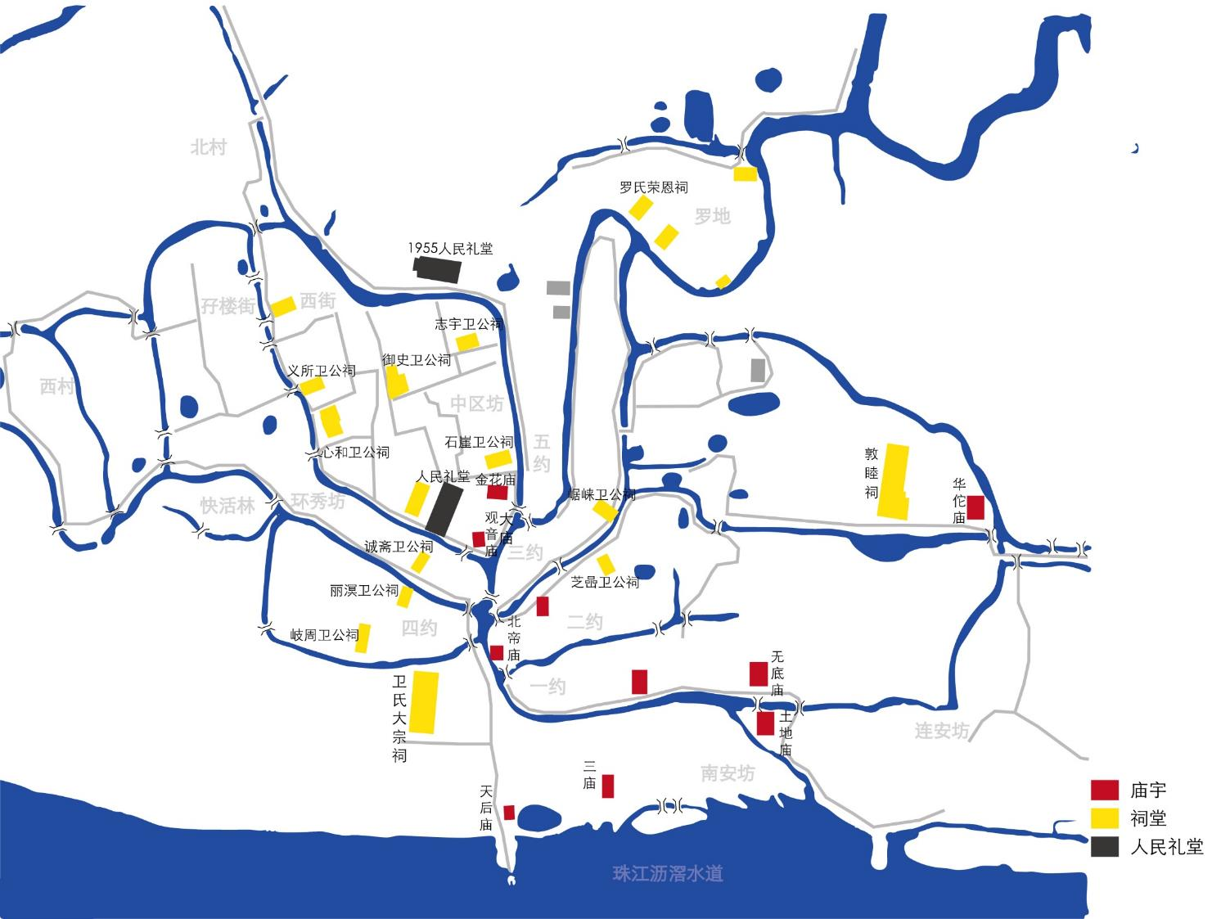
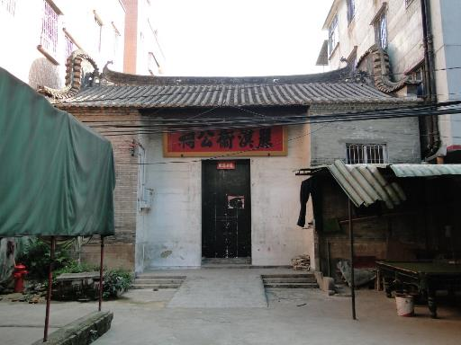
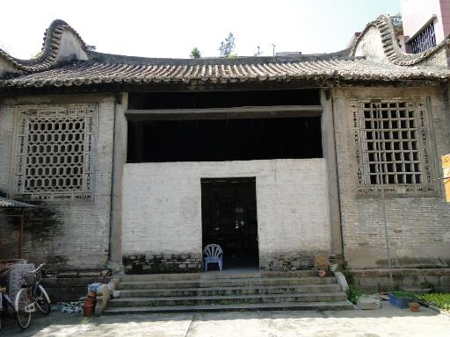
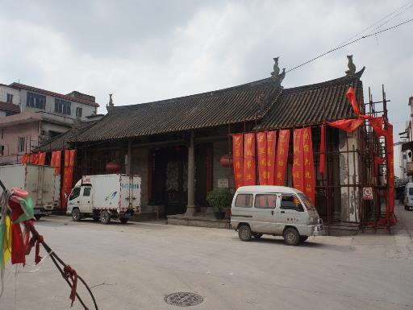
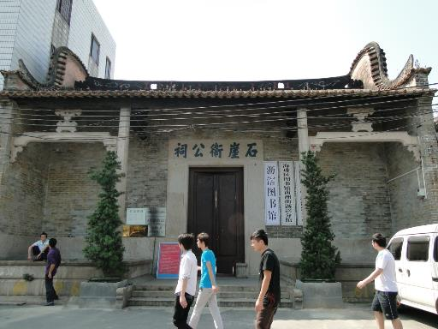
Cultural heritages
Ancestor halls and temples

Slide 30
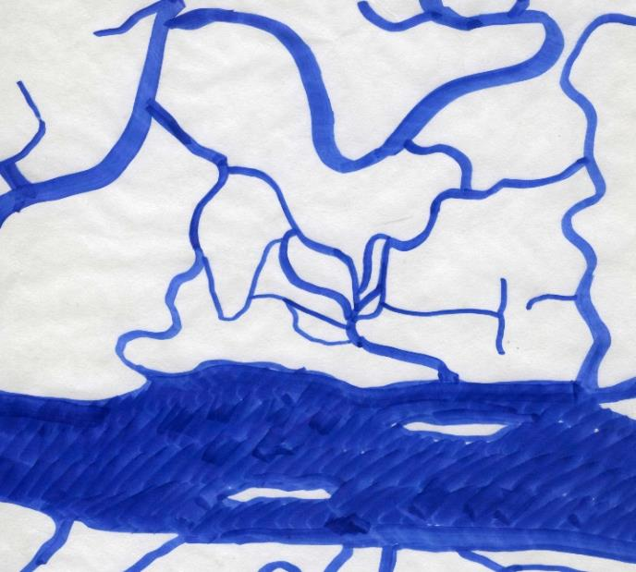
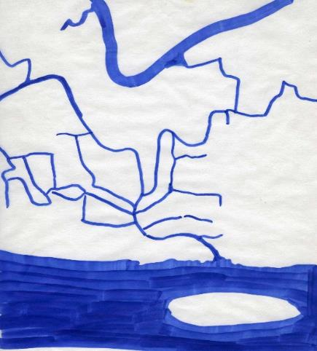
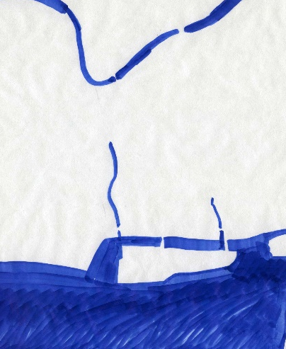
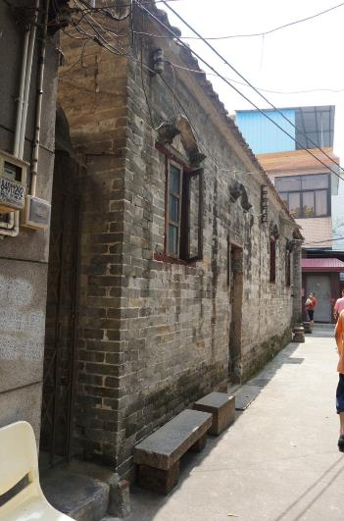


1929
1955
2014

Slide 31


Alternative development models towards a truly green-blue city with economic vitality and socio-cultural continuity?

Slide 32




Field study in November
Meeting People
migrants, planners, designers, and scholars
Walking in the city
urban villages, historical areas and waterfront areas
(The ‘Shenzhen Scenarios’ group of 2014)

